Slide 1
Events: Strategy and Operations
Jim Johnson, IOM, CCE

Slide 2
Events: Strategy and Operations
Course Description:
Events and programs typically bring together a wide range of stakeholders for a specific purpose. Examine events that exceed the needs and expectations of all involved.

Slide 3
What do you label an event?
This Photo by Unknown Author is licensed under CC BY-NC-ND
This Photo by Unknown Author is licensed under CC BY
US Chamber
Accreditation
Program
Event-based activities such as workshops, seminars, annual meetings, etc.

Slide 4
New School
Old School
Contact Tracing
Hybrid Event
Contact Tracing
Hybrid Event
Sustainable

Slide 5
Impact
Why do we do events?
Our mission
Profitability
Our bottom line
Experience
Others ask us

Slide 6
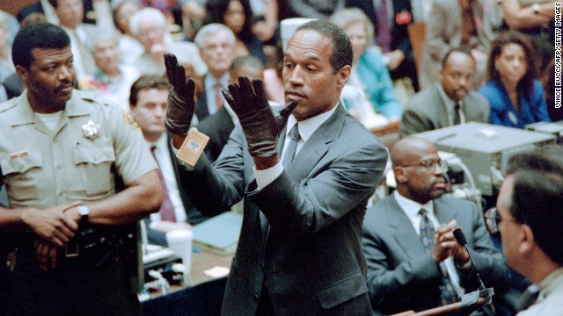
What is your natural fit?
This Photo by Unknown Author is licensed under CC BY-NC-ND

Slide 7
What is your natural fit?
What is the one main source of revenue?
Heartfelt Connector
Beneficiary Builder
Member Motivator
Big Bettor
Public Provider
Policy Innovator
Beneficiary Broker
Resource Recycler
Market Maker
Local Nationalizer

Slide 8
Who decides the event is a success?
Staff
Attendees
Board
Committee

Slide 9
Five Basic Steps of an Event
Research
Planning
Promotion
Coordinate
Evaluate

Slide 10
The Matrix Map
Impact
Profitability

Slide 11
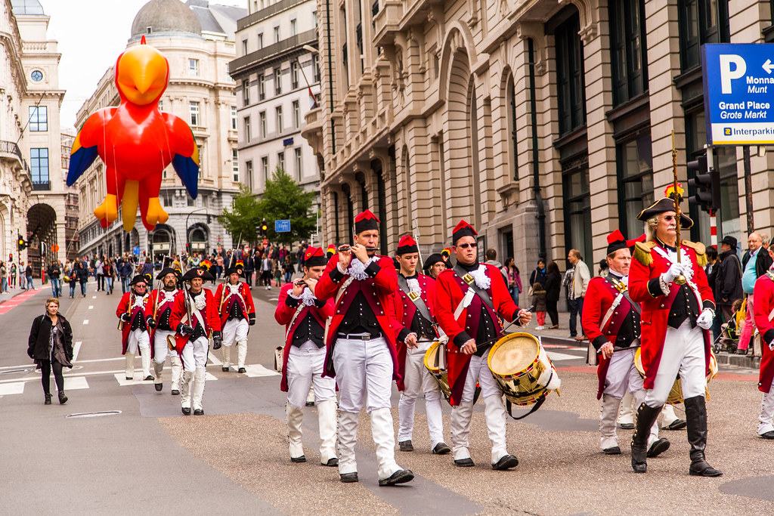
How do we decide if it works or time to go?
This Photo by Unknown Author is licensed under CC BY-SA
This Photo by Unknown Author is licensed under CC BY-SA-NC

Slide 12
Evaluating an Event
Impact Analysis
IMPACT
Delivery
Evaluation
GAP
Mission

Slide 13
Evaluation
This Photo by Unknown Author is licensed under CC BY-SA
Focuses on 10 and 9
How likely are you to refer the event to a friend, business or colleague?

Slide 14
Feedback
Average
Vs
NPS
Average
NPS
 | Average
10 | 60
9 | 16
8 | 11
7 | 5
6 | 4
5 | 2
4 | 1
3 | 0
2 | 1
1 | 0
SCORE | 90.70%
Score | NPS
10 | 60
9 | 16
8 | 11
7 | 5
6 | 4
5 | 2
4 | 1
3 | 0
2 | 1
1 | 0
TOTAL | 100
Promoter | 76%
Passive | 16%
Detractors | 8%
Net Promoter Score | 68%

Slide 15
Mission
Delivery
Evaluation (Survey)
GAP
Impact Analysis
1
2
3
4
5

Slide 16
Money!
Total Income
Vs
Net Profit

Slide 17
Net-Income
The amount you make after expenses and staff cost.

Slide 18
Creating a Budget
Income vs Expense
Timing of Income / Expenses

Slide 19
Creating a Budget
Venue
Food
Speaker
AV
Internet
Transportation
Marketing
Software
Staffing

Slide 20
The Matrix Map
Impact
2.5
$0.00
Profitability

Slide 21
PEAK MOMENTS!
This Photo by Unknown Author is licensed under CC BY

Slide 22
Making Moments
Elevation
Insight
Pride
Connection

Slide 23
Media Coverage at Events
Make the ASK!
[end of press release details]
#
Media participation is encouraged. If you are a member of the media and interested in attending, please contact NAME in advance to secure a spot.
#
Chamber boiler plate goes here

Slide 24
Media Coverage at Events
Make the ASK!
Make the PITCH!
Dear NAME,
We are excited about the EVENT NAME on DATE hosted by the XYZ Chamber and would love to have you attend.
State why they should care... talk about #'s of people, compelling reasons including notable speakers, etc.
INSERT PRESS RELEASE

Slide 25
Media Coverage at Events
Make the ASK!
Make the PITCH!
Audience
Who is the audience of the media partner?
Just because it is important to us - is it important to them?

Slide 26
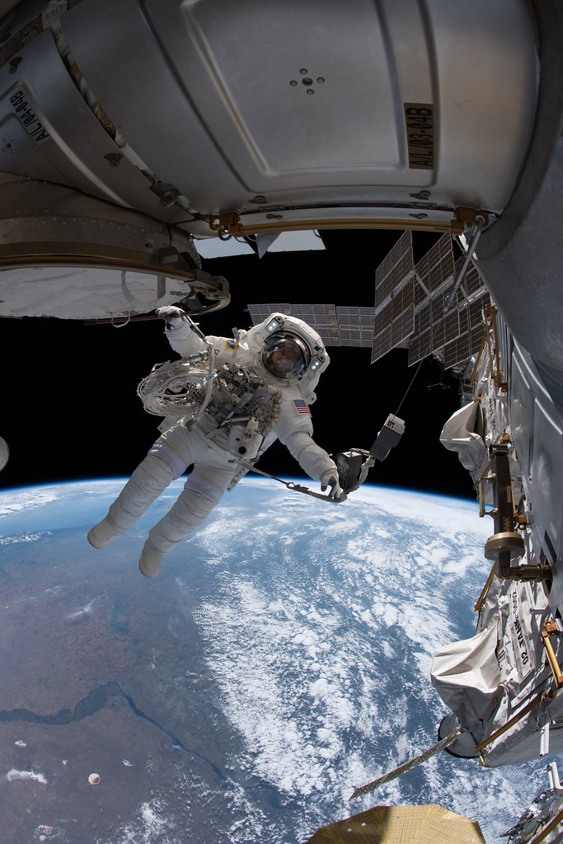
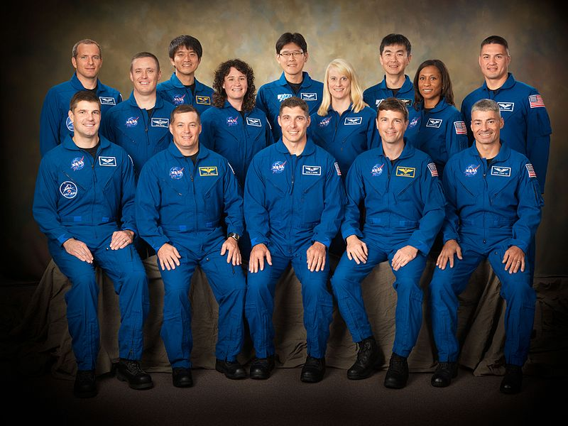
Media Coverage at Events
Make the ASK!
Make the PITCH!
Audience
Wrap Up
This Photo by Unknown Author is licensed under CC BY
This Photo by Unknown Author is licensed under CC BY-NC-ND

Slide 27
Media Coverage at Events
Make the ASK!
Make the PITCH!
Audience
Wrap Up
Share Regularly

Slide 28
Hybrid Events
Host
Announcer
Production
Attendees
Rehearse

Slide 29
CONTRACTS!!!!

Slide 30
CONTRACT TERMS
Attrition
Room Rental
Service Charge
Food and Beverage Minimum
Contract Signer
Direct Bill / Credit Card
Force Majeure

Slide 31
CONTRACT NEGOTIATIONS
Room Rental
WiFi vs Wired
Free Sale for Venue
Average Daily Rate vs Space
Comp Ratio (1 per 40)

Slide 32
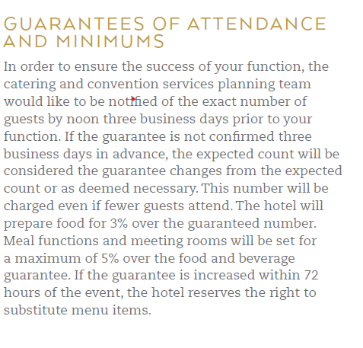
Banquet Event Orders (BEO)
Expected vs Set vs Guarantee
Audio Visual
Per Person vs Consumption
Meeting Standards
Service Charge + Sales Tax

Slide 33
Event Technology
Digital Swag Bags
Live Streaming
Cashless Payments
Real-Time Event Management
Artificial Technology

Slide 34
Event Technology
Facial Recognition
Live Translation
Virtual Reality
Data Collection
Gamifaction

Slide 35
Four Elements of Emergency Management
Mitigation – Identifying problems ahead of time
Preparedness – Anticipating the emergency
Response – Actions during the emergency
Recovery – Short and long-term to return to normal

Slide 36
Elements of an Emergency Plan
Cancellation of Events
Event Insurance
Weather Insurance
Weather
Bomb Threats
Hazardous Material

Slide 37
Elements of an Emergency Plan
Evacuation Plans
Traffic
Medical Emergencies
Disturbances
Power / AV
Speaker No-Show
Distribution List
Incident Report

Slide 38
Jim Johnson, IOM, CCE
832-385-4260
Jim.Johnson@pearlandchamber.org
Twitter:
@ItsJimJohnson
LinkedIn:
www.linkedin.com/in/itsjimjohnson
Your success is important to me…

Slide 39
Sources
https://blog.markgrowth.com/5-steps-to-putting-on-a-successful-event-aab87538072f
https://heathbrothers.com/resources/
https://www.youtube.com/watch?v=syA8FyI6G-4
https://twitter.com/marriottintl/status/1224382371815923716
https://www.bridgespan.org/insights/library/funding-strategy/ten-nonprofit-funding-models
https://socialimpactarchitects.com/nonprofit-funding-priorities/
https://nonprofitquarterly.org/the-matrix-map-a-powerful-tool-for-mission-focused-nonprofits/
https://socio.events/blog/35-event-industry-terms-you-need-to-know-2022

