Slide 1

Building Organizational
Excellence
E - 140
Bob Harris, CAE
www.nonprofitcenter.com

Slide 2

How do we know if we are the best?

Slide 3
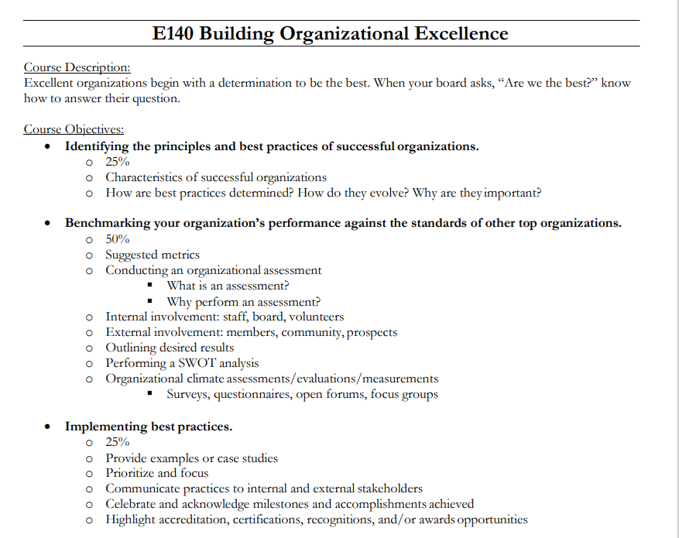
Decide to be the Best
Principles of Successful Organizations.
Benchmarking, SWOT, Evaluations
  Accreditation, Certifications, Awards
Best Practices
  Examples, Milestones.

Slide 4

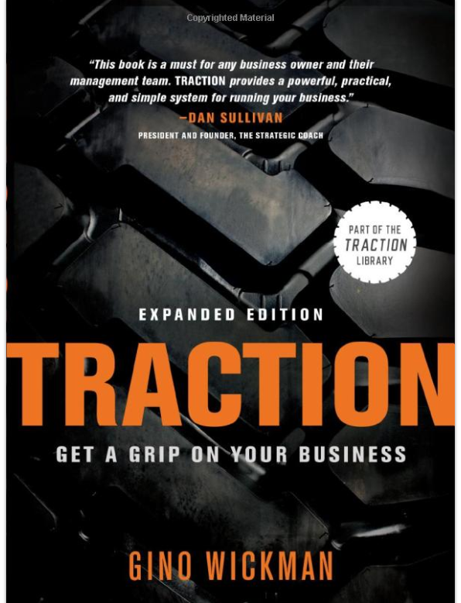
Operational Models

Slide 5
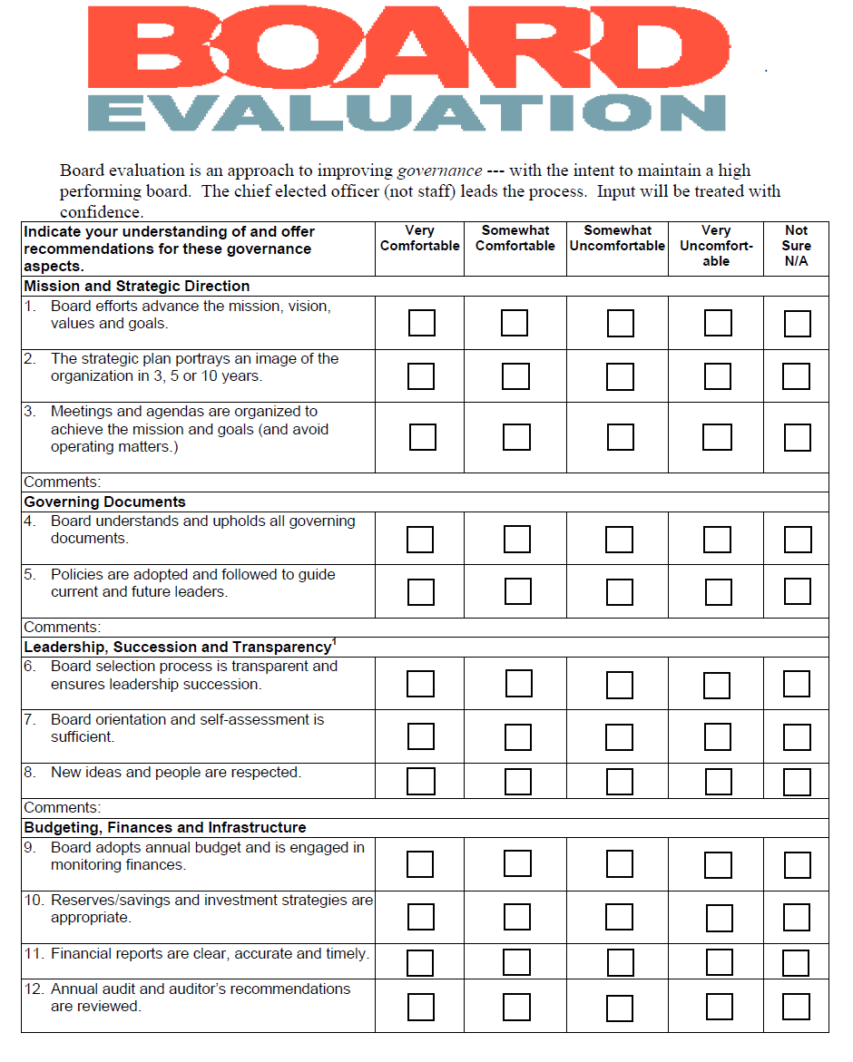
EVALUATE
Budget Performance
Strategic Plan Progress
CEO Performance
Governance and Board

Slide 6
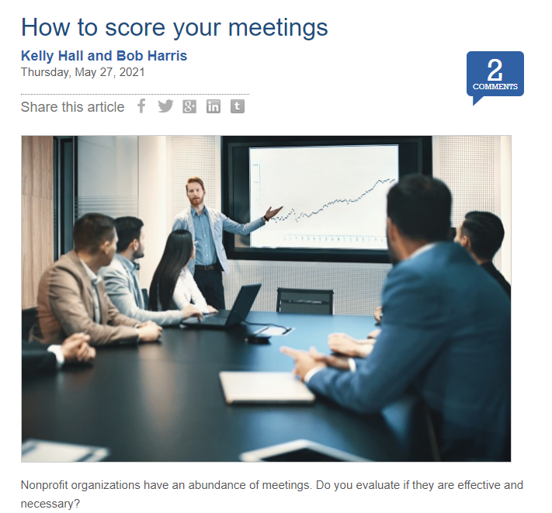
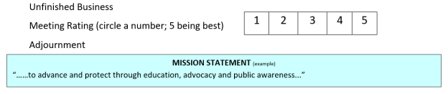
Score Board/Committee Meetings

Slide 7
Structure,
Strategy and Subsidiaries

Slide 8
Assoc
501c6
PAC
For Profit
Foundation
Research, Workforce, Diversity, etc.
501c3

Slide 9
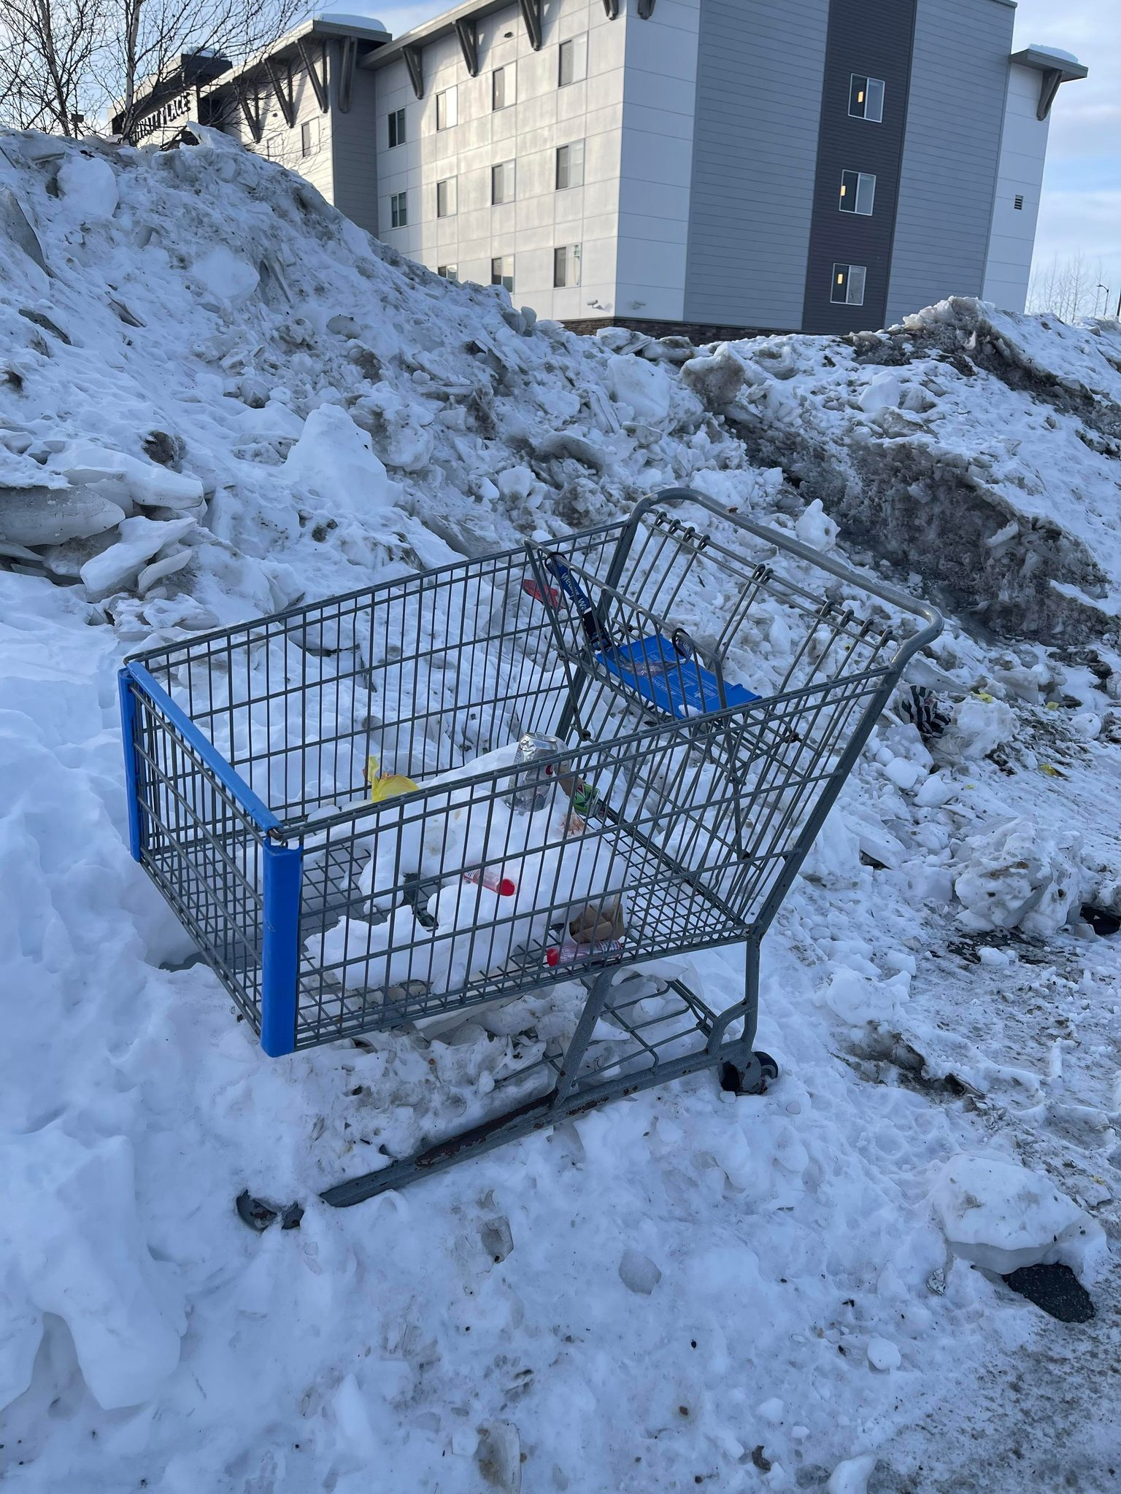



Slide 10
Income Diversity

Slide 11
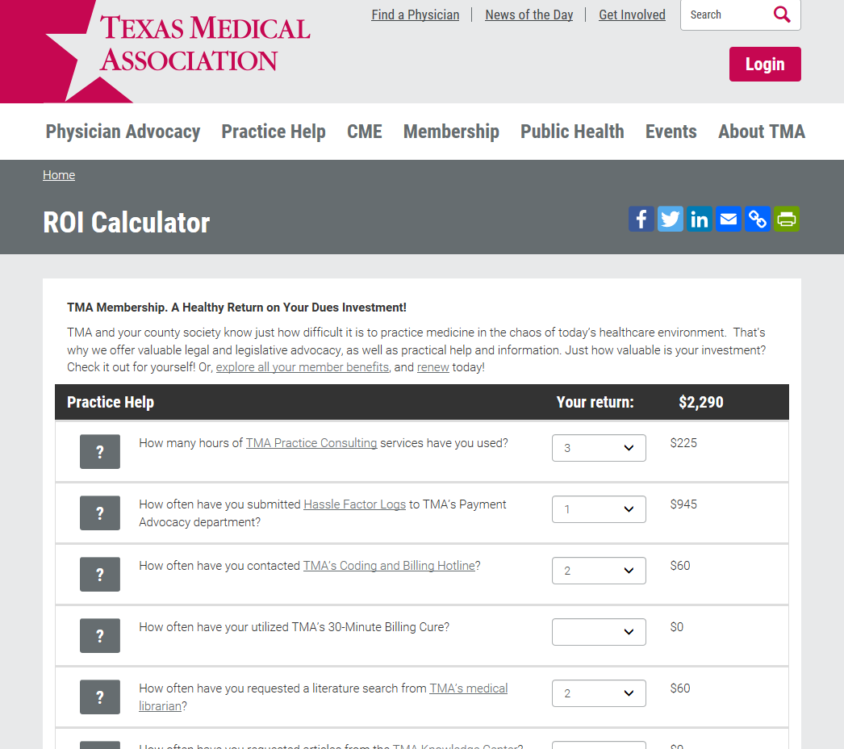
Dues Value

Slide 12
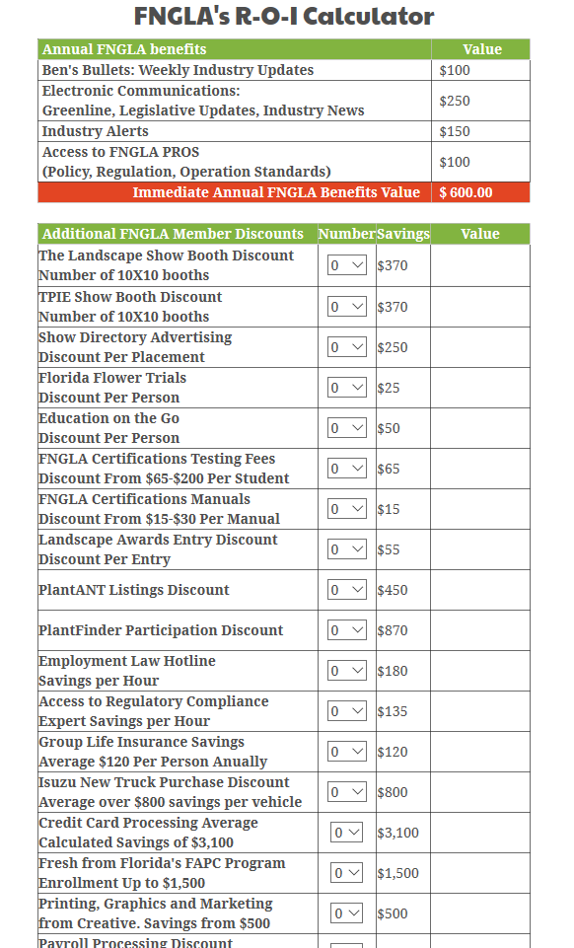
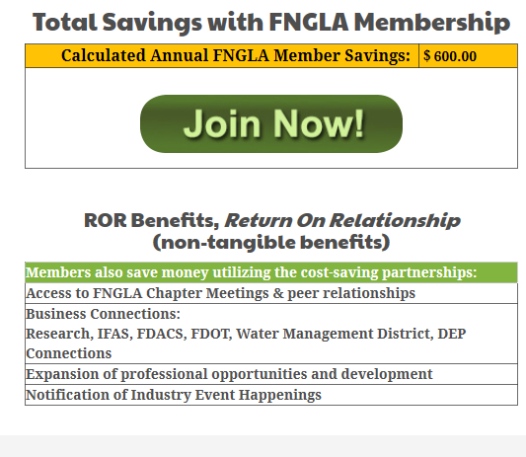
Dues Value Calculator
fngla.org/membership/roi
ROI Value Calculator
ROI – return on (dues) investment
ROR – return on relationships

Slide 13
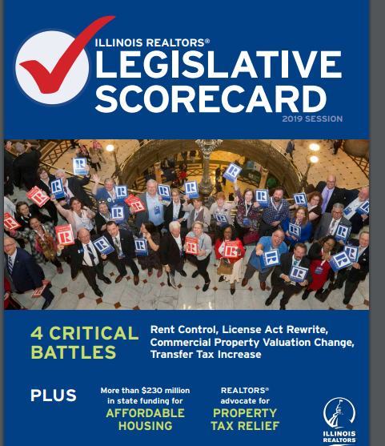
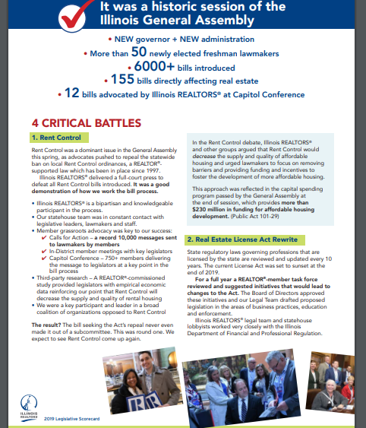
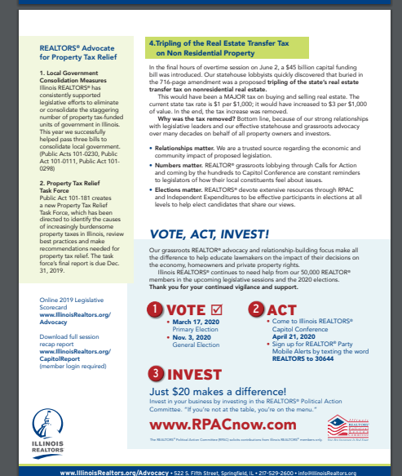
Public Affairs as Value Proposition

Slide 14
Personal Best

Slide 15

CAE by ASAE
Organizational Management
Leadership
Administration
Knowledge Mgmt. & Research
Governance-Structure
Public Policy, Gov’t Relations
Membership
Programs, Products and Services
Marketing, PR and Communications
ethics

Slide 16
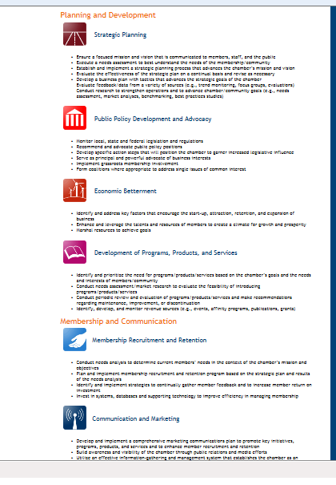
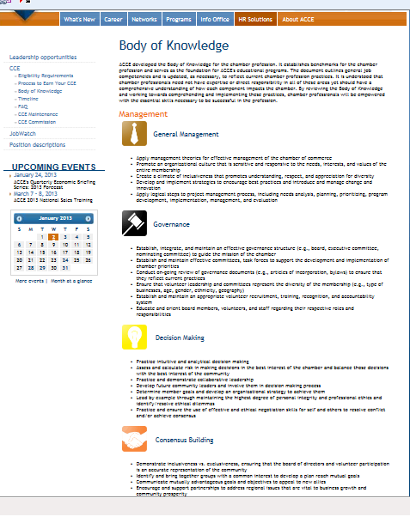
CCE by ACCE

Slide 17
PROCESS: Application and Assessment
Identify Gaps, Weaknesses, Omissions
Staff/Board Team Effort
Identify and Document Best Practices
Corrective Measures
Learning Process is Revealing

Slide 18
Organizational Best

Slide 19

Accreditation by US Chamber
Pg 6
Governance
Finances
HR and Staff
Government Affairs
Program Development
Communications
Technology
Facilities

Slide 20
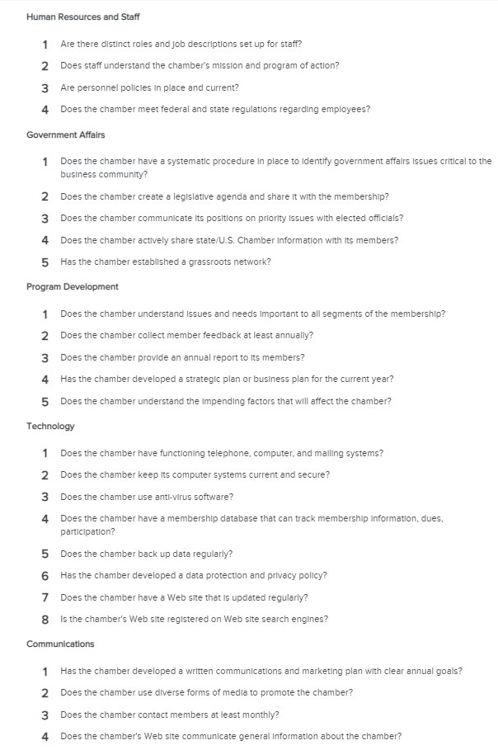
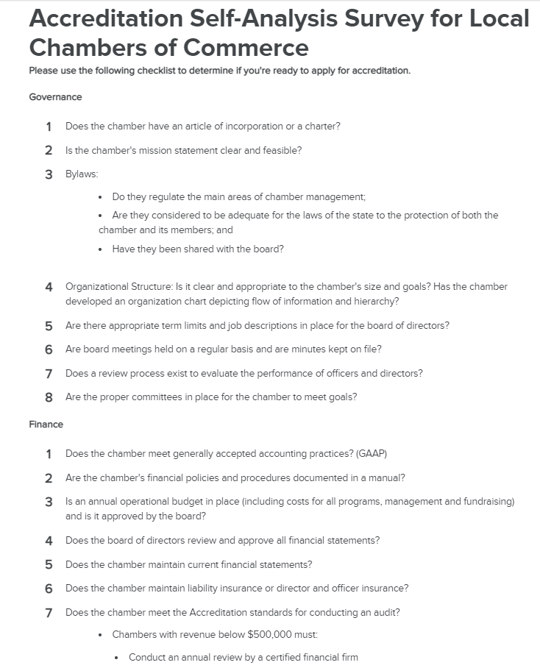
US Chamber Accreditation Self Evaluation

Slide 21
Awards and Recognitions

Slide 22
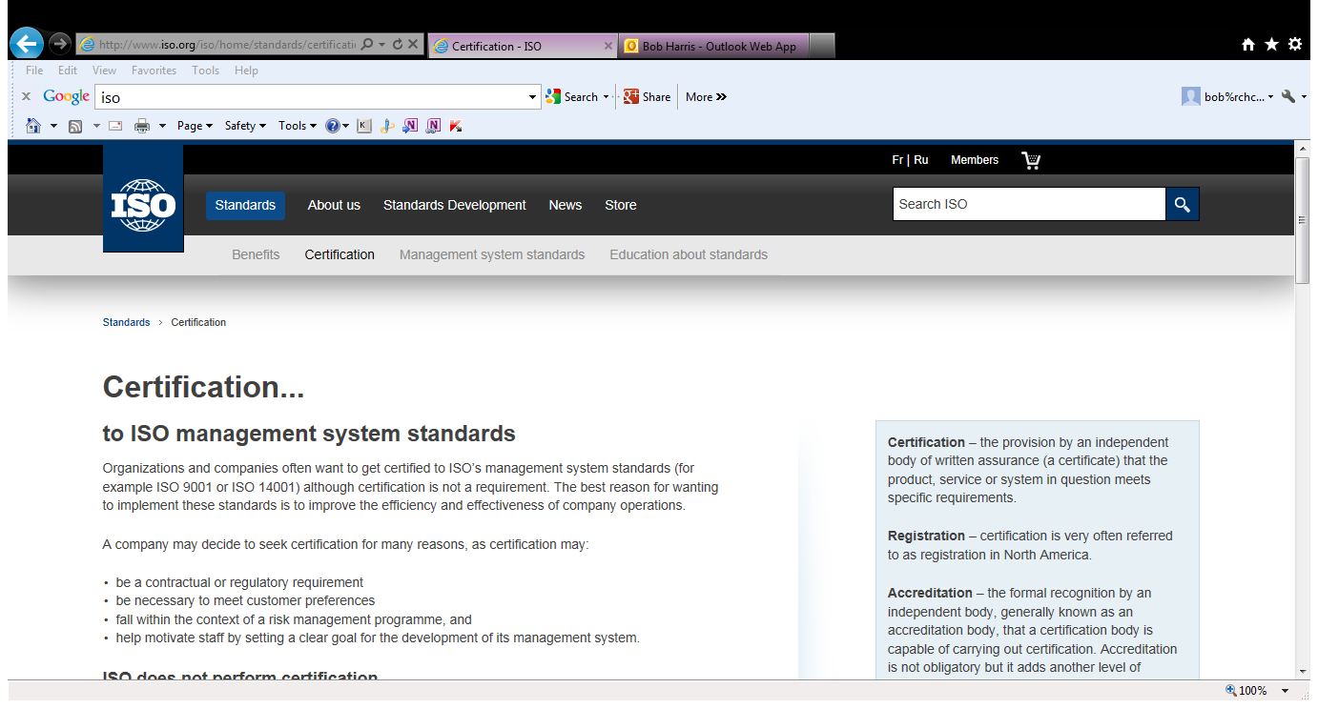

Slide 23




Slide 24



Slide 25


Slide 26
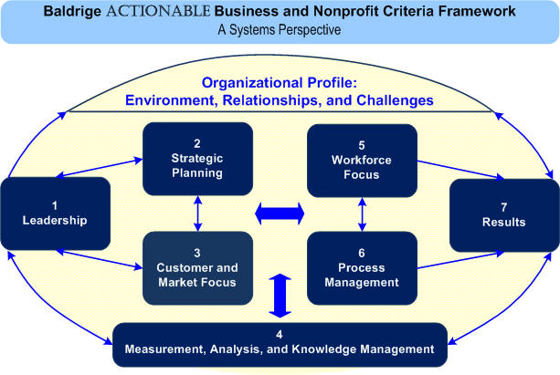
Baldrige Performance Award

Slide 27
Benchmarks

Slide 28
Benchmarking
Outside resources to against which to compare and contrast.
How much should we spend on technology?
Do we pay the staff enough?
What should our membership market-share be?
Ideal ratio of dues to non-dues?

Slide 29

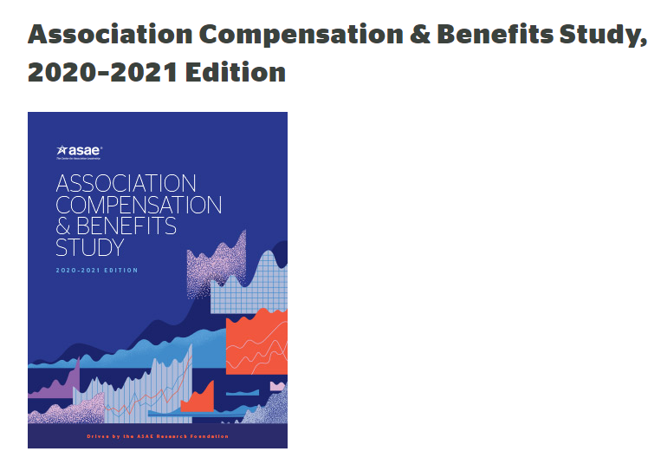

Benchmarking – Operating Ratios

Slide 30
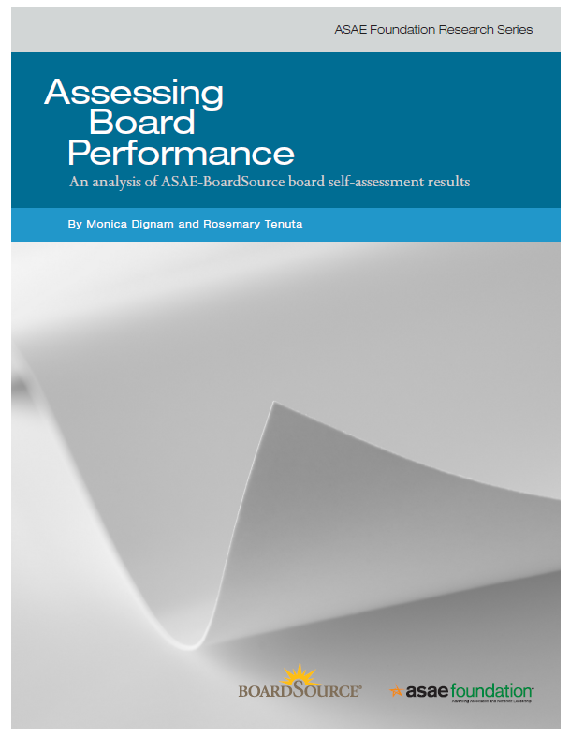

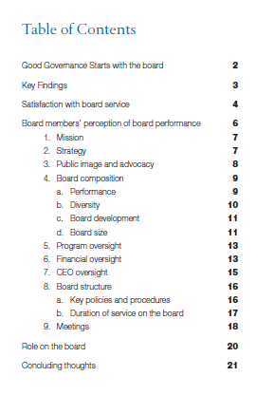

Slide 31


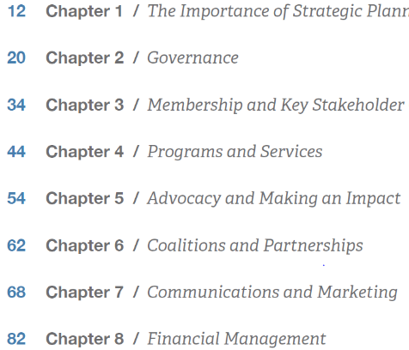
Resource

Slide 32
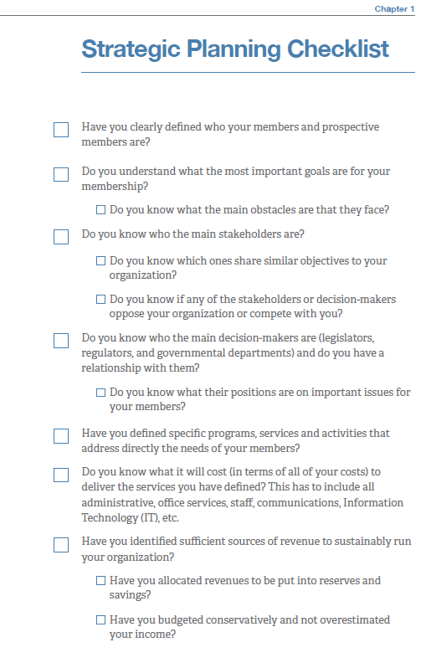
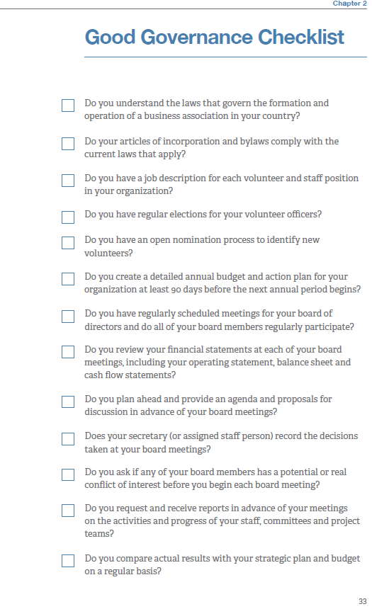

Slide 33


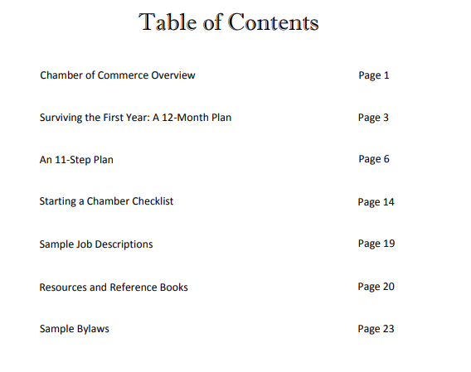

Slide 34
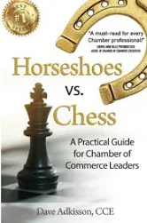

Newer Execs

Slide 35

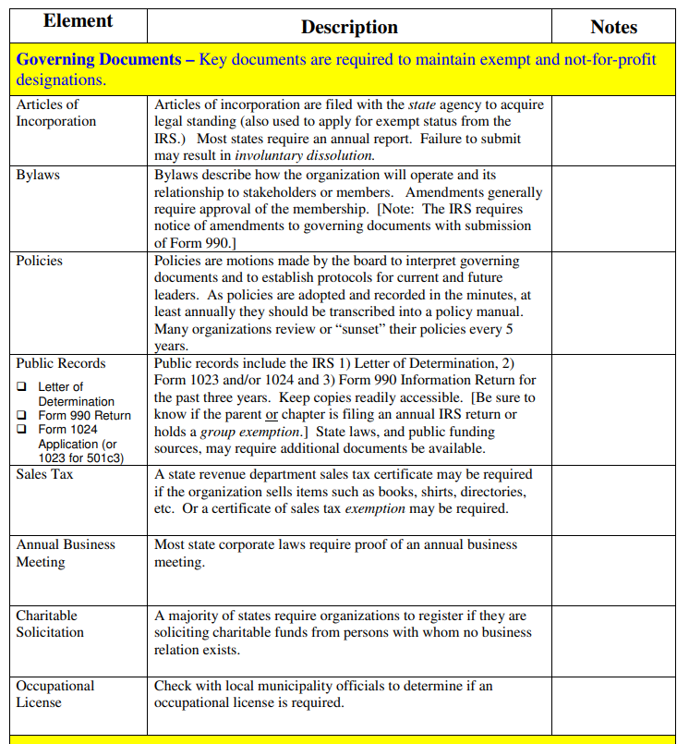


Slide 36
Metrics
Dashboards

Slide 37
Everything can be Measured
  Why are we talking about it if we can’t measure it?
  How will we recognize our success without setting metrics?
  How do we know if the program was successful?

Slide 38
Everything can be Measured
Membership
Finance – Budget
People Performance – Staff Satisfaction, Board Performance and Improvement
Member Satisfaction – Surveys, Retention
Strategic Plan Achievements
Committees, Outcomes, #, Effectiveness
Policies - #
Risk Mgmt. – Safeguards – Incidents
Societal Benefit – Outcomes
Diversity

Slide 39
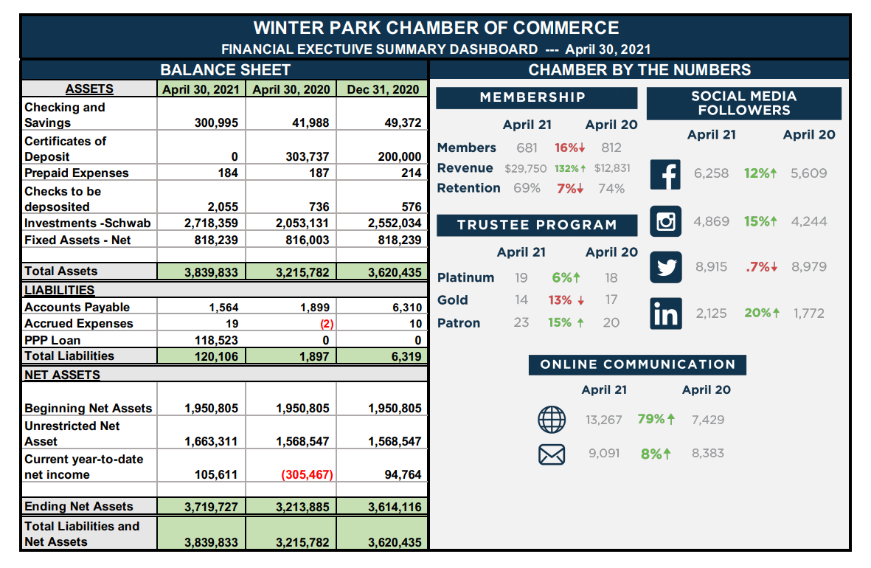
Performance Dashboard

Slide 40
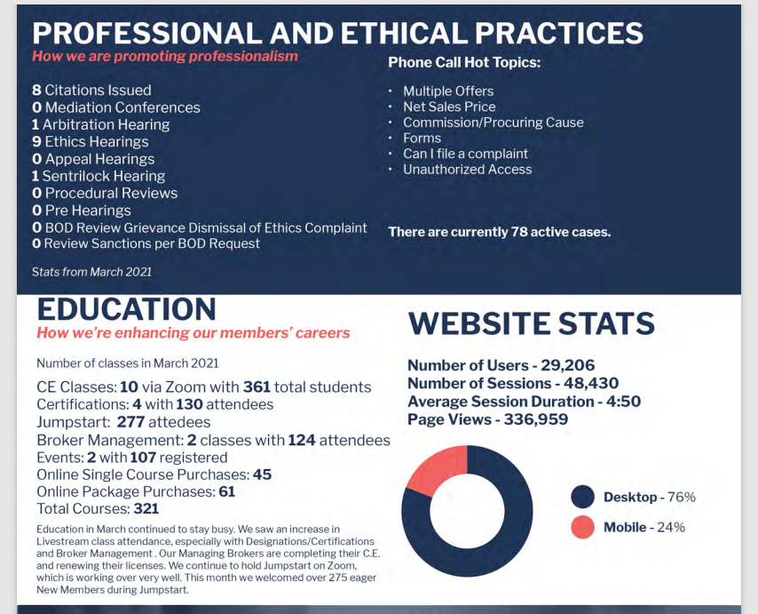
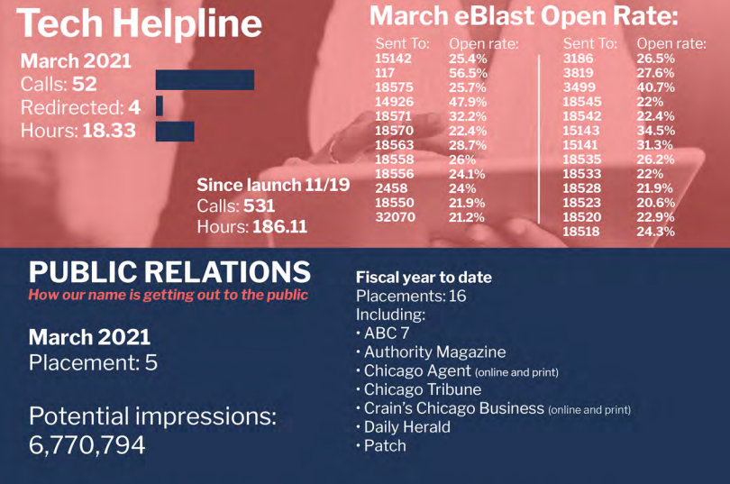
Dashboards

Slide 41
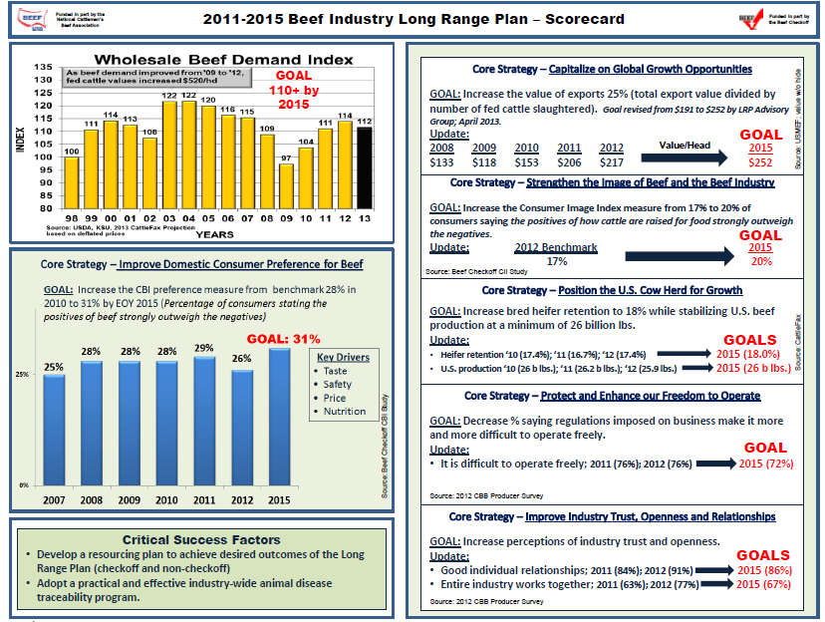

Slide 42
Assessment
Tools

Slide 44
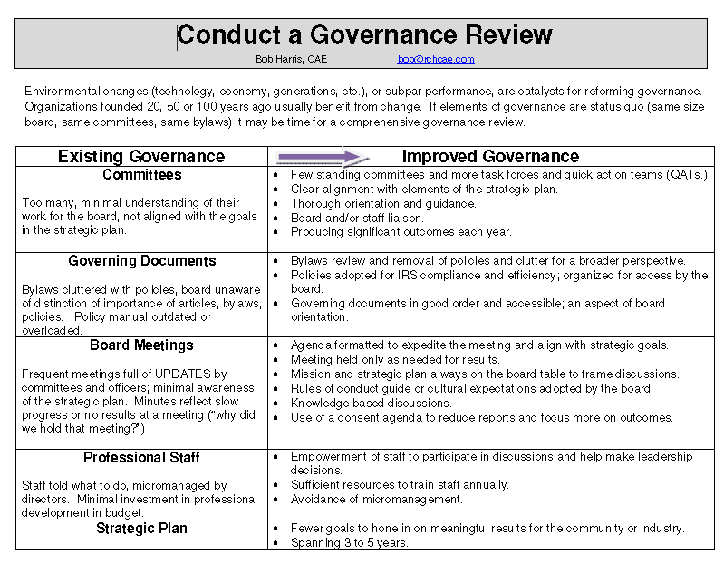
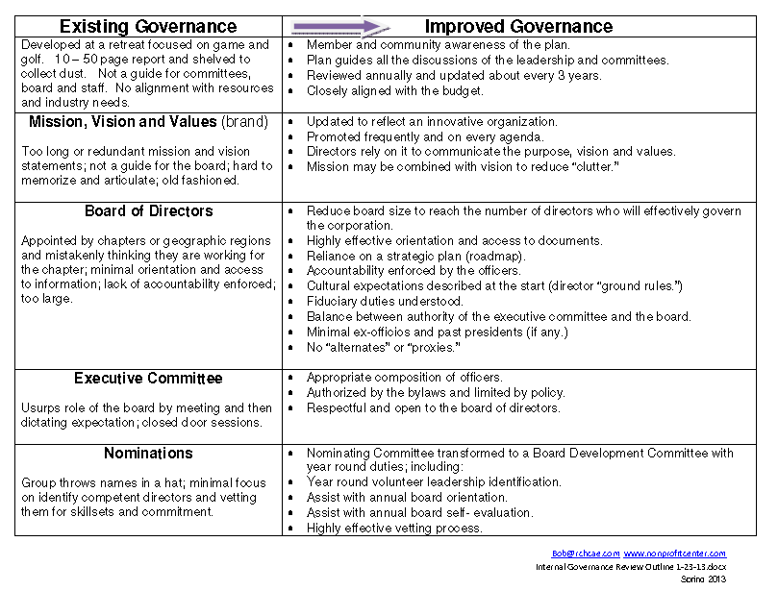

Slide 45
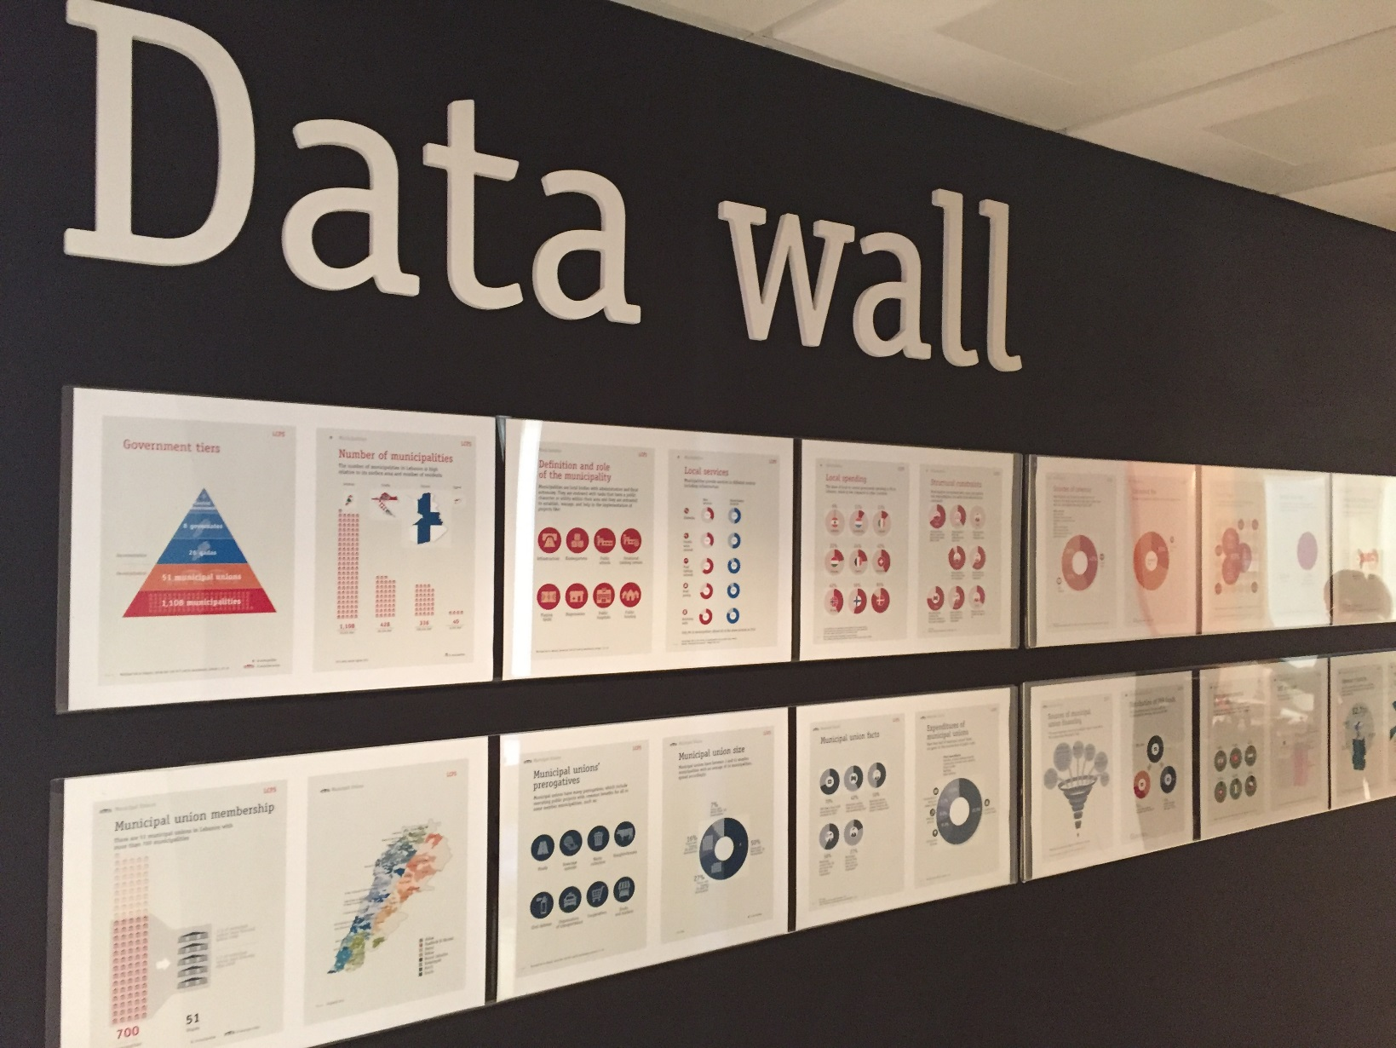
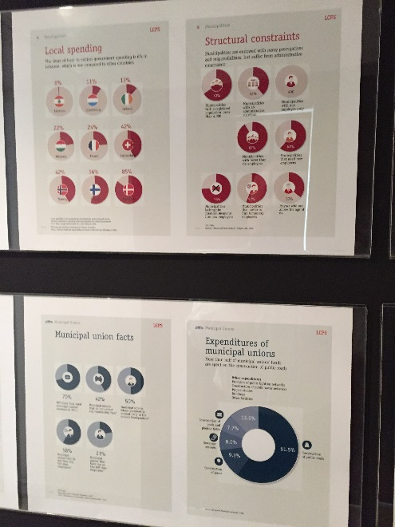
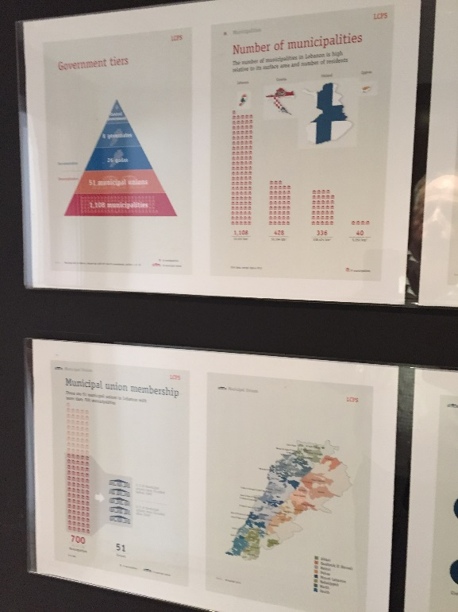

Slide 46
Smart Practices

Slide 47


Slide 48
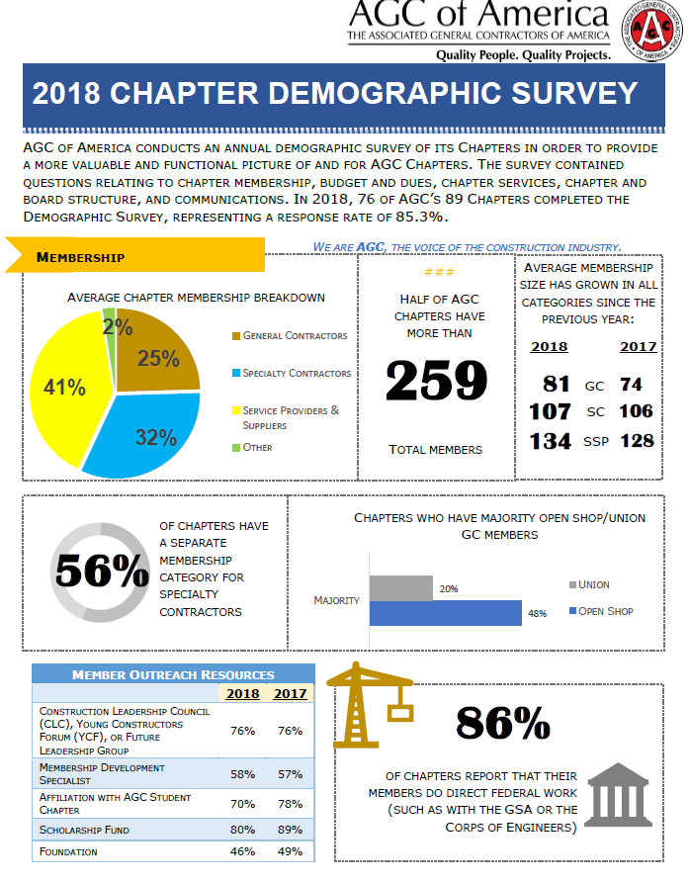
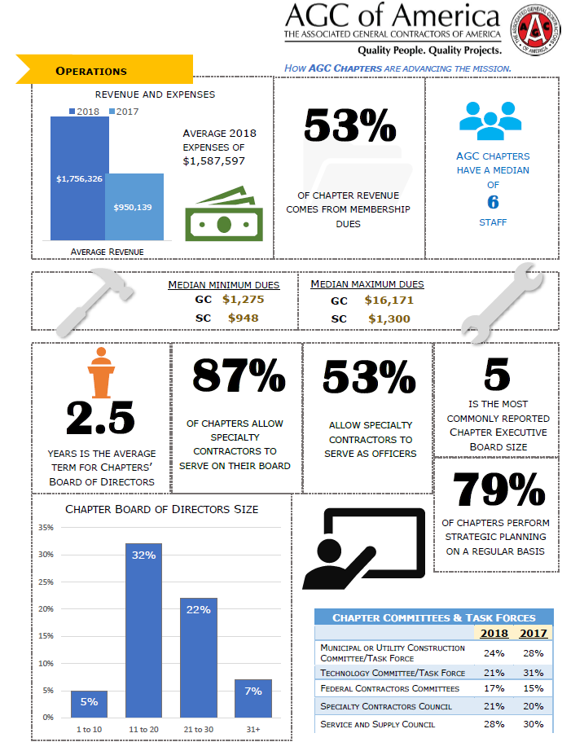

Slide 49

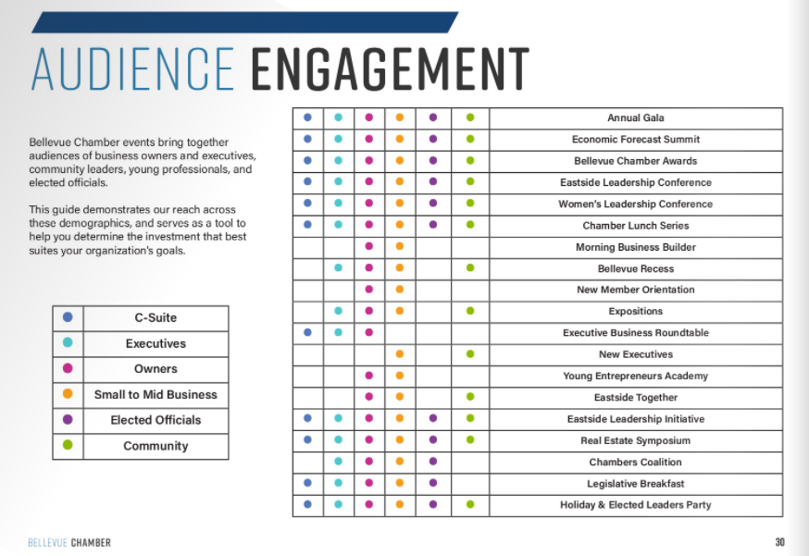
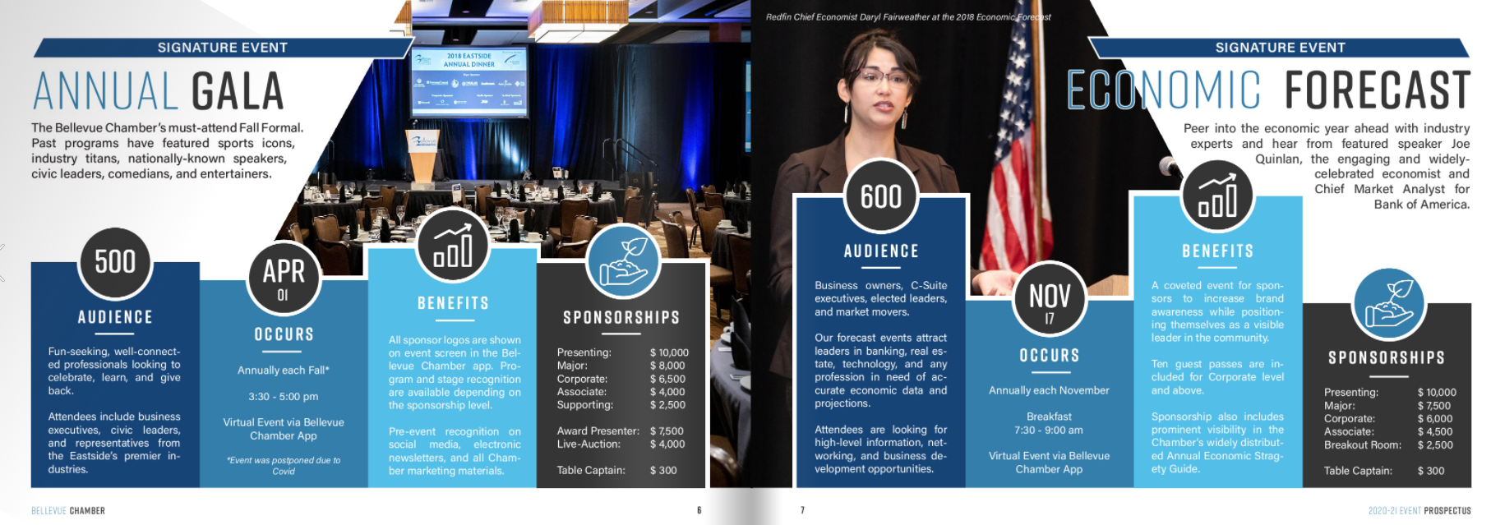
Sponsor
Opportunities

Slide 50

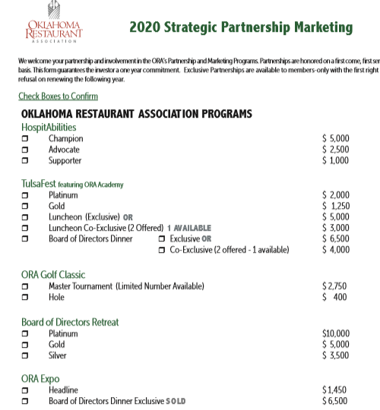
Sponsor Opportunity Menu

Slide 51
Communicate Membership VALUE
fngla.org/membership/roi
ROI Value Calculator
ROI – return on (dues) investment
ROR – return on relationships

Slide 52
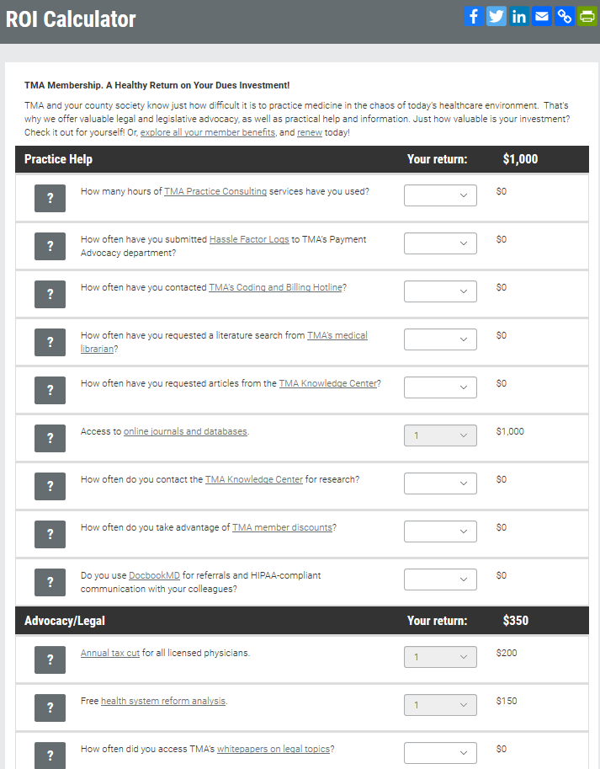
texmed.org/roi/
ROI Value Calculator

Slide 53
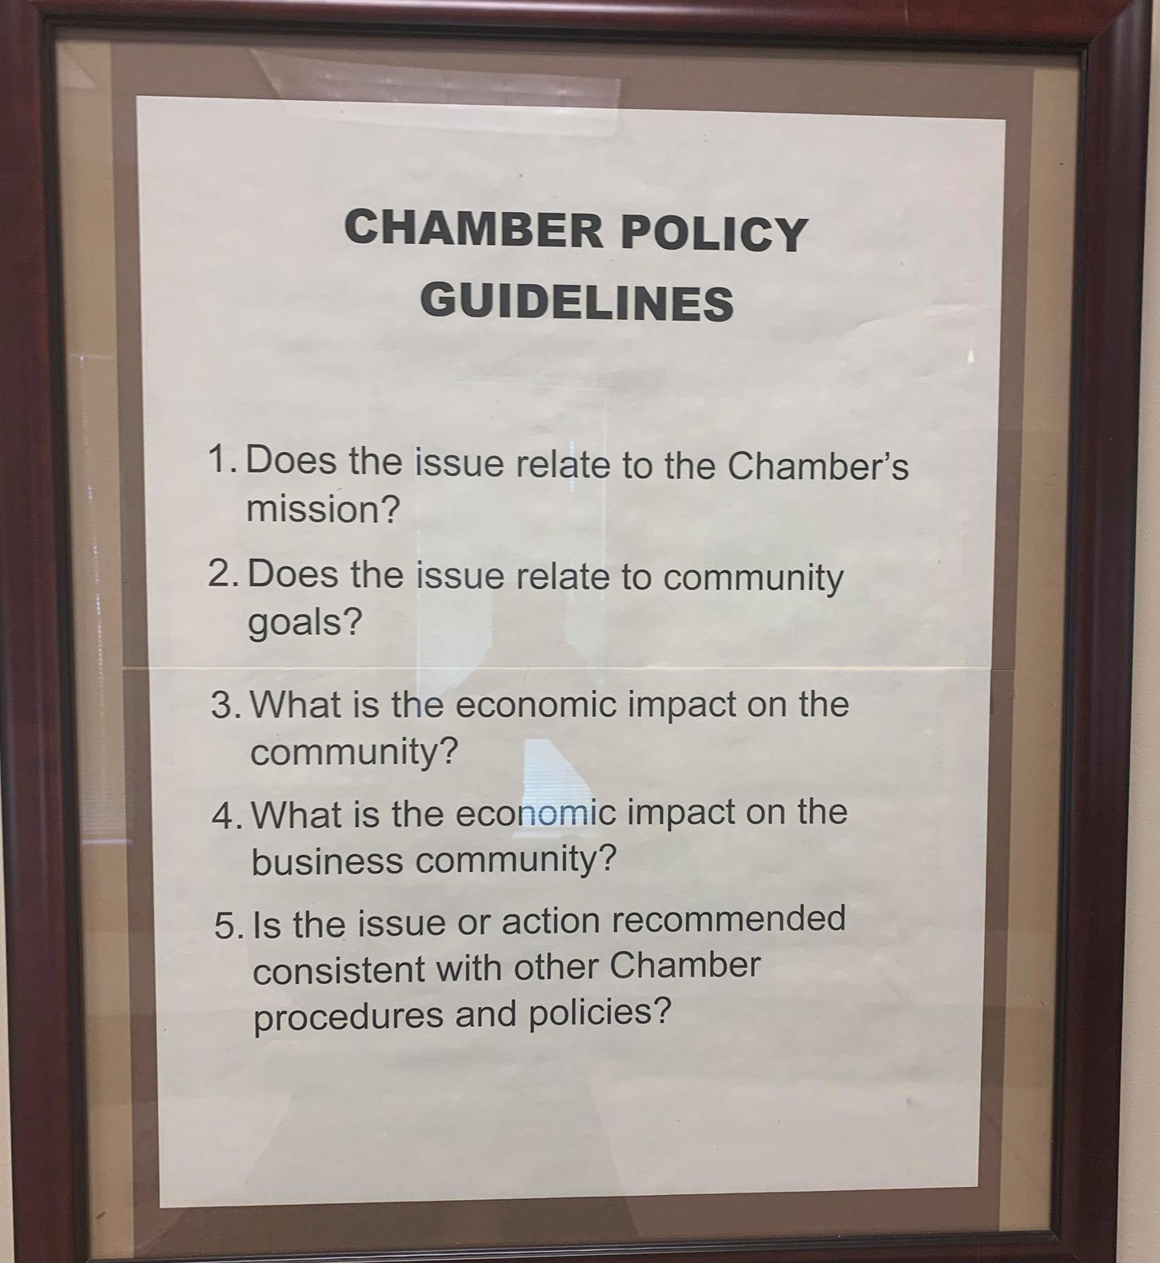
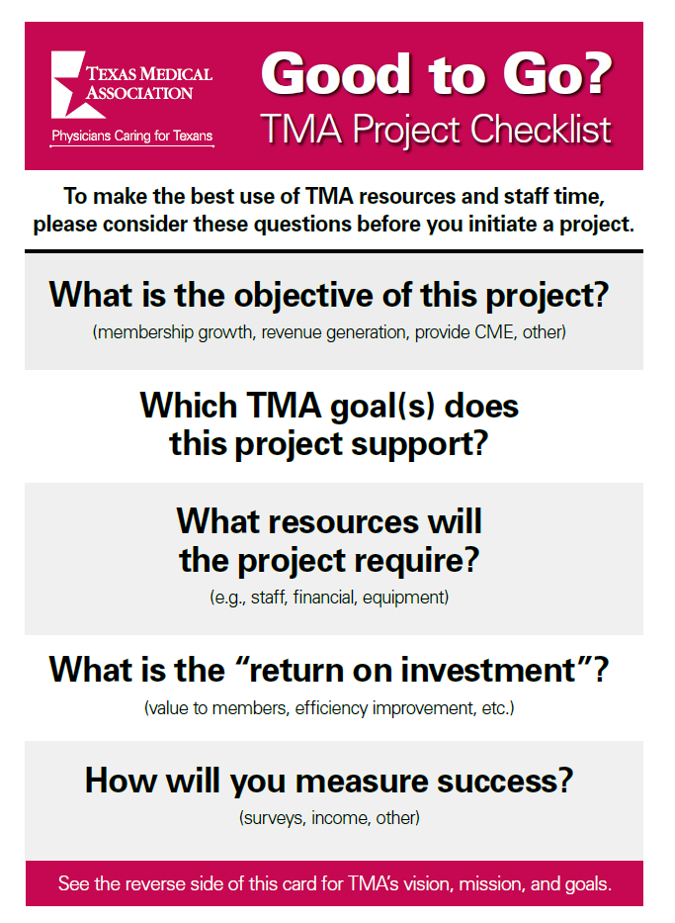
Frame Board Discussions

Slide 54
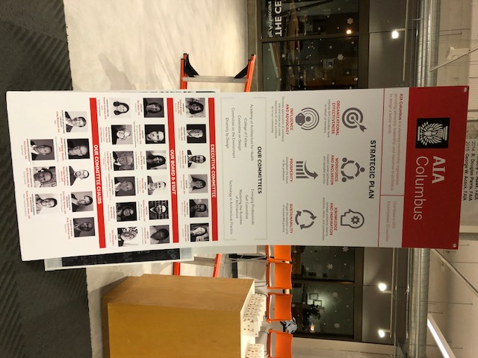

Frame the Strategic Plan

Slide 55


