Slide 2
Building Strategic Partnerships
Becoming a Leader of Significance

Slide 3
What is a Strategic Partnership?
An agreement between two or more organizations that creates shared benefit and accepts shared risk of equal or similar value.

Slide 4
Examples of Supply Chain
Film industry (opening credits J.J. Abrams’ Bad Robot & Paramount)
Automobiles (Toyota makes engines for Lotus sports cars)
Technology (Intel makes processors for computer manufacturers)
Brainstorm examples of potential and/or current alliances….

Slide 5
Why strategic partnerships?
Cut costs
Streamline processes
Improve quality

Slide 6
Examples:
Integration Partnerships Financial Partnerships
Uber and Spotify Accounting Services
Nike and Apple
Technology Partnerships
IT Service
Web Designer
Social Media
Notes:
For instance, Uber and Spotify partnered together to create their “Soundtrack for Your Ride” campaign. In this effort, each brand relied on the other’s technology to create an extraordinary experience for customers. While waiting for their Uber ride to arrive, passengers can connect to their Spotify accounts and control the playlist they’ll be hearing during their trip.
On top of providing a pleasurable ride experience for passengers and improved ratings for drivers, the integration also positioned each brand in a positive light, likely gaining return customers in the process.
Another fantastic example of a strategic integration partnership is the agreement between Nike and Apple. Beginning in the early 2000s, Nike and Apple began pairing their respective products and technology to create what would eventually become Nike+. Upon buying the specific fitness shoes and apparel, customers can pair their products with their Apple iPhone or Watch to track fitness progress and achieve other health goals.

Slide 7
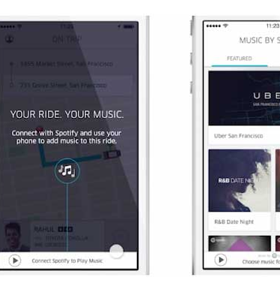
Uber & Spotify
Riders can stream Spotify playlist.
Makes the Uber experience feel more personalized.
Encourages rider to subscribe to Spotify Premium.
Rivals do NOT provide

Slide 8
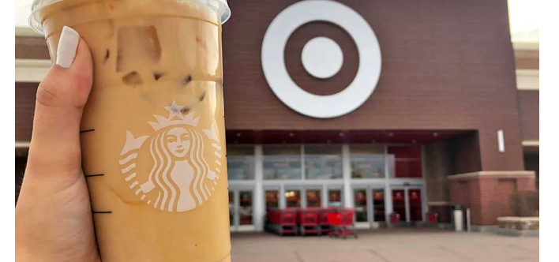
Starbucks & …
Target –
Brands share similar audience
Alliance formed in 1999
Barnes & Noble
Provides customers another reason to visit a physical B&N.
Expands Starbucks audience and boosts sales

Slide 9
Disney & Chevrolet
Created a one-of-a-kind experience that leverages the competencies of both brands
Test drive a vehicle THEY designed
Create a Chevrolet commercial of the car THEY designed
Chevrolet gains brand exposure
Disney benefits with an immersive ride experience for guests

Slide 10
Red Bull & GoPro
Partnership began in 2012
Formed Strategic Alliance for extreme sports events
Connect to audiences who seek high-level thrills

Slide 11
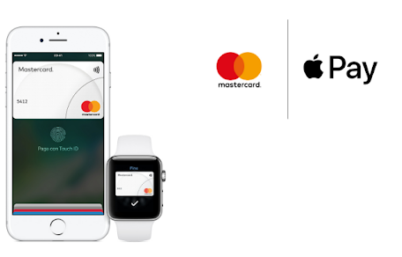
Apple Pay & MC
Apple Pay system has changed the way people use their credit cards forever!
MC was the first company willing to support the new technology.
Only MC customers could pair their card with iPhone
NOW they have launched Apple Card credit card

Slide 12
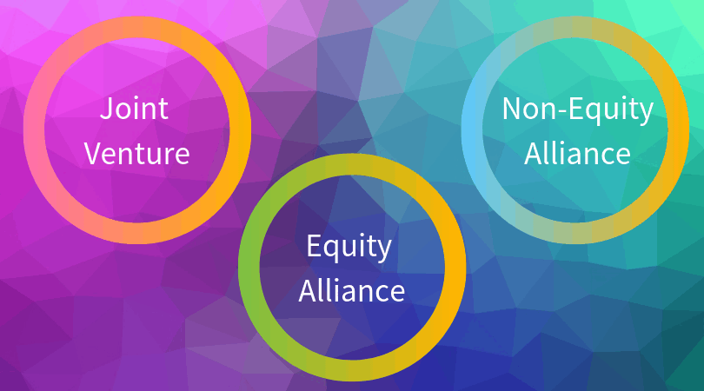
Types of Alliances
Joint ventures
Equity alliances
Non-equity alliances

Slide 13
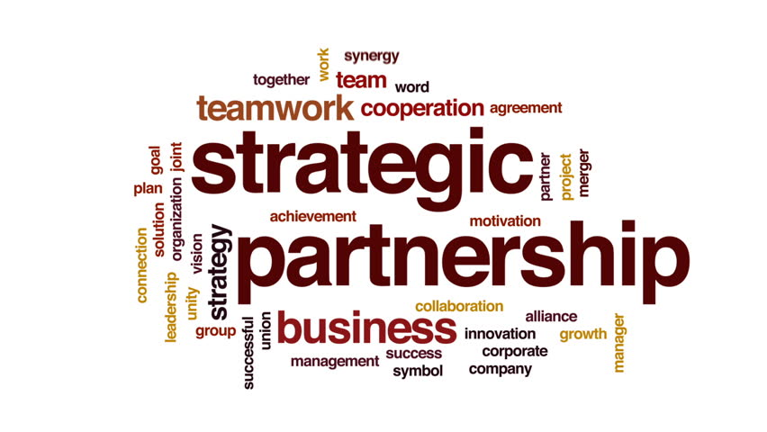
Partnerships
Discipline
Develop the framework
Explore Structures
Manage Relationships

Slide 14
Factors to Consider
Your organization requires a new competency or capability that, while important as an enabler to future success, will not become foundational to your business model in the future.
You’re pursuing a high-risk strategy and/or entering uncertain market conditions.
Your brand doesn’t have permission to play in the areas you’re pursuing and you require another brand’s equity to endorse this evolution or transformation.
You’re seeking to broaden your reach and engage with new audiences.
Scenarios where maintaining independence of brand, processes and customer relationships is advantageous.

Slide 15
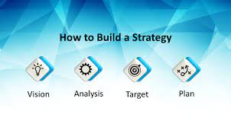
4 Pillars of Success
Articulate both sides of the value equation before seeking a partner
Take the blinders off
Negotiate to assess fit, not simply to structure the relationship
Manage towards the partnership goal, not the contract

Slide 16
Strategic Partnership Agreements
The parties involved in the agreement;
The services to be performed by each partner;
The terms of the agreement (percentages of profit, method of billing, etc.);
The reporting structure, person of contact, etc.;
The duration of the agreement;
The signatures of company officers or their designees.

Slide 17
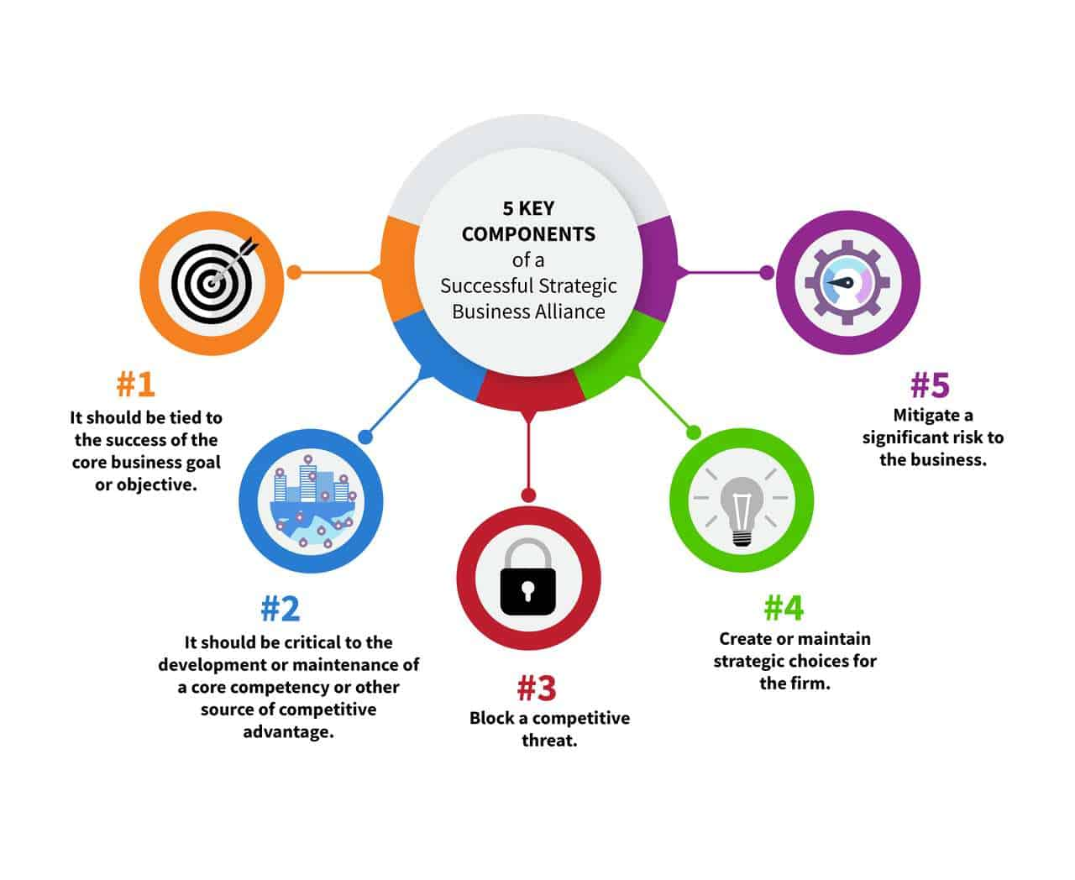
Strategic Partnerships
Will it help you reduce costs AND increase your bottom line?
Will it help mitigate risk? (example provider is bonded and insured can you remove or reduce costs)
Will it help accomplish common goal?
Will it improve competitive advantage?
Will it block a common threat?

Slide 18
Can you answer the following questions?
Where should we take our organization in the next five years?
Is our leadership aligned to our organization’s challenges and future direction?
What is our promise to customers?
How do we align and energize our organization to consistently deliver on our promise?
How do we maximize the value of our brand portfolio?
How do we leverage the power of our people?

Slide 19
How will we implement our new strategy?
Will our culture enable or hinder success?
Is our leadership aligned, engaged and accountable for the journey ahead?
How do we transform our organization to drive greater value – for ourselves and for our customers?
Do we have the right capabilities in place?

Slide 20
Affinity Marketing

Slide 21
Affinity Marketing?
Involves a mutually beneficial partnership between two brands. It is sometimes called co-marketing, co-branding, or partnership marketing.
Partners with a non-competing organization to offer products, services, or other benefits to both their target audiences.
Benefit:
INCREASED brand awareness and GROW customer base!

Slide 22
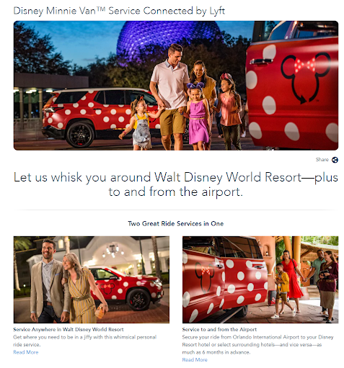
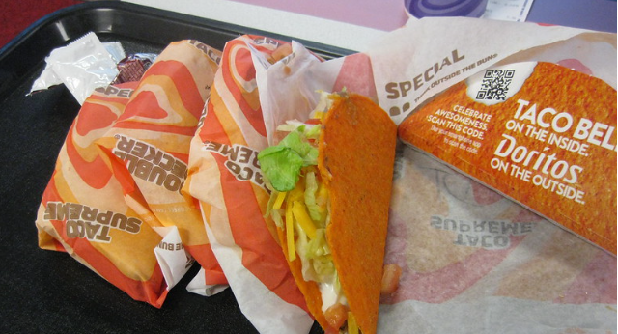
Examples
Taco Bell & Doritos
Disney Minnie VanTM & Lyft

Slide 23
Why do Affinity Alliances Work?
Brands have similar audiences.
Brands relate well to each others and will mutually benefit.
Partnership makes sense and offer an incentive for both brands.

Slide 24
Choose a partner who has a similar audience and/or is in your broader industry but doesn’t directly compete with you.
Partner with a brand that your customers would genuinely be interested in and benefit from.
Make sure your brands – the ways you each present yourself – complement each other. You don’t want to partner with a brand whose values or image clashes with yours.
Consider the value each brand brings to the partnership: Growth of your customer base or membership base? Increased social media following? Exposure to an audience that hasn’t heard of you before?
Offer something to the other brand’s audience that they can’t on their own. And vice-versa – what can the other brand offer to your audience?

Slide 25
Detailed goals you could set include:
Increase leads from a specific audience demographic by X%
Increase purchases from a specific audience demographic by X%
Increase social media following by X%
Increase brand awareness, measured by an increase in website or social media visitors

Slide 26
Communications
Agree on communication methods to convey important information in real time.
Build a partner portal to share files and access materials needed for the campaign.
Dedicate times for status check ups.
Maintain an issue list and to do list for accountability purposes.
Acknowledge and celebrate success!

Slide 27
Test and Tweak Campaigns TOGETHER
Identify and agree upon:
a. Campaign Goals
b. KPIs
c. Measurement system.
2. Commit to tracking key engagement metrics closely.
3. Will still need to track success within YOUR respective channels and share results.
4. Commit to using a shared CRM or lead management tool.

Slide 29
Kelly R Hall, IOM CCE MSL
President/CEO
Longview Chamber of Commerce
(903) 237.4004
khall@longviewtx.com

