Slide 1
PACs and Political Endorsements
Joseph Jones, Executive Director,
The Harkin Institute for Public Policy & Citizen Engagement,
Des Moines, Iowa

Slide 2
Introductions

Slide 3
Overview
Is your organization ready to begin a PAC and engage in endorsements? This class will provide step-by-step instruction on how to establish and grow successful political action committees and endorse candidates.
Course objectives:
Addressing ballot initiatives and referendums
Creating and maintaining a PAC
Building an airtight endorsement strategy

Slide 4
The Harkin Institute for Public Policy & Citizen Engagement
Notes:
Go over what the Harkin Institute does, Senator's Harkin bio (brief)
- Founded in 2013, currently at Drake.
- Student-centric policy research, events, etc, etc.
- Focus on congressional career of Senator Harkin, hit main points (ADA, farm bills, and child labor).
- Talk about yourself and your background in Harkin's office, political career.
- Transition that into your experiences with PACs in and out of D.C.

Slide 5
What is a PAC?
To some, it's a game, but it shouldn't be when promoting your issues...
Notes:
Joke around about PAC-MAN, GO, PACK, GO! Really, any pun you could think of for this.

Slide 6
What is a PAC?
PAC stands for “Political Action Committee.”
Political Action Committees – Organized apparatus intended for raising and spending money to elect and defeat candidates.
PACs represent business, labor, or ideological interests, or general advocacy issues.
Source OpenSecrets.org
Notes:
Source: https://www.opensecrets.org/political-action-committees-pacs/what-is-a-pac

Slide 7
Types of PACs
Three Main Types:
Separate Segregated Funds
Nonconnected Committees
Super PACs
Other Types
Leadership PACs
Hybrid PACs
Source: Federal Election Commission
Notes:
Source: https://www.fec.gov/press/resources-journalists/political-action-committees-pacs/
Leadership PACs – FEC Definition: A Leadership PAC is a political committee that is directly or indirectly established, financed, maintained or controlled by a candidate or an individual holding federal office, but is not an authorized committee of the candidate or officeholder and is not affiliated with an authorized committee of a candidate or officeholder. Members of Congress and other political leaders often establish Leadership PACs in order to support candidates for various federal and nonfederal offices.
Hybrid PACs- (political committees with non-contribution accounts) solicit and accept unlimited contributions from individuals, corporations, labor organizations and other political committees to a segregated bank account for the purpose of financing independent expenditures, other ads that refer to a federal candidate, and generic voter drives in federal elections, while maintaining a separate bank account, subject to all the statutory amount limitations and source prohibitions, that is permitted to make contributions to federal candidates.

Slide 8
Separate Segregated Funds/Nonconnected Committees
Separate Segregated Funds
Established by a corporation or labor organization.
Part of organization, money separate from general organization funds.
Receives funds from individuals/organizations directly connected to the PAC.
Nonconnected PACs
Does not have a connected organization.
Can receive limited support from a sponsoring organization, that is not a corporation or labor organization. I.e. a partnership or unincorporated association.
Individuals outside of an organization can support the PACs.
Source: Federal Election Commission
Notes:
Source: https://www.fec.gov/press/resources-journalists/political-action-committees-pacs/
https://www.opensecrets.org/political-action-committees-pacs/what-is-a-pac
SSFs: Separate funds from general treasuries of Unions/Corporations due to the Smith-Connally Act of 1943.
Non-Connected PACs: Limited Administrative and Financial Support from Sponsoring organization.

Slide 9
Super PACs
Formally known as independent expenditure-only committees.
Resulted from Citizens United v. FEC (2010) and SpeechNow.org v. Federal Election Commission (2010)
“May raise unlimited sums of money from corporations, unions, associations, and individuals.”
Can spend unlimited money on advocating for/against candidates.
Cannot donate directly to candidates and cannot coordinate directly with candidates they benefit.
Source: OpenSecrets.org.
Notes:
Source: https://www.opensecrets.org/political-action-committees-pacs/super-pacs/2020
Super PACs must report their donors monthly during the year of an election or semi-annually in off-years.
Over $3.4 billion in receipts to Super PACs in 2019-2020 cycle, Over $2.1 Billion in expenditures in 2019-2020 cycle.

Slide 10
Super PACs in Action
Notes:
Source: https://www.opensecrets.org/political-action-committees-pacs/super-pacs/2020
Super PACs must report their donors monthly during the year of an election or semi-annually in off-years.
Over $3.4 billion in receipts to Super PACs in 2019-2020 cycle, Over $2.1 Billion in expenditures in 2019-2020 cycle.

Slide 11
Who Can and Can’t Contribute to a PAC...
Well, it depends...

Slide 12
Political Candidate
Committee
Separate Political Infrastructure For Or
Against Candidates
SSFs
Nonconnected PACs
Super PAC
Unions
Corporations
Associations
General Public
Notes:
Separate Segregated Funds (Unions, Corporations, People associated with the two, can go directly to campaign)
Nonconnected PACs (Associations not directly affiliated with unions/corps, General Public can contribute, can go directly to campaign)
Super PAC (Anyone can contribute, can't go directly to campaign or directly coordinate with campaign)

Slide 13
Who Can’t Contribute to a PAC...
Federal Government Contractors
Foreign Nationals
Notes:
FEC Definition of a Federal Government Contractor:
The prohibition applies to contributions from:
A partnership with a government contract;
The personal or business funds of an individual under contract with the federal government; and
Sole proprietors with government contracts.
Stockholders, officers, members or employees of an entity that is a federal contractor may, however, make contributions from their personal funds.
FEC Definition of a Foreign National:
The following entities are considered foreign nationals and are therefore subject to the prohibition: foreign governments, foreign political parties, foreign corporations, foreign associations, foreign partnerships and individuals with foreign citizenship unless they have “green cards” indicating they have been lawfully admitted for permanent residence

Slide 14
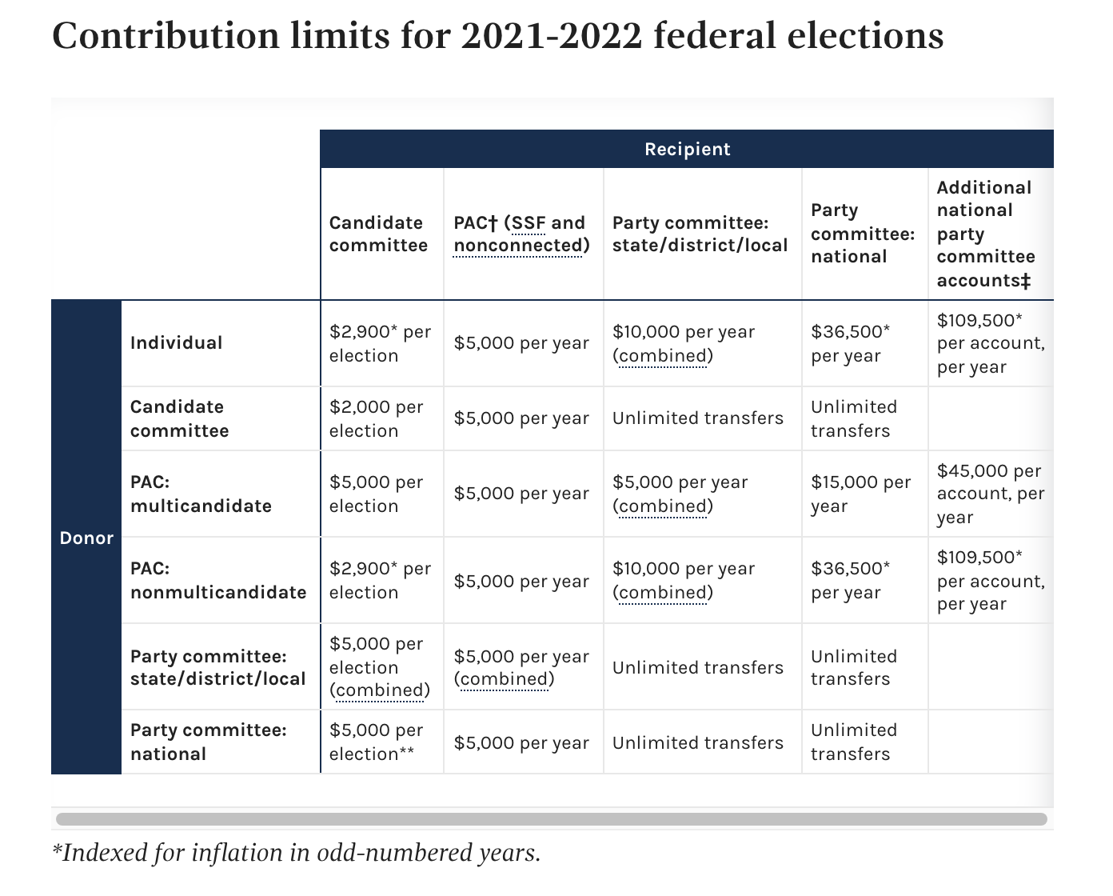
Contribution Limits
Notes:
Source: FEC
https://www.fec.gov/help-candidates-and-committees/making-disbursements-pac/contribution-limits-nonconnected-pacs/

Slide 15
State PACs
Every state has their own PAC rules.
Important to engage with these PACs.
Great amounts of influence on state level.
Many metropolitan and state Chamber of Commerce organizations have their own PACs.
i.e. Atlanta, Cleveland, and Detroit

Slide 16
How Influential Can PACs Be in Their Endorsements and Support?
Notes:
Transition into provided examples

Slide 17
Political Endorsements
Political endorsements are when an individual, group, or organization comes out in support of a particular candidate or issue.
Endorsements can mean:
Votes
Donations
Institutional Support
Media Coverage

Slide 18
PACs in Relation to Endorsements
Like endorsements by influential people or groups, PAC endorsements can create a ripple effect for a campaign or issue.
Votes
Donations
Institutional Support
Media Coverage

Slide 19
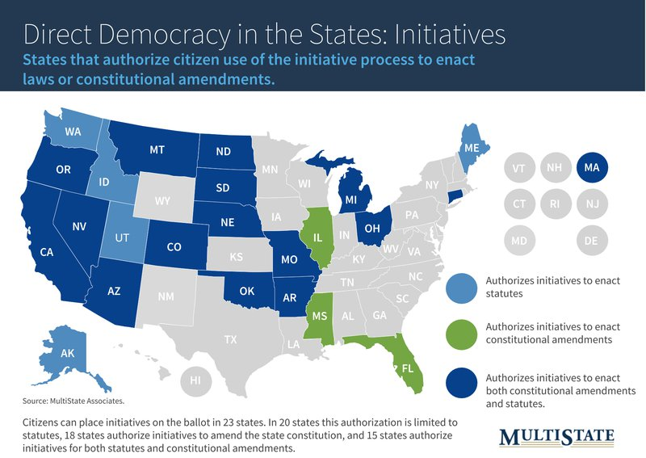
PACs, Endorsements, and Ballot Initiatives
In addition to candidates, PACs can influence the various ballot initiatives that exist throughout the country.
Map Source: MultiState
Notes:
Ballot Initiatives: A process that puts constitutional amendments or statutes up for vote by the public.
https://www.multistate.us/insider/2017/11/6/direct-democracy-in-action-a-guide-to-state-ballot-measures

Slide 20
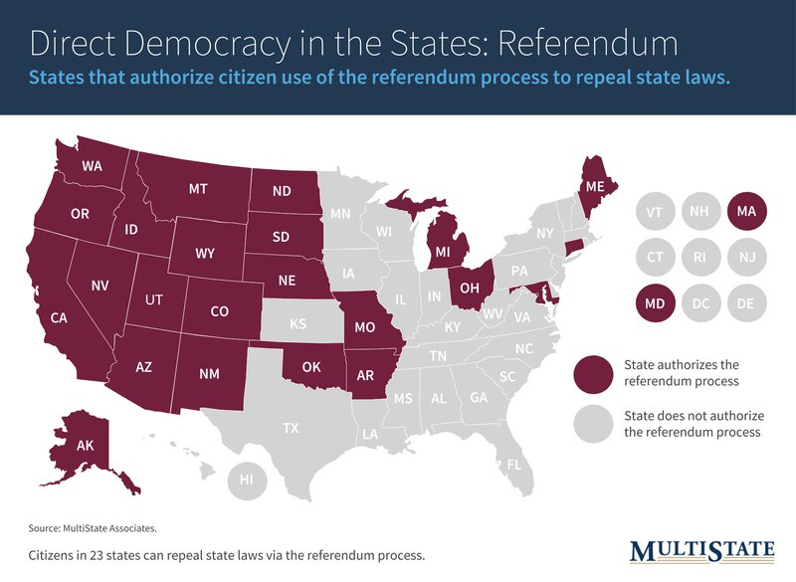
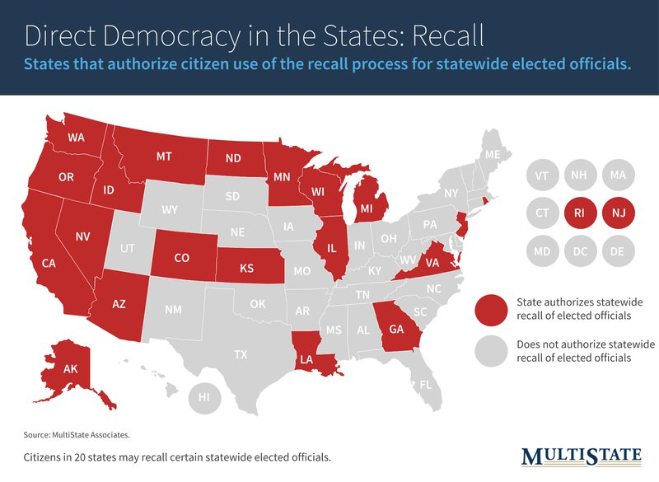
PACs, Endorsements, and Ballot Initiatives
Map Source: MultiState
Notes:
Referendums: A process that puts a question, legislative proposal, or statutes repeal up for vote by the public.
Recalls: Process that allows the public to remove elected officials from office before their term has expired.
https://www.multistate.us/insider/2017/11/6/direct-democracy-in-action-a-guide-to-state-ballot-measures

Slide 21
Endorsement Strategy for Candidates
You're looking for the best possible candidates to promote your organization's advocacy work.
Just because a candidate aligns with your organization's mission doesn't mean you should endorse them.
Things to Consider:
Other policy beliefs of the candidate(s) and whether that conflicts with the support base of the PACs support.
Conflicting PACs supporting that candidate?
Is the race competitive?
Will the candidate follow through on issue?

Slide 22
Endorsement Strategy for Initiatives
Voters are deciding on a broad-based initiative that could be good or bad for your organization.
Things to Consider:
What are the short-term/long-term effects that the initiative could have for your organization?
Could the initiative trigger other effects to happen?
How much should you invest in the ballot initiative?
Has the ballot initiative gone through in other states? What was the result?

Slide 23
Other Support from PACs
PACs can organize more than just funds...
Organize volunteers to walk or canvass in your downtown/business district.
Educate other businesses and organizations about candidates on the issues.
Getting more actors and institutions involved will increase awareness and leverage for getting supportive candidates elected.

Slide 24
Examples of PAC Influence in Action

Slide 25
Example 1:
LARP PAC is a multicandidate political action committee supporting the rights of live action role-players (LARPers) to expand federally-protected rights and national influence for them.
Frank and Sue are running for Congress.
Frank has come out in favor of policies supporting LARPers.
Sue has been silent on the issue of LARP policies.
Notes:
https://www.fec.gov/help-candidates-and-committees/registering-pac/understanding-nonconnected-pacs/
LARP PAC would be an example of a Nonconnected PAC.

Slide 26
Example 1 Continued:
Frank has won the endorsement and campaign funds from LARP PAC.
$5,000 max from LARP PAC + Money from donors supportive of LARP PAC’s mission.
Frank gets $50,000 total from the combination of LARP PAC’s donation and LARP-sympathetic donors.
Notes:
In addition to the $5,000 maximum the multicandidate PAC can contribute, the endorsement can encourage people who support the PAC’s cause to donate more money than the PAC is able to contribute.

Slide 27
Function of Nonconnected PAC
Individual
Donor
Connected with PAC
Individual
Donor
Connected with PAC
Political Action
Committee
Endorsing
Candidate
Political Candidate
Supportive of Issue
Individual
Donor
Supportive, not
Connected w/ PAC
Note: Arrows reflect donations.
Notes:
Someone can donate to the PAC and then the endorsed candidate.
Someone who doesn’t donate to the PAC but supports the issue can donate to the candidate on their own.
Examples: ay not want to
1. If a supporter of the issue is a Republican but the PAC endorses the Democrat, the supporter may not want to support the individual candidate but the PAC only.
2. Conversely, a Democratic donor may support the PAC but also monetarily supports Democrats who support that issue.
Finally, a donor may like an issue but doesn’t donate to the PAC and selects individual candidates who the PAC supports that the donor also supports for other reasons.

Slide 28
Example 2:
Toolworkers United PAC (TUPAC) is a political action committee that supports the union organizing efforts of toolworkers across the country.
Beth and Luis are running for the state legislature.
Beth has come out in favor of policies that are pro-organizing.
Luis has come out against pro-union legislation.
Notes:
Example of a Separate Segregated Fund. (SSF)

Slide 29
Example 2 Continued:
TUPAC throws their PACs support behind Beth.
Other unions and union-sympathetic throw their support behind Beth as a result of TUPAC's endorsement, both directly and indirectly.
The institutional support of the organizations helps increase the word of the Beth's campaign.
What else happens?

Slide 30
Individual
Supportive of
Organization
Function of SSF PAC
Advocacy Group
Political Action
Committee
Endorsing
Candidate
Political Candidate
Supportive of Issue
Similar, Supportive PAC
Advocacy Group
Green reflects PAC influence on others.
Blue reflects direct support from the PAC to campaign.
Red reflects additional campaign support.
Notes:
With this chart, you can see that when a certain PAC gives support to a certain campaign, it can cause a chain reaction.
Advocacy groups, individuals, and other PACs can look at one PAC's support and decide they want to support the campaign too and be influenced by it.
Note: this doesn't mean the various organizations are coerced into support; it means the orgs/individuals may be aligned with their own issues.
I.e. A union PAC support might encourage a progressive worker's group or disability rights org to lend their support to the candidate too.

Slide 31
Example 3:
CurdUSA PAC is a Super PAC that reflects the interest of national cheese and dairy interests.
Whitney and Lee are running for governor.
As a minor policy issue, Lee has proposed the reduction of dairy products, such as ice cream and cheese, in school lunches, in favor of promoting more non-dairy options for food and drink.
Notes:
This is an example of a Super PAC.

Slide 32
Example 3 Continued:
CurdUSA doesn't want to risk having dairy farmers lose potential revenue if that policy passes.
A consortium of individual farmers, dairy corporations, and distribution companies fund the super PAC to run negative campaigns against Lee.
A total of $500,000 was spent in negative ads against Lee without any input from Whitney's campaign.
Notes:
"Lee wants to ban milk from the grocery store!" or "Lee is bought out by the soy lobby that wants soy products to replace dairy products in our schools," attacks like that.

Slide 33
Function of Super PAC
Individual
Other
Political
Candidate
Advertisements
and Other Support Separate from Campaigns
Corporation
Super PAC
Political Candidate
Against Issue
Advocacy Group
Green reflects the campaign being helped.
Blue reflects support to SuperPAC and to issue.
Red reflects the campaign being harmed.
Notes:
Individuals, corporations, and groups are coming together to bring forth advocacy issue.
Again, it doesn't have any direct relation with the candidate they're supporting/attacking.

Slide 34
PACs and Endorsements at Work: Greater Phoenix Chamber of Commerce

Slide 35
Relating to Advocacy
PACs and political endorsements have leverage in fighting for your issues.
Things you can do in your advocacy:
Invest in a PAC.
Keep up-to-date on advocacy PACs.
Start your own PAC.

Slide 36
Creating a PAC That Works For You
Funding
Segregation of Funds (SSF).
Register with IRS.
Be mindful of the PAC limits.

Slide 37
Creating a PAC That Works For You Cont.
How to choose PAC Board members:
Interested in government affairs.
Well-connected or is willing to make connections.
Can fundraise effectively.
Be bipartisan.
A team player.
Notes:
https://ota.com/about-ota/ota-political-action-committee/organic-pac-committee/criteria-pac-committee-members

Slide 38
Creating a PAC That Works For You
Have something tangible for stakeholders.
Comprehensive endorsement plan.
Show how issue will be promoted.
BUT focus on the big picture.
Allegiance to the organization, not individual want or single policy.

Slide 39
Class Activity
Draft your own PAC.
Write down what your PAC will focus on.
Think about all of your needs.
Ask yourself, what tools might you need.
Spend 5-7 Minutes on this exercise.

Slide 40
Resources from the Chamber of Commerce
Regional government affairs conferences.
Advocacy and communications workshop put on by C of C
Fly-ins
Chamber of Commerce will arrange for state business leaders and organizations to come to DC to meet with a state's congressional delegation.

Slide 41
Resources from the Chamber of Commerce
Issue Briefs available on US Chamber website.
Provides information on current issues relevant to business.
Campaign School and Leadership Training Programs
Learn how to get involved with a campaign with the Chamber.

Slide 42
Voter Education vs. Advocacy
Educating voters
Use campaign ads and mailers as an education vs. advocacy conversation.

Slide 43
Relating to Advocacy
No matter if your advocacy is about general issues or specialized areas, PACs can have a great impact on pushing your issues into the forefront.
How do you make your advocacy clear?

Slide 44
Advocacy Begins With Intent...
Living Proof by John Capecci and Timothy Cage.

Slide 45
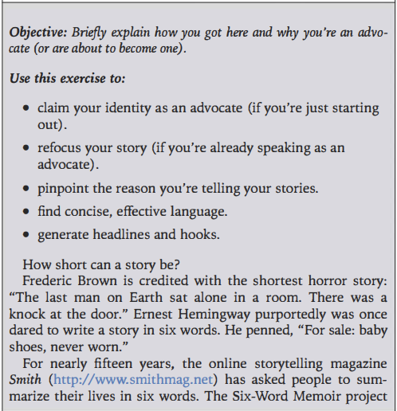
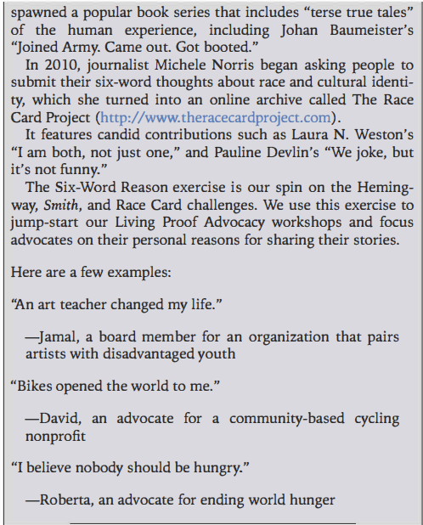
Six-Word Reason

Slide 46
What is Your Six-Word Reason?
For the next three minutes, come up with your six-word reason for advocacy.
Talk with the person next to you about each of your reasons.
We’ll come back in 5-7 minutes.
Notes:
Anybody want to share?

Slide 47
Why the Six-Word Reason?
Like with PACs, creating a simple and straight-forward reason for your intentions helps clarify your path and puts you on a track to accomplish your advocacy goals.

Slide 48
What We Learned
This course taught you the following objectives:
Addressing ballot initiatives and referendums.
Creating and maintaining a PAC.
Building an airtight endorsement strategy.

Slide 49
Questions?

Slide 50
Thank You!

