Slide 1
Effective Government Affairs Programs
Joseph Jones, Executive Director,
The Harkin Institute for Public Policy & Citizen Engagement
Des Moines, Iowa

Slide 2
Introductions

Slide 3
The Harkin Institute for Public Policy & Citizen Engagement
Notes:
Go over what the Harkin Institute does, Senator's Harkin bio (brief)
- Founded in 2013, currently at Drake.
- Student-centric policy research, events, etc, etc.
- Focus on congressional career of Senator Harkin, hit main points (ADA, farm bills, and child labor).
- Talk about yourself and your background in Harkin's office, political career.
- Transition that into your experiences with PACs in and out of D.C.

Slide 4
Overview
Nonprofits serve as advocates for their members and communities. Despite your experience or your organization’s size, establishing a grassroots network doesn’t have to be overwhelming. Learn the basics of a successful approach to legislative advocacy and policy.
Course objectives:
Determining who should be involved in the program and why.
Creating a legislative policy.
Running a grassroots network.

Slide 5
Importance of Government Affairs
An organization's government affairs can provide an important perspectives and expertise in their various fields.
This can include:
Updates and changes to laws.
Relationships between an organization, the government, and public
The future of an industry or political issues.
Lawmakers and other government officials don't know everything...

Slide 6
Importance of Government Affairs
Can be very valuable for an organization's mission:
McKinsey: Business value related to government: 30%, 50% for financial sector.
Not just good for profits, but also long-term well-being of a company.
Notes:
https://fiscalnote.com/blog/getting-a-seat-at-the-table

Slide 7
Importance in Government Affairs
Advocacy is increasingly global, competitive, and complex.
More voices competing for the ears of Congress and the White House than ever.
Some may feel discouraged by the amount of money some organizations put into their government affairs programs.

Slide 8
Personal Experience in Dealing with Government Affairs

Slide 9
New to Government Affairs?
Don't go all out when starting new.
Visit the capitol or government agency.
Collaborative with other groups.
Raise Money.
Keep it legal.
Understand where to go to...
Notes:
https://www.acc.com/sites/default/files/resources/vl/membersonly/ProgramMaterial/19982_1.pdf

Slide 10
Who to Include in Your Gov. Affairs?
Should be interested in government.
Understand the policy or policies you are advocating for.
Well-connected or is willing to make connections.
Be bipartisan.
A team player.
Notes:
https://www.acc.com/sites/default/files/resources/vl/membersonly/ProgramMaterial/19982_1.pdf

Slide 11
Government in Government Affairs
Three Branches of Government:
Executive Branch
President and Administration
Legislative Branch
Congress (House and Senate)
Judicial Branch
Courts

Slide 12
Government 101
Different Levels of Government:
Federal
State
County
Local
Legislative and bureaucratic sides exist at all levels of government.

Slide 13
How Do You Factor Into How a Bill Becomes a Law?

Slide 14
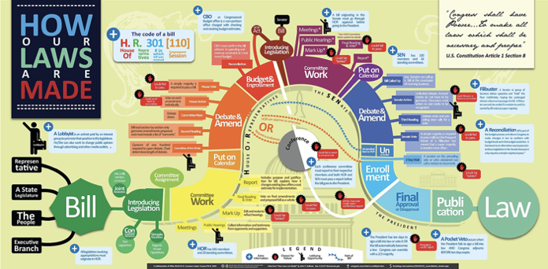
How Laws Are Made

Slide 15
Government in Government Affairs
More to the process than what Schoolhouse Rock taught you.
You can have a major impact in the policymaking process with an effective government affairs program.
Important to maintain relationships at all levels of government.
Local and state actions affect your operations more on a day-to-day basis.
Understanding bureaucratic agencies and their roles also pertinent.

Slide 16
Working in Government Affairs

Slide 17
Government Affairs in the Executive Branch/Bureaucracy
The Executive Branch is more than just the President.
Includes all the federal agencies in government.
Department of Defense, Federal Trade Commission, Federal Communications Commission, etc.
Responsible for interpreting and implementing legislative policies.

Slide 18
Government Affairs in the Executive Branch/Bureaucracy
Exists at state/county/city level too!
Each government has its own bureaucracy in charge of interpreting and implementing legislative mandates.

Slide 19
Government Affairs in the Legislative Branch
Whether it is Congress, state legislature, or city council, it is important to advocate in those branches.
They create the laws and policies that then get enacted and can affect your organization.

Slide 20
With All of These Government Branches, How Do You Breakthrough?

Slide 21
Be Prepared For Government Affairs...

Slide 22
Be Careful What You Read/Watch
Make sure you have the best information possible when bringing your case to officials.

Slide 23
Know What You Want To Do
Are you looking to:
Lobby?
Educate?
Advocate?

Slide 24
Lobbying vs. Educating
Lobbying is an attempt to influence any legislation by communicating with policymakers, officials, or public and referring or reflecting on specific legislation, encouraging others to take action on a bill.
Lobbying does not include non-partisan analysis, study, or research and the communication of research findings to the general public, officials, or governmental bodies.

Slide 25
Government Affairs Begin with Intent
Living Proof by John Capecci and Timothy Cage.

Slide 26
Six Word Reason

Slide 27
Six Word Reason
For the next three minutes, create your six-word reason for advocacy.
Talk with the person next to you about each of your reasons.
We’ll come back in 5-7 minutes.

Slide 28
Expand That Reason
Now that you have a simple, straight-forward reason for advocacy, it is time to expand into your organization goals.

Slide 29
Create a Position Statement
What are the core values of your organization or company?
Important to be clear on what you stand for.
When an elected official asks, you should be prepared.
"Give us a reason/issue that is important."

Slide 30
Position Statement from C of C on Infrastructure Bills

Slide 31
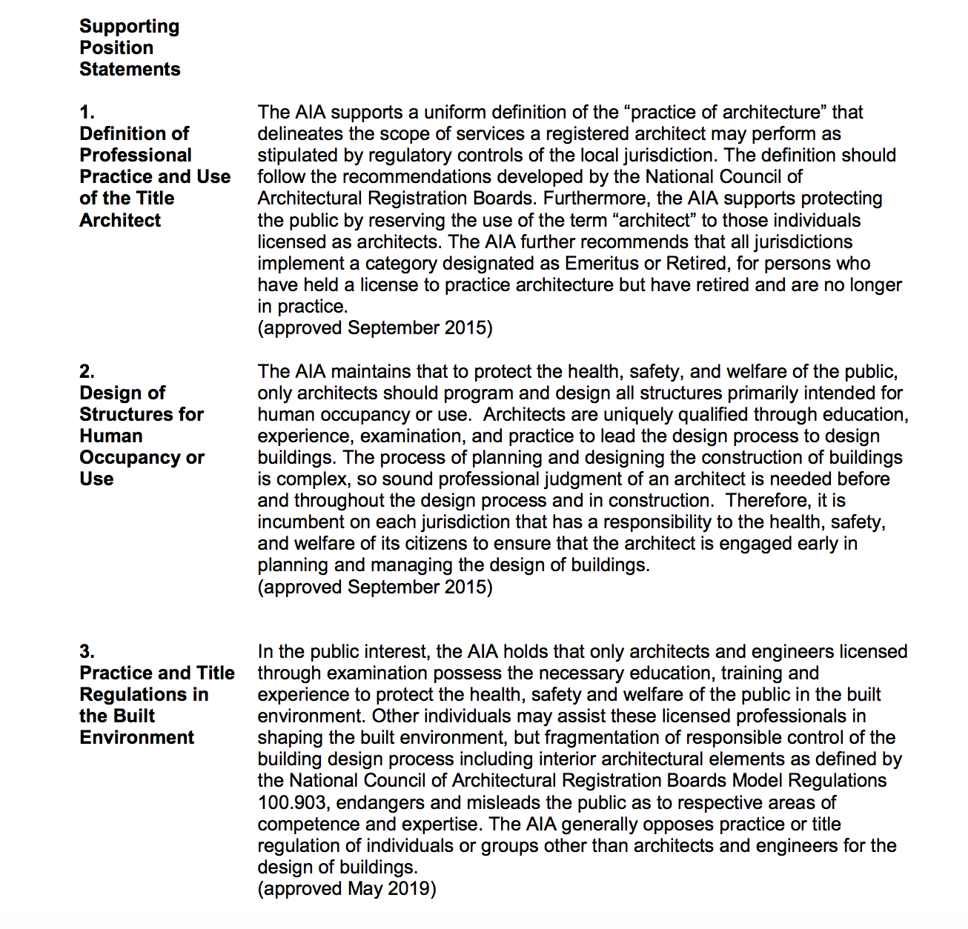
Position Statement Example
Source: American Institute of Architects.

Slide 32
Write a Position Statement
Take 10-15 minutes to create your own position statements about your organization.
Feel free to talk with the people around you for ideas.

Slide 33
Build a Legislative Agenda
Applicable to all levels of government.
Legislation can affect you directly and indirectly.
From position statement, build it into a legislative agenda.
Includes:
Background on policy issue.
Organization's relation to the issue.

Slide 34
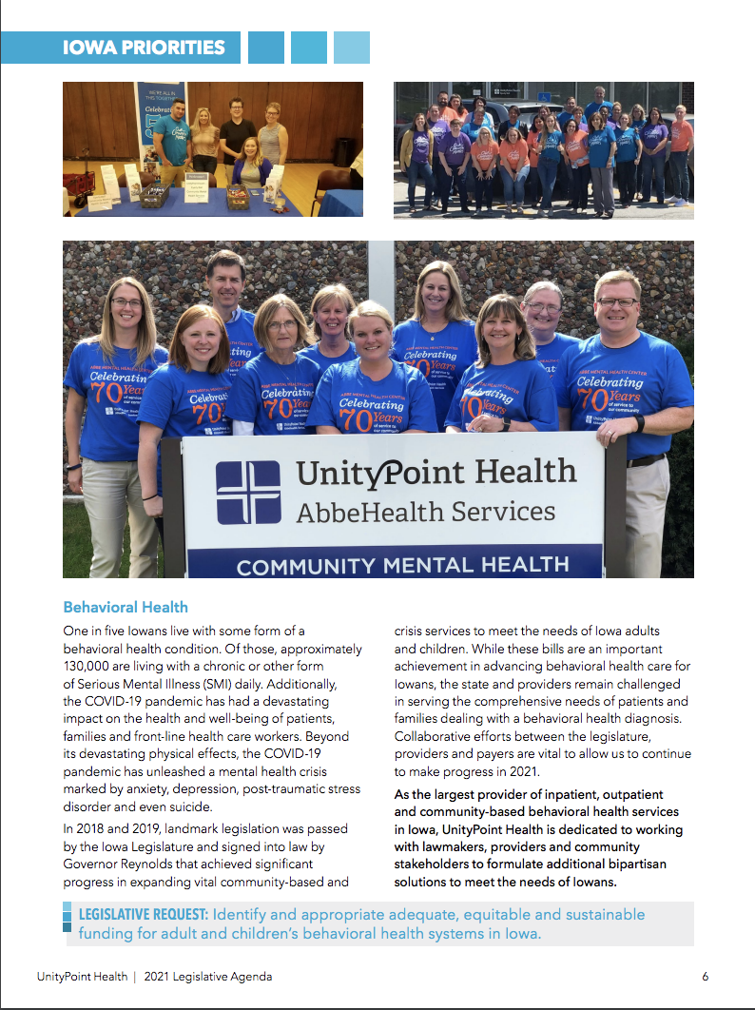
Build a Legislative Agenda
Example from UnityPoint Health.
Notes:
https://govaffairs.unitypoint.org/wp-content/uploads/000032-10_2021-Legislative-Agenda_Web_V04-1.pdf

Slide 35
Taking Action
You now know what your needs are to have an effective government advocacy program.
Next, we will discuss how to put that knowledge into action...
...after the break!

Slide 37
Best Tactics
Many ways of creating a strategy for an effective government affairs program.
Using media to tell your story.
Create a grassroots/volunteer network.
Reach out to a representative/government official.

Slide 38
Government Affairs in Action

Slide 39
What Can Your Organization Do?

Slide 40
Giving Public Testimony
Use your position statement to provide a framework to articulate your objectives in government affairs.
Cohesive, well-thought-out statements push your issues out in the forefront.
Take your case directly to Congress by being a part of a hearing.
Can also register public comments at government agencies.

Slide 41
Prepare for Public Testimony
Attend or watch other hearings to get a sense of the process.
Get notifications on bills or hearings or sign up for updates from advocacy organizations.
Keep current on news pertaining to bill/proposal.
Read the bill/proposal.
Learn testimonial guidelines.
Draft testimony and submit in advance.
Practice, Practice, Practice!
Notes:
https://deathwithdignity.org/learn/how-to-testify-public-legislative-hearing/

Slide 42
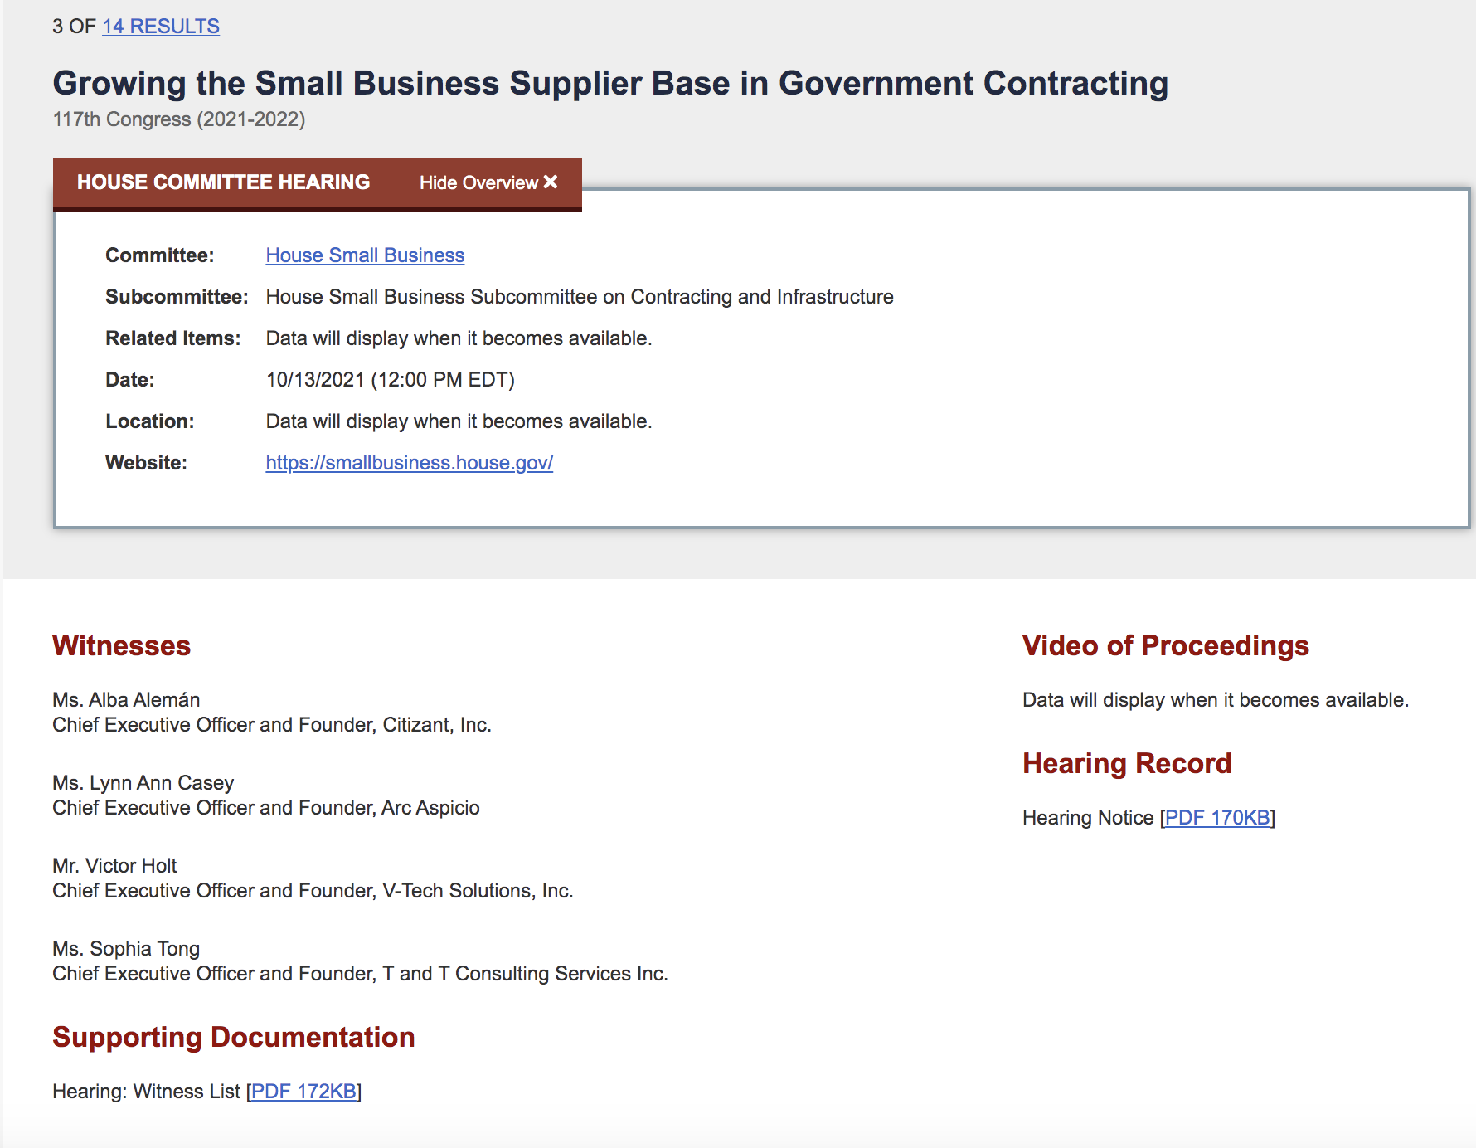
Examples of Public Testimony Schedule:
From the U.S. House of Representatives.

Slide 43
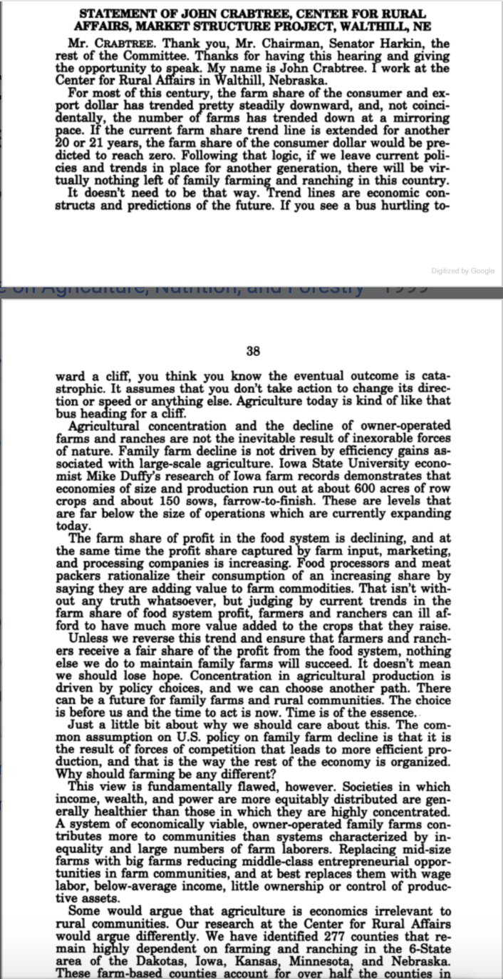
Structure of Public Testimony
The introduction provides historical background on the subject matter.
Testimony moves into the issues/research into it.
Conclusion makes recommendations or proposals to committee.
Notes:
Taken From: Agricultural Consolidation Antitrust
Hearing Before the Committee on Agriculture, Nutrition, and Forestry, United States Senate, One Hundred Sixth Congress, First Session ... July 27, 1999
https://www.google.com/books/edition/Agricultural_Consolidation_Antitrust/I56VFKAOcxIC?hl=en&gbpv=0

Slide 44
Example of Public Testimony
Notes:
Skip to 27:00 and watch that testimony as an example.

Slide 45
Use the Media to Tell Your Story
Media is a powerful tool in dealing with government affairs.
Many different forms to help promote your agenda:
Print
Radio
TV
Online
Social Media
Advertise, Advertise, Advertise!
Be public in talking to elected representatives.
Take your issue to the public and educate them.

Slide 46
Use the Media to Tell Your Story
Example of using media to promote advocacy (Courtesy: National Federation of Independent Business):

Slide 47
Draft Your Own Gov. Affairs Media Campaign
Partner up and consider what each of your own government affairs media campaigns could look like.
Things to consider:
The issue
Budget
Length of campaign
Who are you targeting?
Federal level or state level campaign?
Take 10-15 minutes to do this exercise. We will discuss when everyone is done.

Slide 48
Running a Grassroots Network
Government affairs needs a community of volunteers, advocates, and activists around it to:
Give legitimacy.
Grow awareness.
Gain allies.
Brand engagement
People can associate with more than just the product/cause.

Slide 49
Building a Volunteer Network
People share your advocacy goals from all backgrounds.
Bring in partner organizations who can provide connections and resources.
Keep them engaged.

Slide 50
Putting Your Volunteers to Work

Slide 51
Letters, and Emails, and Calls - Oh My!
Keeping your affairs out in the forefront.
Encourage your employees, volunteers, and advocates to actively contact elected officials when the time comes.
Whether it is through email, letters, or calling, these tools make a difference.
Encourage people to draft their own personal comments instead of boiler plate material.
Elected officials will pay more attention to personalized comments.

Slide 52
Gov't. Affairs During Recesses
Target representatives when they are on congressional recess and are home.
Look for town halls to attend and organize.
Schedule meetings in their district office with them or a staffer.
While they can't introduce or vote on legislation during recess, it allows the legislator to consider the issue.
Make sure to follow-up with the member of Congress when the session resumes.
Notes:
Source: https://nlihc.org/sites/default/files/AG-2021/02-15_Best-Practices-Tips-for-Advocacy-and-Lobbying.pdf

Slide 53
Effectively Advocating in the Government
Schedule a face-to-face meeting with a legislator or staffer.
Take a conversational approach.
Work to build a relationship.
Connect your issue to something that can be relevant to the elected official.
Notes:
https://nlihc.org/sites/default/files/AG-2021/02-15_Best-Practices-Tips-for-Advocacy-and-Lobbying.pdf
Healthcare and veterans' I.e.

Slide 54
Need Additional Support?

Slide 55
Prominent Government Affairs Firms
Cornerstone Government Affairs (CGA)
Holland and Knight
McKinsey & Company
Stateside Associates
Taft, Stettinius, and Hollister LLP

Slide 56
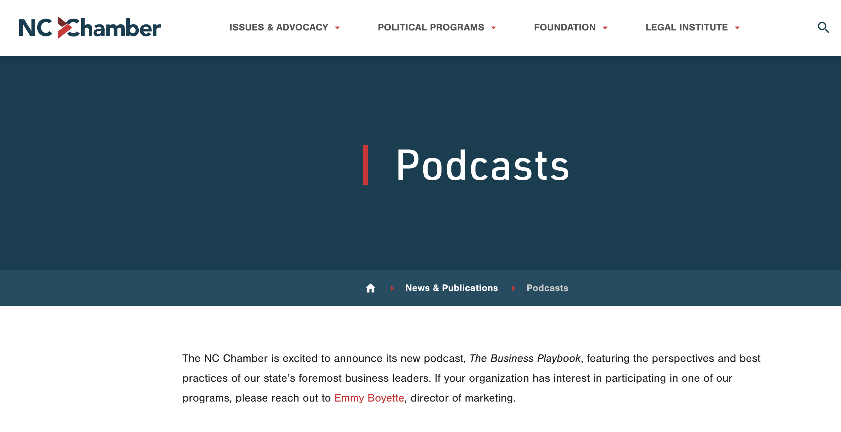
Chamber Resources
The Chamber of Commerce has multiple resources at your disposal.
Workshops
Conferences
Media Outreach
Social Media
Podcasts

Slide 57
An effective government affairs program puts significant leverage into whatever you are advocating for.

Slide 58
Review
From this class, you are now able to succeed in these course objectives:
Determining who should be involved in the program and why.
Creating a legislative policy.
Running a grassroots network.

Slide 59
Questions?

Slide 60
Thank You!

