Slide 1
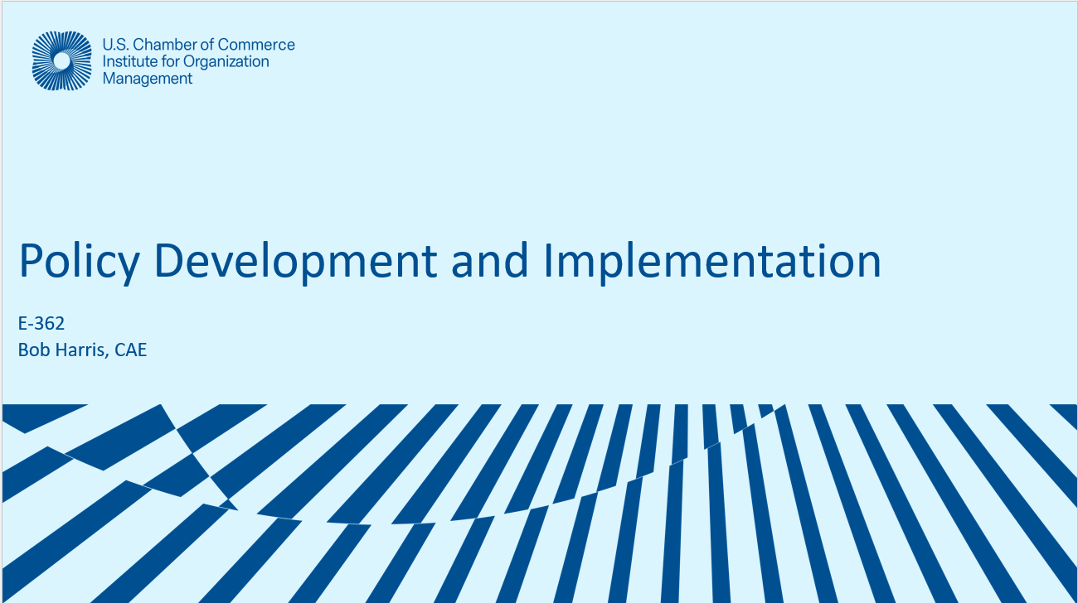
Policy Development and Implementatoin
Bob Harris, CAE
www.nonprofitcenter.com

Slide 2
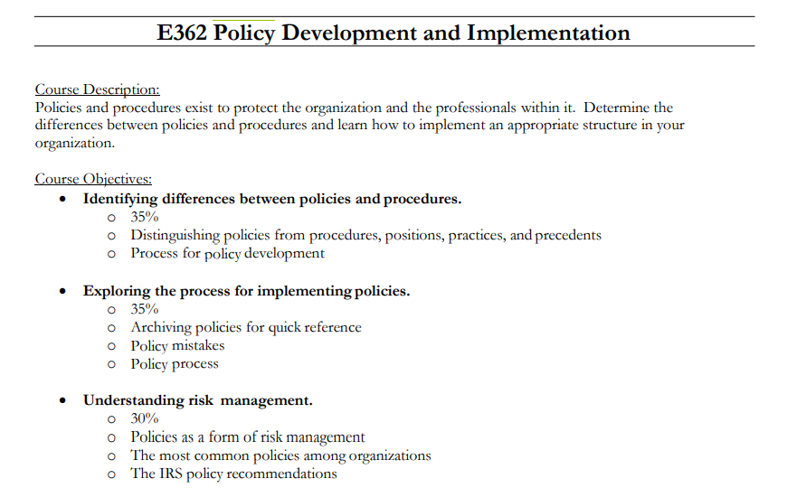
Policy Development and Implementation
Distinguish policy and procedures
Adoption and Implementation.
Risk Avoidance and Policies

Slide 3
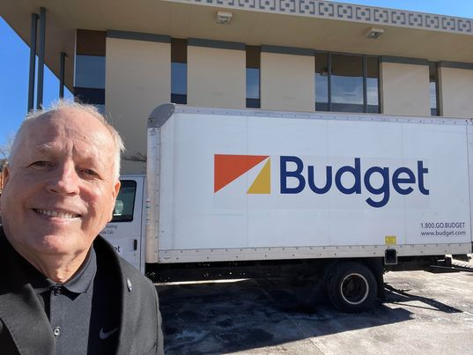

Unauthorized Committee Work
Unauthorized committee promotion to local media.
“We are raising money for disaster relief.”
Send funds to my office payable to “Disaster Recovery Special Fund.”
We reserve the right to refuse funds.
Misuse of assoc. LOGO and executive’s name/title.
Liability concerns? Authority?

Slide 4
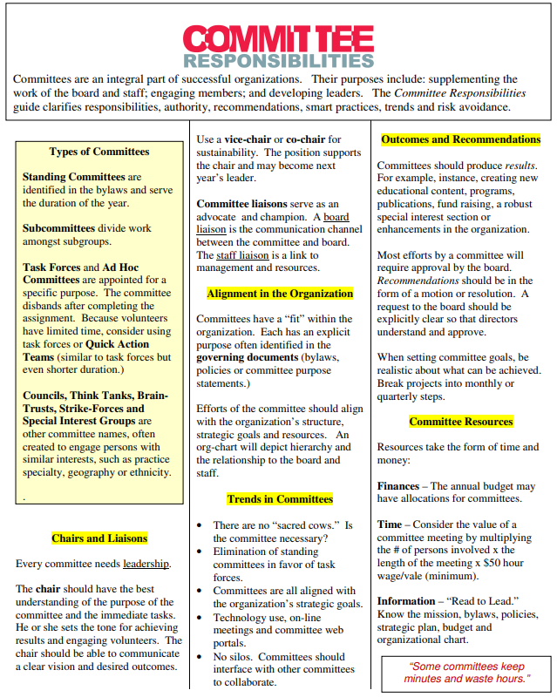
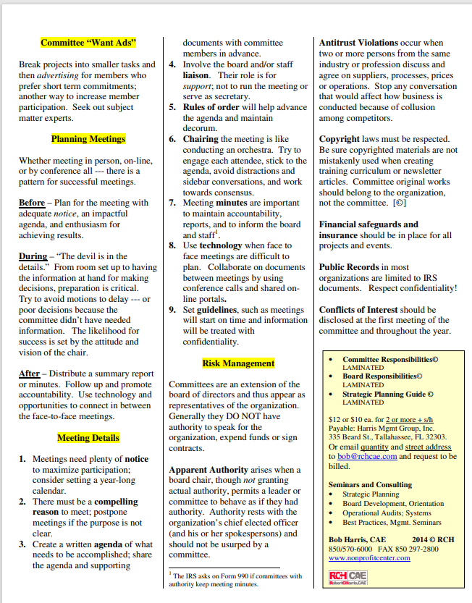


Committee Policies

Slide 5
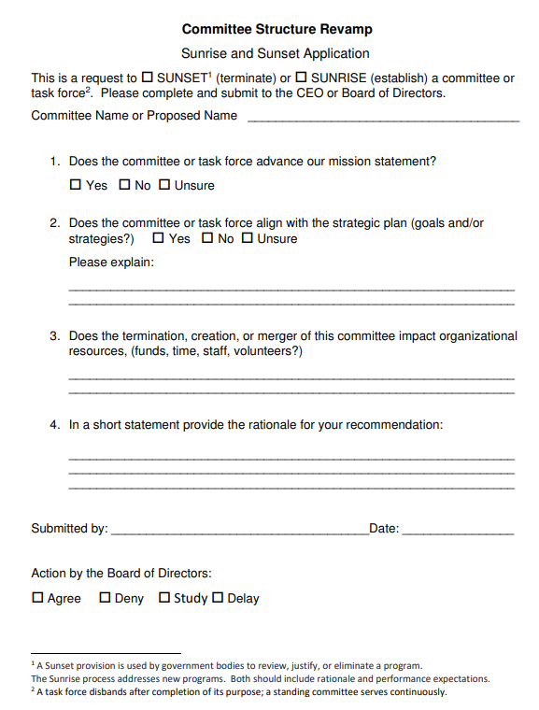

Committee Sunset

Slide 6
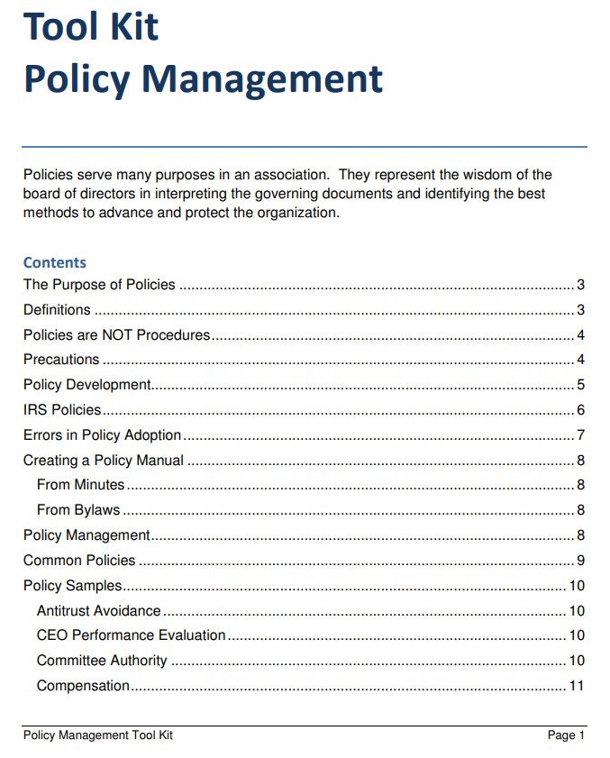


Slide 7
Policies are your friend!
Policies are NOT procedures.
Policies interpret the bylaws.

Slide 8



Read to Lead
Mission
(Purpose for existence)
Articles of Incorporation
(Relationship to state gov’t.)
Bylaws
(Relationship to members)
Policies
(interpretation of the governing documents)
Strategic Plan
(roadmap for the organization)
Annual Budget
(financial position)

Slide 9
Discussion Outcomes
Pg 2 TOC
Purpose of Policies
Policy or Procedure?
IRS Policy Questions
Policy Manual
Common Policies
Sunsetting Policies

Slide 10
Sarbanes Oxley Act
The Sarbanes–Oxley Act of 2002 is a United States federal law that mandates certain practices in financial record keeping and reporting for corporations.
IRS Form 990
Annual filing by exempt organizations including policy questions.

Slide 11
Identify the Policy Questions in IRS Form 990

Slide 12

IRS Form 990
Policy Questions

Slide 13
Background

Slide 14
P-Words
Policies (board driven)
Procedures (staff driven)
Precedent (been done before)
Practice (we always do it that way; never written down)
Positions (governmental)

Slide 15
Policy Definition
Pg 3
1 a : wisdom in the management of affairs
2 a : course or method of action selected from among alternatives and in light of given conditions to guide and determine present and future decisions
2b : acceptable procedures of a governmental body

Slide 16

Policy vs. Procedure
Pg 3
The wisdom of the board of directors for current and future actions.
Interpretation of the governing documents.
The processes or steps for managing staff duties, events, activities, etc.

Slide 17
How Polices Arise

Slide 18
Policies Arise Naturally
Issue at the board table.
Legal protection needed.
Documented best practices in governance.
Exec. Dir., Attorney or CPA recommends….

Slide 19
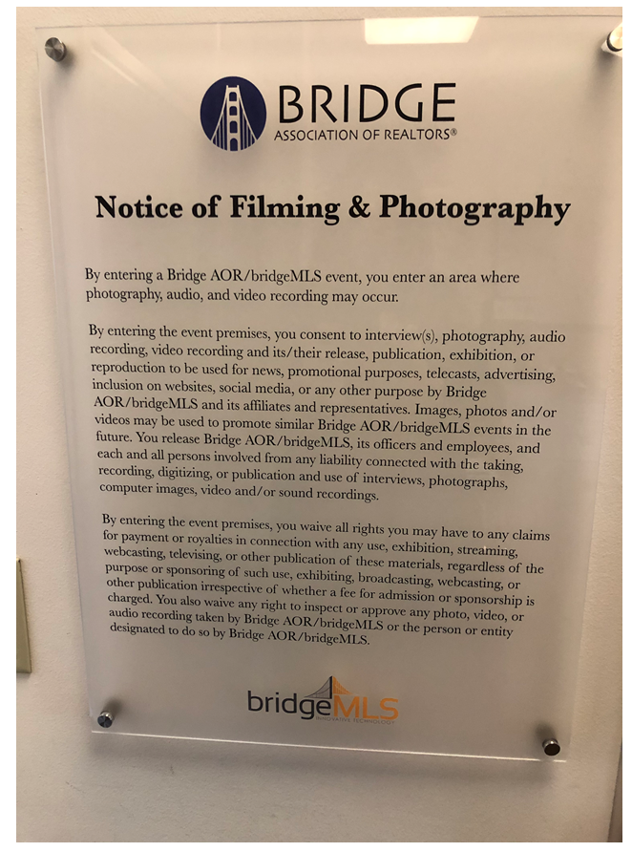
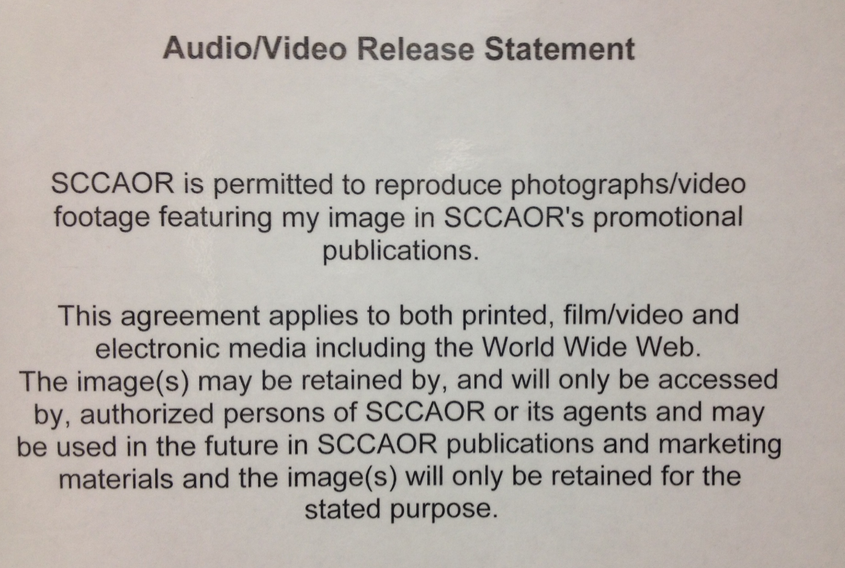
Marketing Photos

Slide 20
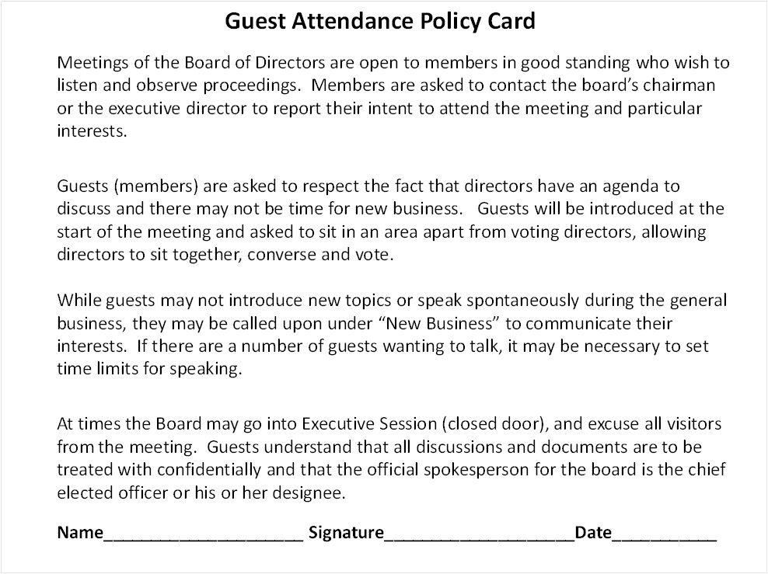
Guests at Board Meetings

Slide 21
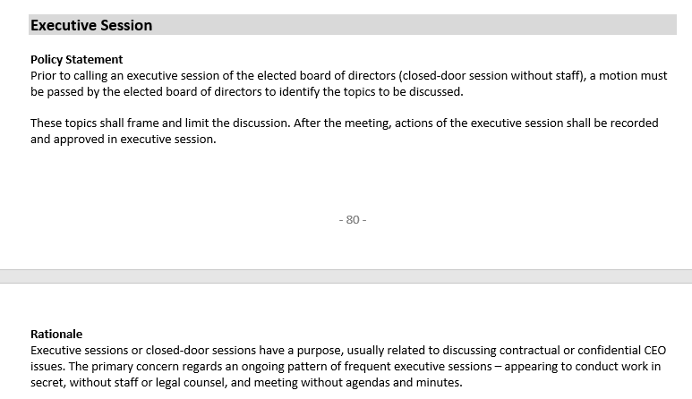
Executive Sessions - Policy

Slide 22
Policy – Who is Official Spokesperson?
No one shall purport to be an official spokesperson for the organization except the chief elected officer of the board of directors or a person or persons so designated.

Slide 23
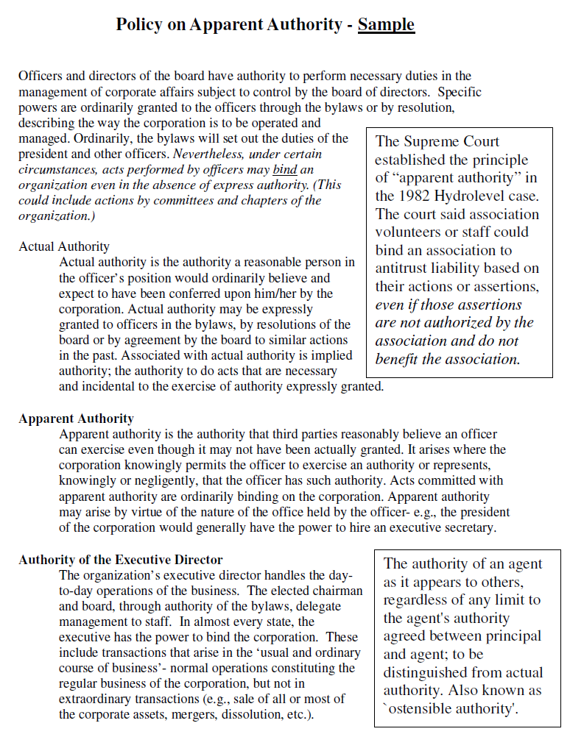
Pg 9

Slide 24
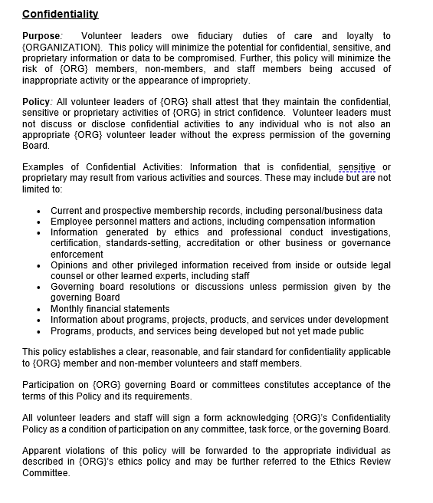
Addressing Confidentiality

Slide 25
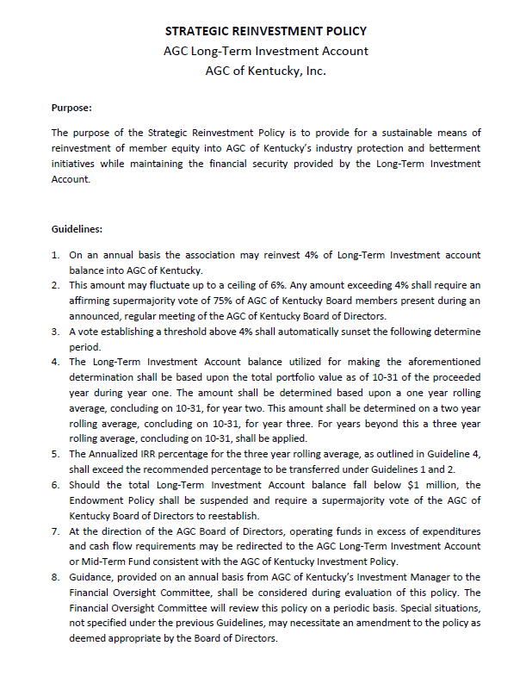
Using Reserves – Spend and Replenish

Slide 26
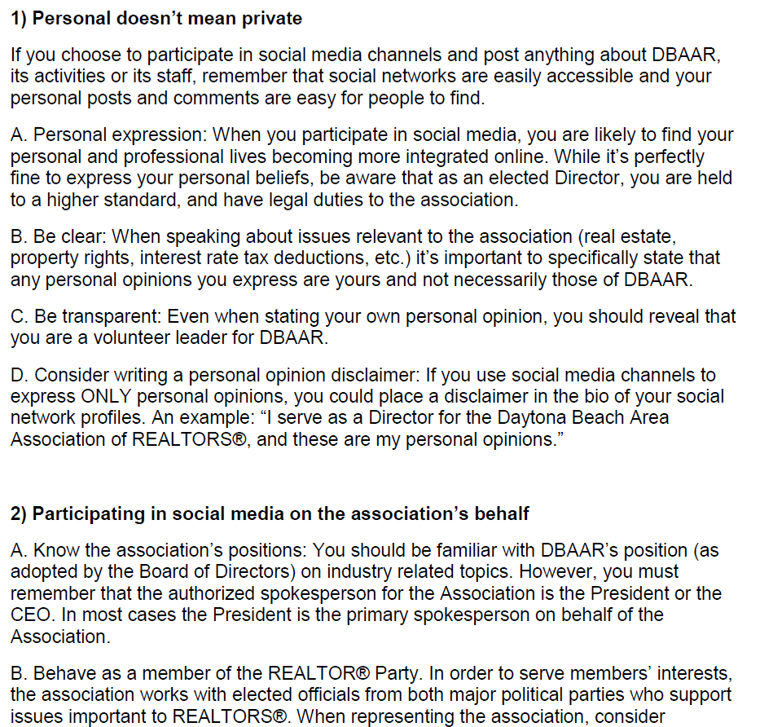
Social Media

Slide 27
Antitrust Avoidance
“We’ve got a supplier that won’t renew their membership….. we should tell the members to boycott them.”
“We don’t want that company in the expo – they have a bad reputation.”

Slide 28
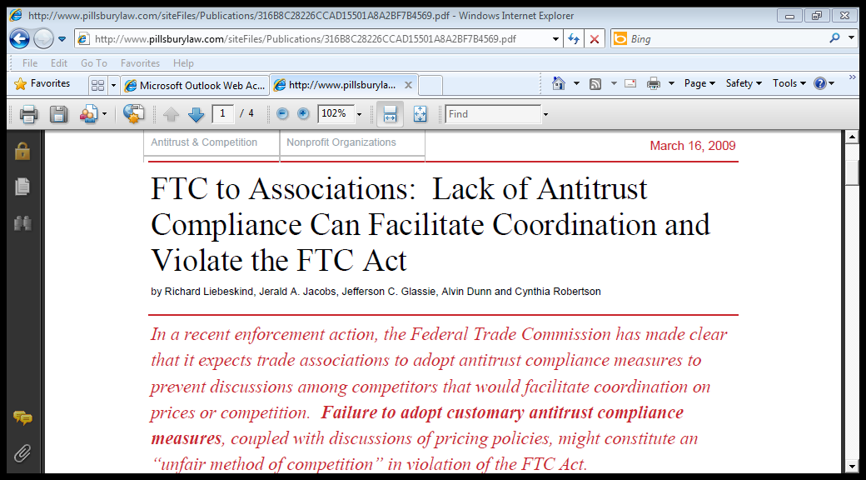
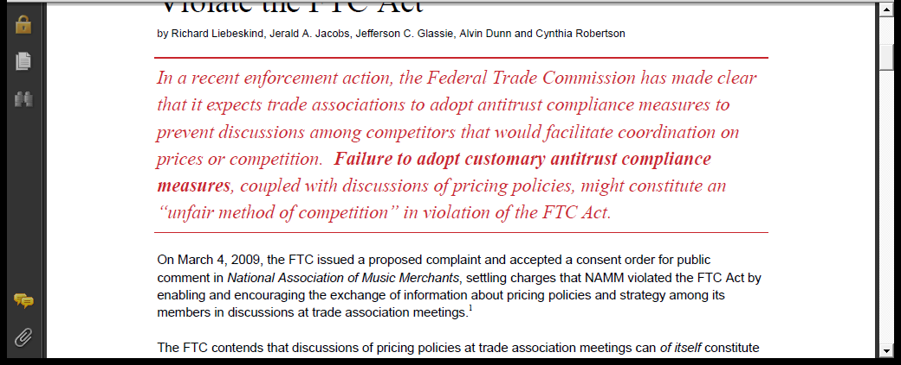

Slide 29
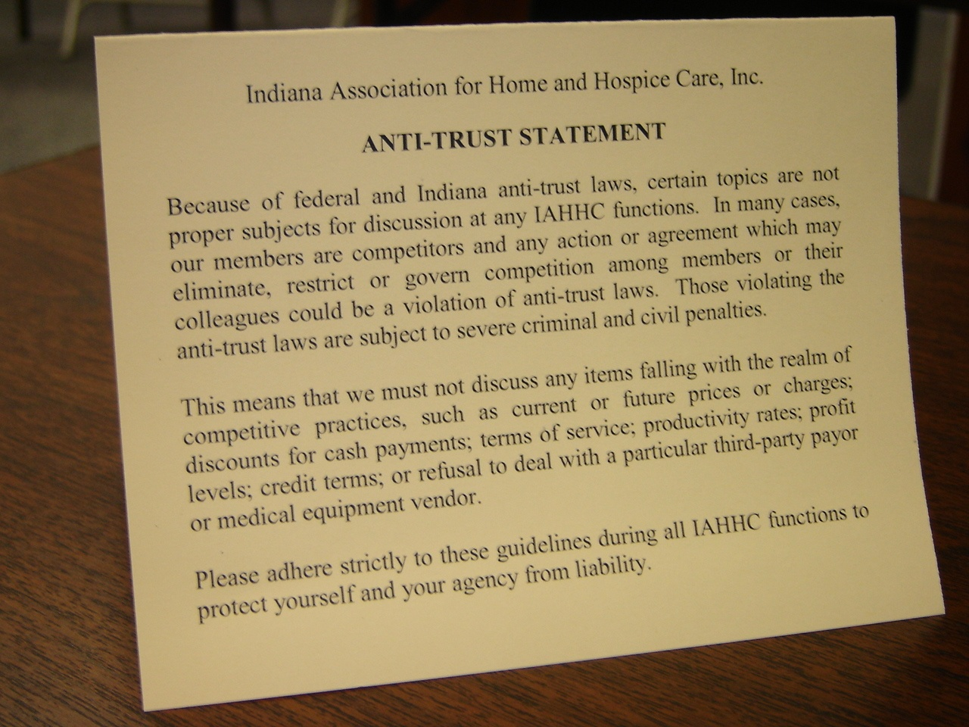

Slide 30
Committee Authority Policy
“Our committee made a motion to create bylaws and open a checking account; we think that’s smart for our activities.”
Policy: Committees work under the direction of the board. They do not have authority to speak for or contract on behalf of the organization.

Slide 31
Record Requests - Policy
Scenario: A member in good standing who is not on the board requested a copy of the organization’s financial position and proposed budget.
WHAT’S YOUR POLICY ON SHARING MINUTES, FINANCIALS, MEMBER LISTS, ETC?
The organization complies with all state and federal public record laws. Members in good standing may have access to documents so long as they maintain the same protocols of the board regarding confidentiality. Please make request in writing, with time to process. A member of the staff or an officer will provide access and explain.

Slide 32
Policy
Fundmentals

Slide 33
Uses of Policy
1. Authority - Empowerment and limitations for board and staff.
2. Continuity of operations (transitions.)
3. Clarity for volunteer leaders. (What and how do I govern?)*

Slide 34
Uses of Policy
4. Good Guy/Bad Guy -blame it on the policy.
5. Risk Management.
6. Staff Guide and understanding; history.
7. Defense

Slide 35
Policies Often Result in Procedures
Board - Governance Staff - Management
Pg 3
Policy
Example:
“The board mandates that an annual financial audit shall be conducted.”
Procedure Example
Provide documents for the audit
Involve the Treasurer and finance committee
Ensure time on the agenda for presentation of the audit to the board
Staff will recommend a CPA

Slide 36
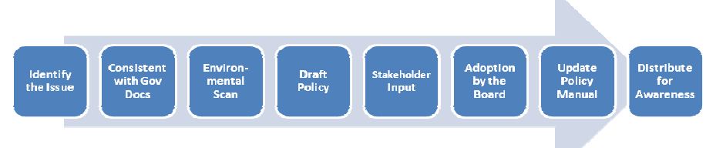
Drafting a Policy
Identify the Issue.
Consistent with Governing Documents.
Environmental Scan, Research.
Draft and Propose to Board.
Input by Committees.
Motion by the Board to Adopt.
Transcribe to Policy Manual.
Distribute for Awareness.

Slide 37
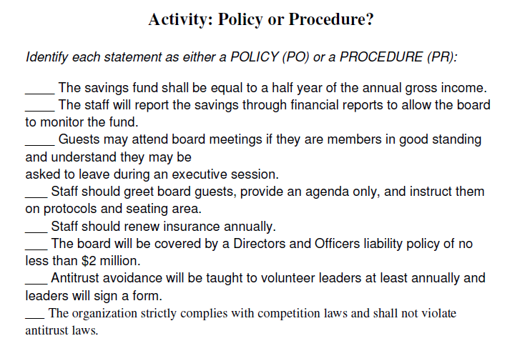
Pg 6

Slide 38
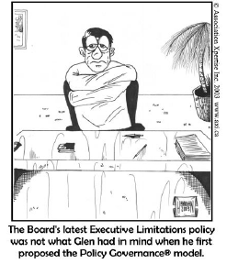
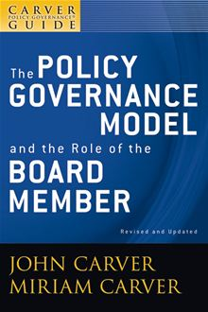
Pg 7

Slide 39
Errors in Policy Making
Pg 13
Let’s put it in the bylaws!
Conflict with other documents.
Policy overload at board table.
Archiving in the minutes.
Lack of research/scanning.
Policy mania – too many.
Policies >>> Procedures

Slide 40
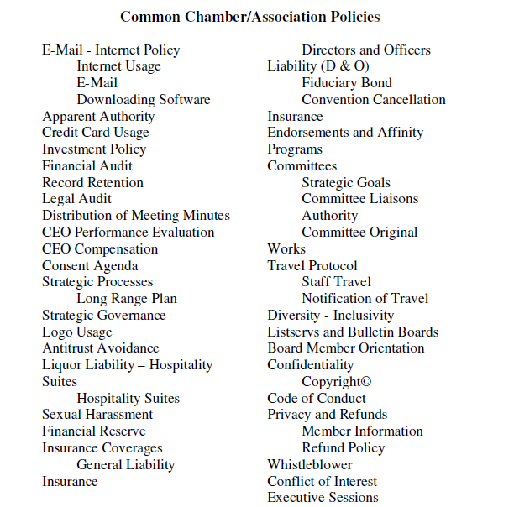
Common Policies

Slide 41
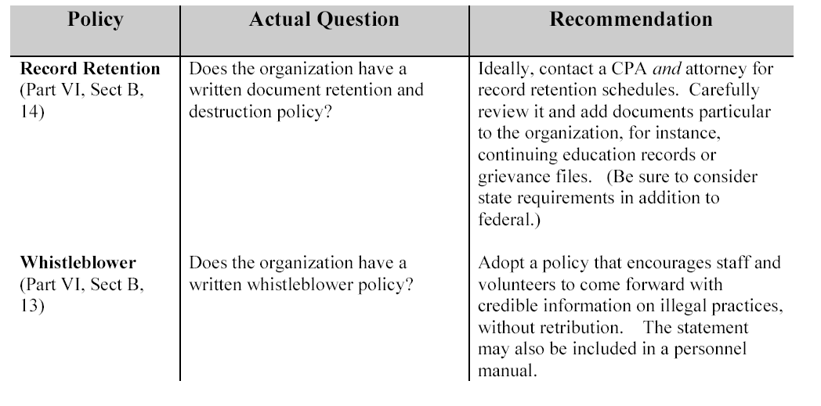
IRS Form 990 Policies
Pg 11

Slide 42
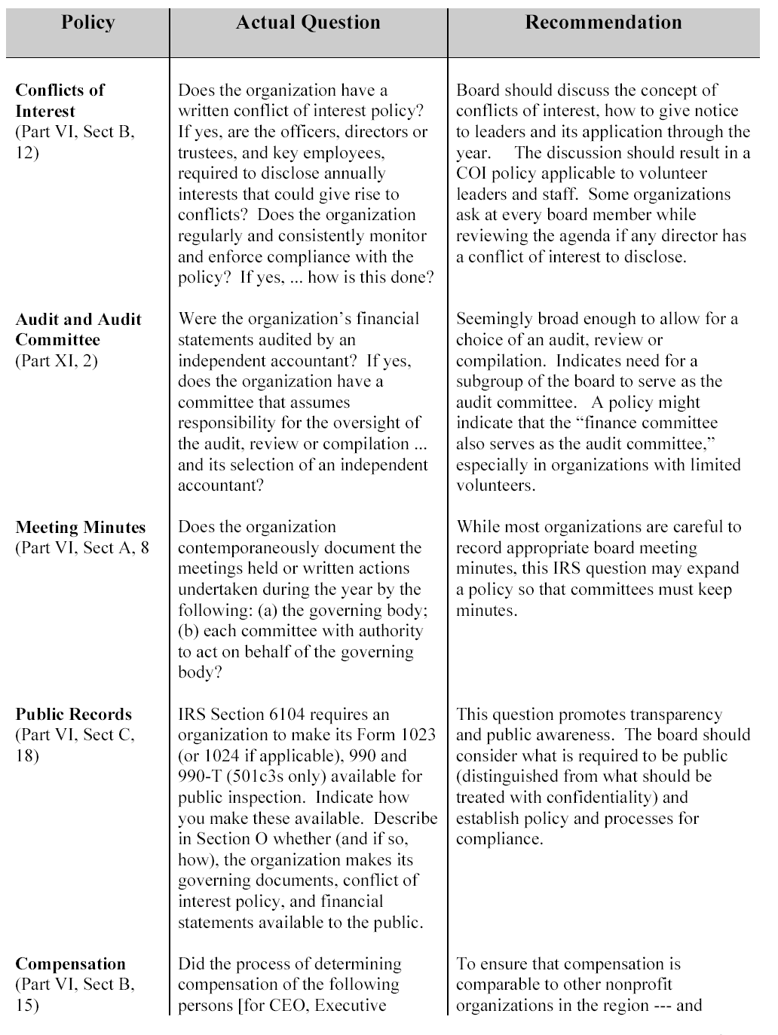
Pg 11-13

Slide 43
Pg 11-13

Slide 44
Policy Management

Slide 45
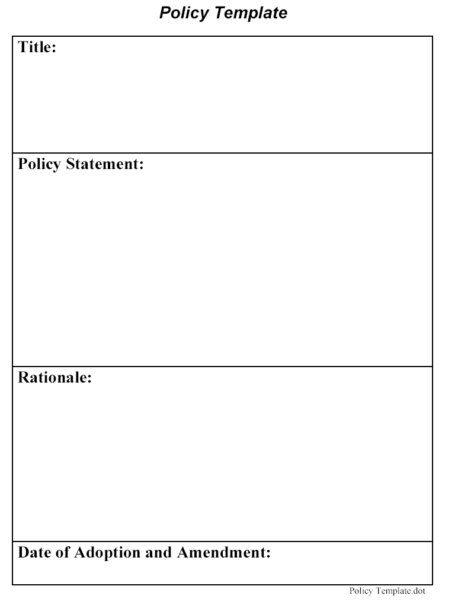
Pg 15

Slide 46
Pg 16

Slide 47
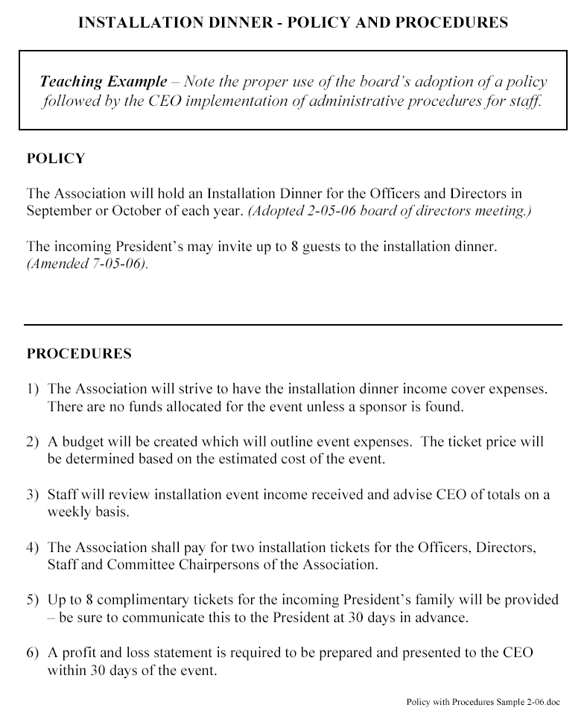
Policy & Procedure
combined

Slide 48
Create a Policy Manual
Pg 17
Copy 5 years of minutes.
Give to eager volunteer with yellow highlighter.
Highlight every motion that looks like a policy.
Assign to category and note date of passage.
Type into Word doc.
Board approves.
Set Categories
Awards - Scholarships
Board of Directors
Chapters
Committees
Education
Finances/Budget
Membership

Slide 49
Sunset or Update Policies
Periodic: Every 3 to 5 years
Elected Secretary and a Task Force
Staff Review/Attorney Review and Recommendations to the Board

Slide 50

Governing Notebooks
Leadership Manual
Policy Manual
Style Guide
Crisis Emergency Manual
Personnel Manual
Procedures Manual
Procedures
Board Manual
Policies
Emergency

Slide 51

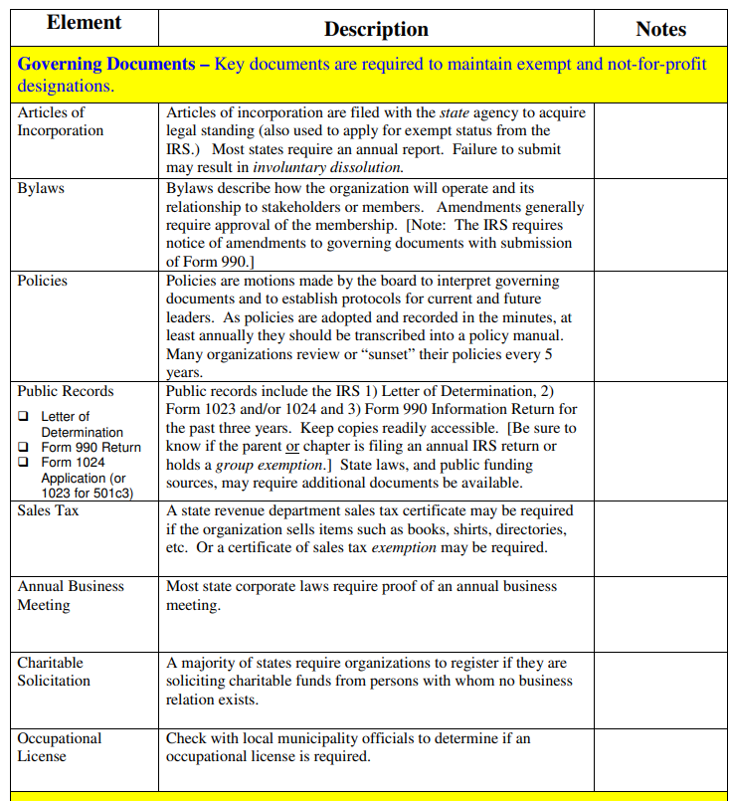


Slide 52
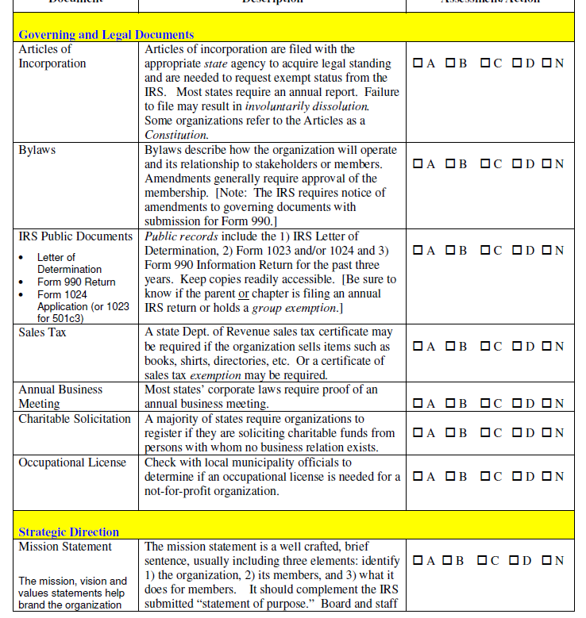

Slide 53
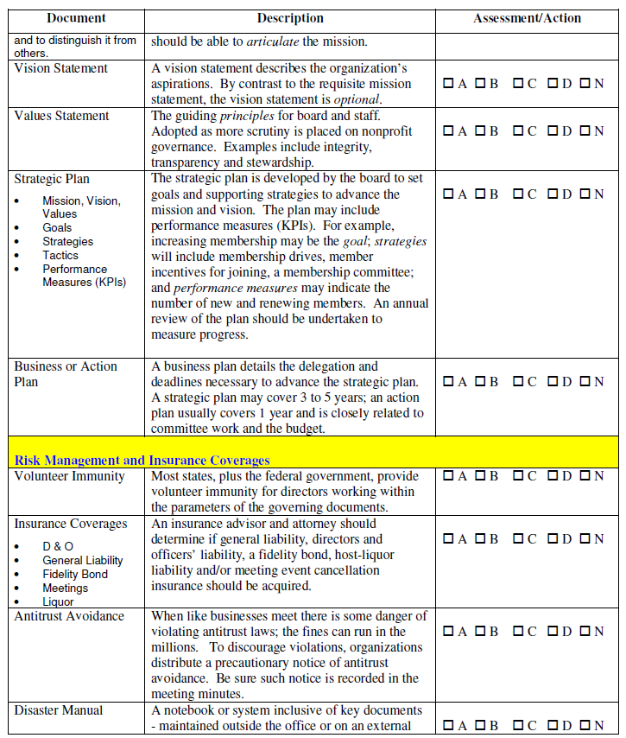

Slide 54
Summary
Authority, Limitations
Continuity in Operations, Perpetuity
Clarity for Volunteers, Transition
Good Guy/Bad Guy (blame it on a policy)
Risk Management for Organization
Staff Guide

Slide 55
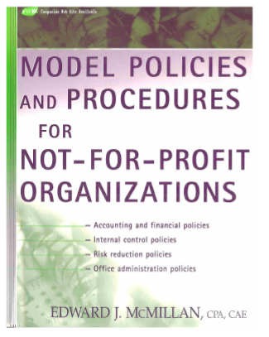
Resources
Policies & Procedures in Association Management (ASAE)
Benchmarking & Best Practices for Associations (Canada SAE)
Model Accounting & Financial Policies and Procedures Handbook (Ed McMillan, CPA, CAE)
Policy Governance Fieldbook (John Carver)
Policy Toolkit (Harris)

Slide 56
Consult Professionals
Before adopting policies, be sure to consult legal, accounting, insurance and financial professionals.

