Slide 2
Guide to Governance
C180
Kelle Marsalis, IOM, CCE
Plano (TX) Chamber
Midwest Institute 2022

Slide 3
Course Description
A sound governance structure is needed to ensure success at all levels of an organization. Create a great organization through strong relationships with volunteers.

Slide 4
Discussion Topics
Building a solid governance structure.
Enhancing volunteer support for governance.
Reviewing key governance documents.

Slide 6
Governance?
Governance literally means the action or manner of governing.
For us, governance encompasses the system by which an organization is controlled and operates, the mechanisms by which it, and its people are held accountable.

Slide 7
Three functions of governance
Strategy
Setting the strategic direction and vision. Advancing the organization’s multi-year strategic plan.
Policy
Creating policies (internal) and positions (external) to benefit members and advance the mission.
Oversight
Overseeing resource allocation, including the adoption of the annual budget, and evaluating performance of programs, products and services.

Slide 8
WHO’S WHO IN GOVERNANCE
MEMBERS
The partnership of business and professional people working together for the betterment of the business community/industry and community at-large.
BOARD OF DIRECTORS
The individuals elected by the members to direct the affairs of the organization. This is the Policy-Making Level.
OFFICERS
The individuals elected by the Board – the Executive Committee. This is the Direction Level.
STAFF
The President/CEO (paid staff) is hired by the Board of Directors. This individual is responsible for the day-to-day management of the organization. He or she is also responsible for employing and managing the staff. This is the Management Level.
COMMITTEES
Committees are the membership of the organization working in small groups (task forces and committees) to achieve the organization’s objective.
This is the Planning and Action Level.

Slide 9
BOARD OF DIRECTORS

Slide 10
A Board’s Many Roles…
The Board’s Relationship to Organization Policy
Their status is that of an individual acting in a legislative capacity. You have the right to exert your influence with the Board for approval of actions and policies, but your authority does not go beyond your vote. You have no authority as an individual to commit the Chamber or Association to any action or policy.
The Board’s Relationship to the Public
They are an official representative of the membership. They are also an unofficial representative of the entire community. They should defend the organization against criticism and take steps to remedy conditions that cause justified criticism.

Slide 11
A Board’s Many Roles…
The Board’s Relationship to the Professional Staff
The Board’s responsibility for the professional staff is limited to that of advisor. The chief paid executive is responsible for the hiring and functioning of the staff.
The Board’s Relationship to Committees, Task Forces
They have a responsibility to keep informed about the activities of all committees and task forces because they may be asked to act on their recommendations. The Board also has a responsibility to see that all committees and task forces operate within the established structure.

Slide 12
A Board’s Many Roles…
The Board’s Relationship to the Program of Work/ Strategic Plan
The Board must understand the relationship between the Board and the organization’s Program of Work/ Strategic Plan in order to reach established objectives. Remember that a Program of Work/ Strategic Plan charts a future course of action, establishes timelines for completion, furnishes measurements for performance. They are an active participant.
The Board’s Relationship to the Budget
Financial support of the Chamber or Association is through annual investments voluntarily made by business, industry, and individuals. The Chamber operates on a budget approved by the Board. It is the responsibility of Chamber management to get maximum results from available funds and to operate within the approved budget, and the Board has a fiduciary responsibility to make decisions in the best interest of the organization.

Slide 13
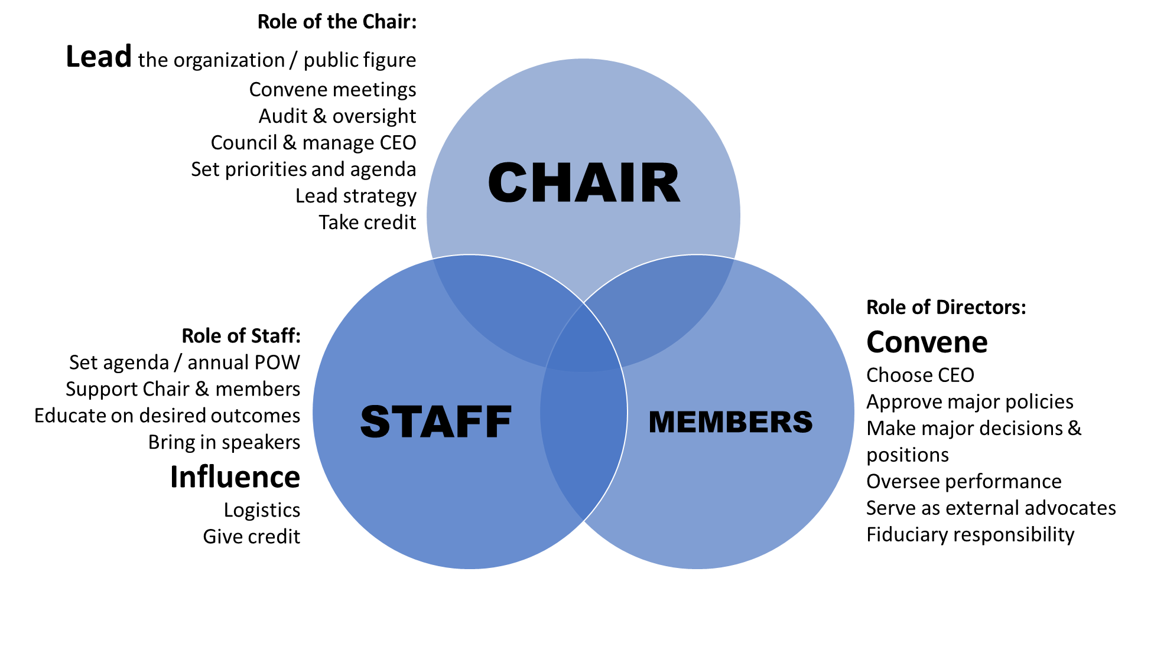
Board Roles

Slide 14
EFFECTIVE BOARD MEETINGS
AGENDAS
Discussion Items
Minutes
Create with Chair
Consent agendas
Speakers
Approval of items / Action items
Desired outcomes should be visible
Share ahead of time
Informational – background, white paper, bios
Time for discussion
Recap of recommendation
Walk away having accomplished something
Be brief, but record any and all decisions
Accurate attendance
No need to record names on votes
Consent Agenda Items:
Program reports
Financial reports
Minutes
Upcoming events
Important FYI

Slide 15
BOARD DIVERSIFICATION KNOW YOUR COMMUNITY MAKE-UP KNOW BOARD STRENGTHS AND GAPS HAVE CLEAR SUCCESSION PLAN
DIVERSIFY YOUR BOARD BY DOING IT ON PURPOSE.
STOP RECRUITING PEOPLE BASED ON YOUR CULTURE

Slide 16
BOARD ELECTION DRIVEN BY BYLAWS SPECIFIC PROCESS TRANSPARENCY
WORK YEAR-ROUND TO RECRUIT BOARD MEMBERS
YOU HAVE TO STEP AWAY FROM TRADITIONAL RULES TO GROW

Slide 17
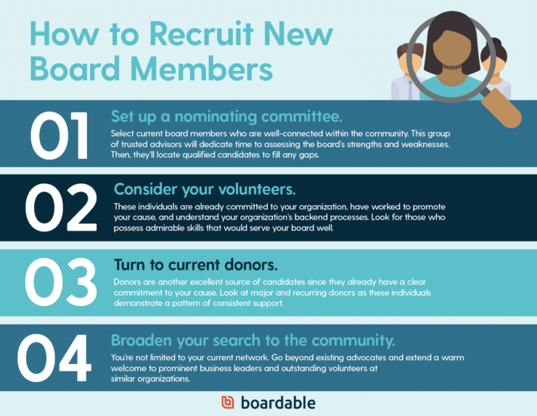

Slide 18
COMMITTEES

Slide 19
COMMITTEE VS. TASK FORCE
COUNCIL
COMMITTEE
TASK FORCE
Advisory
High-level
leadership
Larger group
Not working
Informational
Provides info or guidance
Expertise or
similar group
Varied roles
General
Leadership
Varied in size
Working or not working
Provides recommendation, researches
Varied
backgrounds &
points of view
“Do-ers”
Less staff
oversight
Small
Working
Takes action,
takes direction
Diverse based
on need
Ends with project

Slide 20
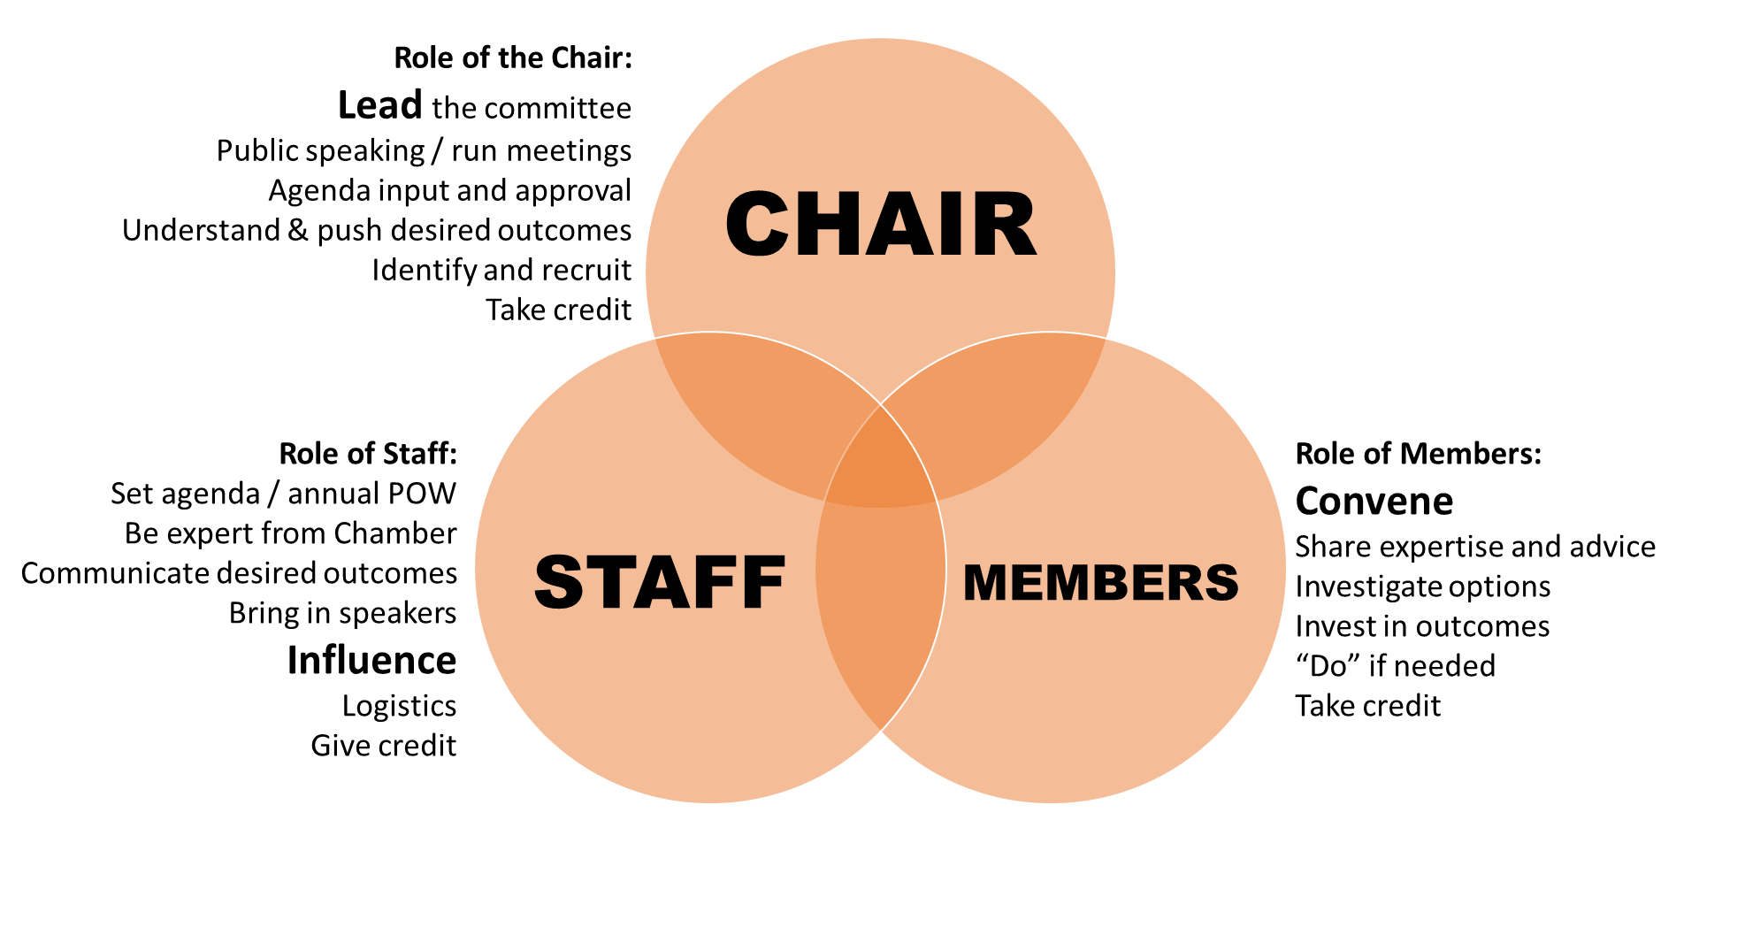
Responsibilities of Committees

Slide 21
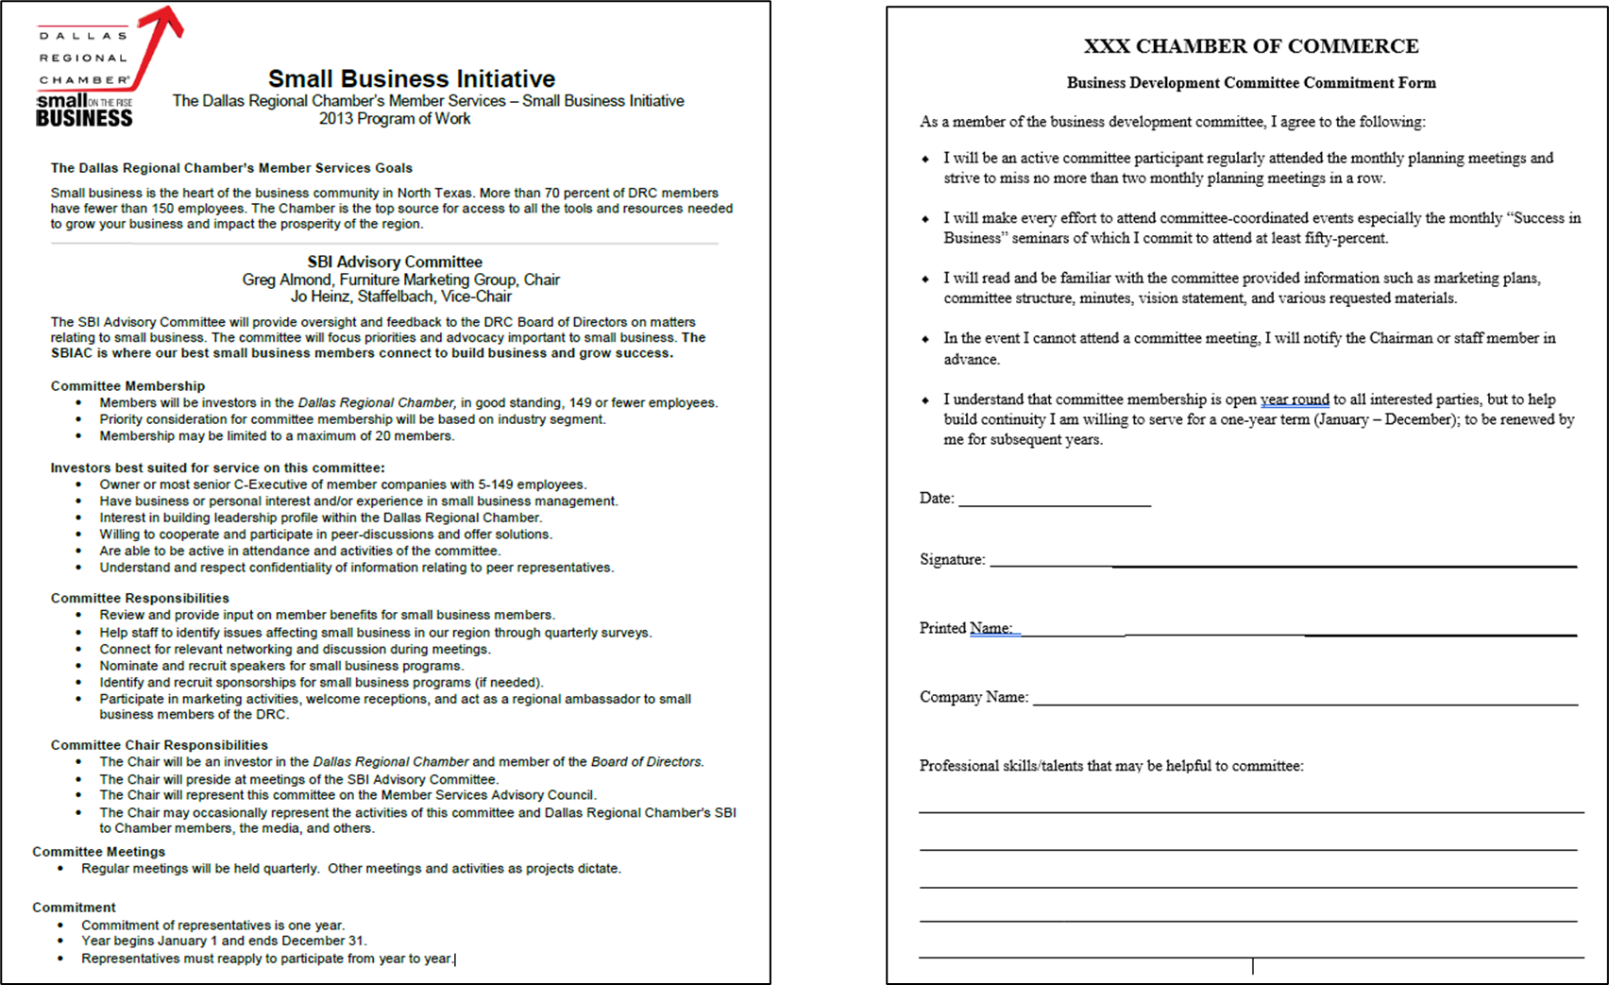

Slide 22
EFFECTIVE COMMITTEE MEETINGS
AGENDAS
COMMITTEE WORK
Minutes
Create with Chair or standing
Speakers
Approval of items / Action items
Desired outcomes should be clear
Share ahead of time
Informational – background, white paper, bios
Time for discussion
Recap of recommendation
Walk away having accomplished something
Don’t take minutes at committee level
No need to record names if you do
Keep committee members accountable with reminders on actions & deadlines

Slide 23
Case Study: Dallas Regional Chamber
Building a more inclusive & impactful Chamber through governance

Slide 24
CASE STUDY:
DALLAS REGIONAL CHAMBER

Slide 34
Establishing Priorities
How to attract and keep Board members engaged

Slide 35
Establishing Priorities
Strategic Plan
A multi-year strategy and program of work is key to driving impact for members and your constituency. The Board should help create this long-term plan, as well as use it as a guiding star throughout their terms.
Board Orientation
Spend some time here. Don’t assume because your new Board members have served before, that they know anything. And don’t let them bring bad habits with them.

Slide 36
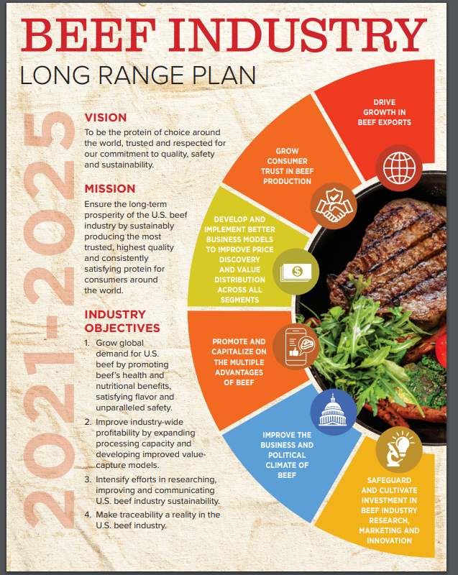
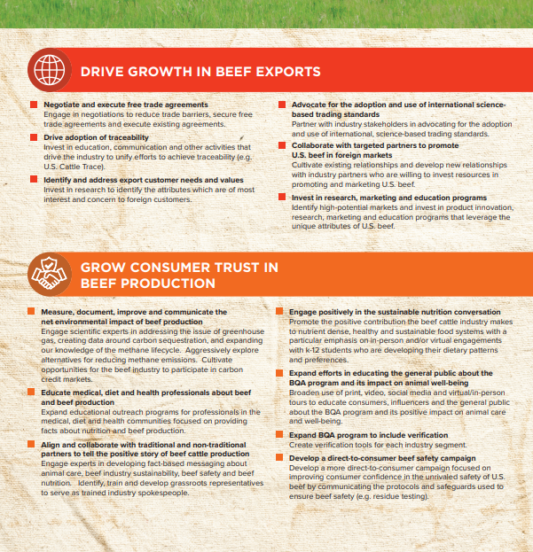
Strategic Plans

Slide 37
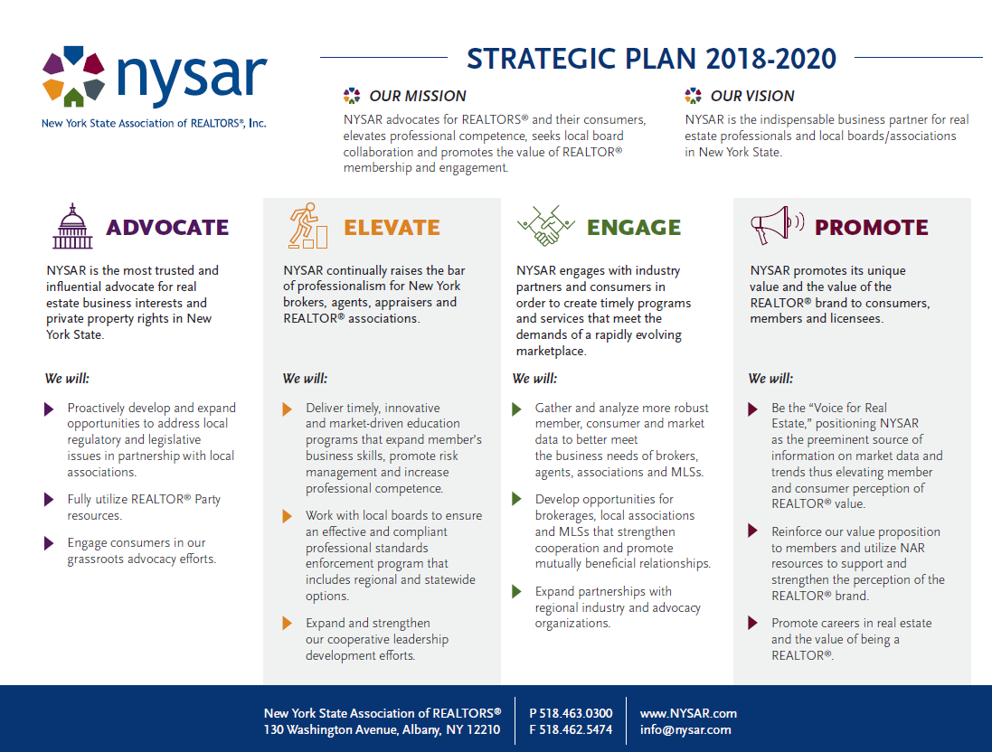
Strategic Plans

Slide 38
Strategic Plans

Slide 39
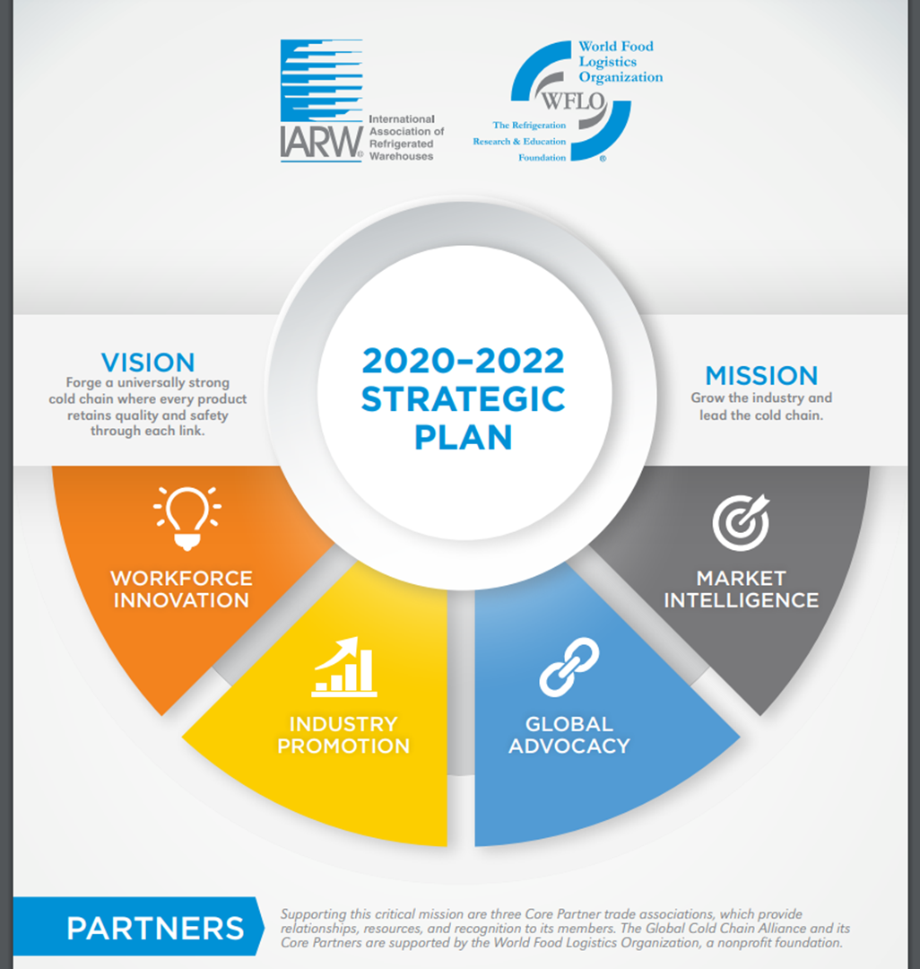
Strategic Plans

Slide 41
Board Orientation

Slide 42
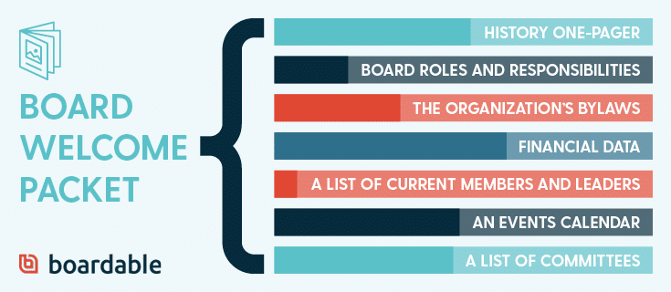

Slide 43
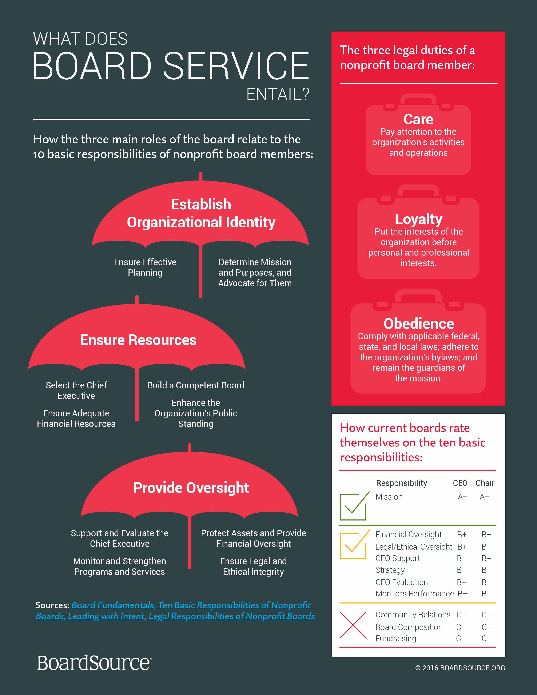

Slide 44
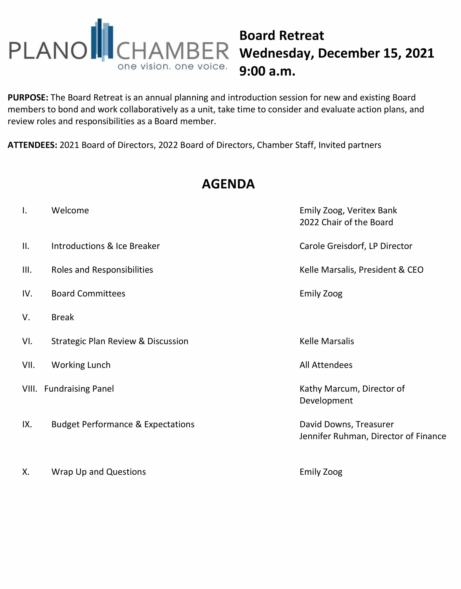
Establishing Priorities
Annual Retreat
Annual planning meetings can be a great reset for Boards. Even high performing Boards go through some burn out or ‘lighter’ times. Get your board together annually to discuss challenges, opportunities, and re-emphasize your mission and purpose.

Slide 45
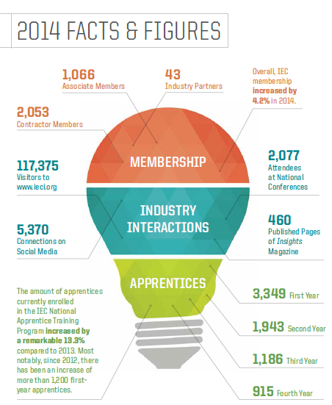
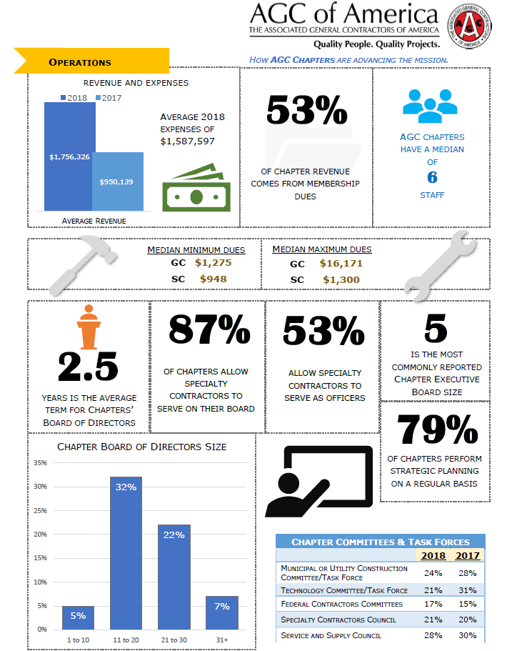
Establishing Priorities
Dashboard
A dashboard can be effective as a tool to SHOW the health of the organization, being transparent on strategic goal status, or highlighting successes and areas for more support from the Board.

Slide 46
Keeping Board Members Engaged is Hard Work
Brevity in meetings and asks
Set the meter (what are you measuring)
Teach roles and responsibilities and remind them
Follow a GOOD strategic plan*
Get the right people in the room with them
Design your agenda carefully
Know everyone’s strengths and keep them in their lanes

Slide 47
Governance Documents
Must-haves

Slide 48
Governance Documents
Statement of Purpose, or Mission
The formal summary of the aims and values of an organization
Articles of Incorporation
Sometimes called a certificate of formation, articles are a set of documents filed with a government body to legally document its creation.
Bylaws
The governing rules by which an organization operates. Includes procedures for selecting board members, meeting requirements and defines membership.

Slide 49
Governance Documents
Policy Manual
A policy manual is a coded document that outlines all the necessary rules and best practices that the employees and members must follow. THERE IS A DIFFERENT IN PROCEDURES.
Budget
Sometimes called a certificate of formation, articles are a set of documents filed with a government body to legally document its creation.
Bylaws
The governing rules by which an organization operates. Includes procedures for selecting board members, meeting requirements and defines membership.

Slide 50
POLICIES

Slide 51
Policies
Policy
The formal guidance needed to coordinate and execute activity. POLICY PROVIDES THE OPERATIONAL FRAMEWORK WITHIN WHICH THE INSTITUTE FUNCTIONS.
Policy vs. Procedure
If policy is what the organization does, then procedure is how it does it. Boards will help set policy, but shouldn’t get into the weeds on procedure. That’s your job.
Policies are…
Widespread application (applicable to all)
Change less frequently
Answers major operational questions/issues

Slide 52
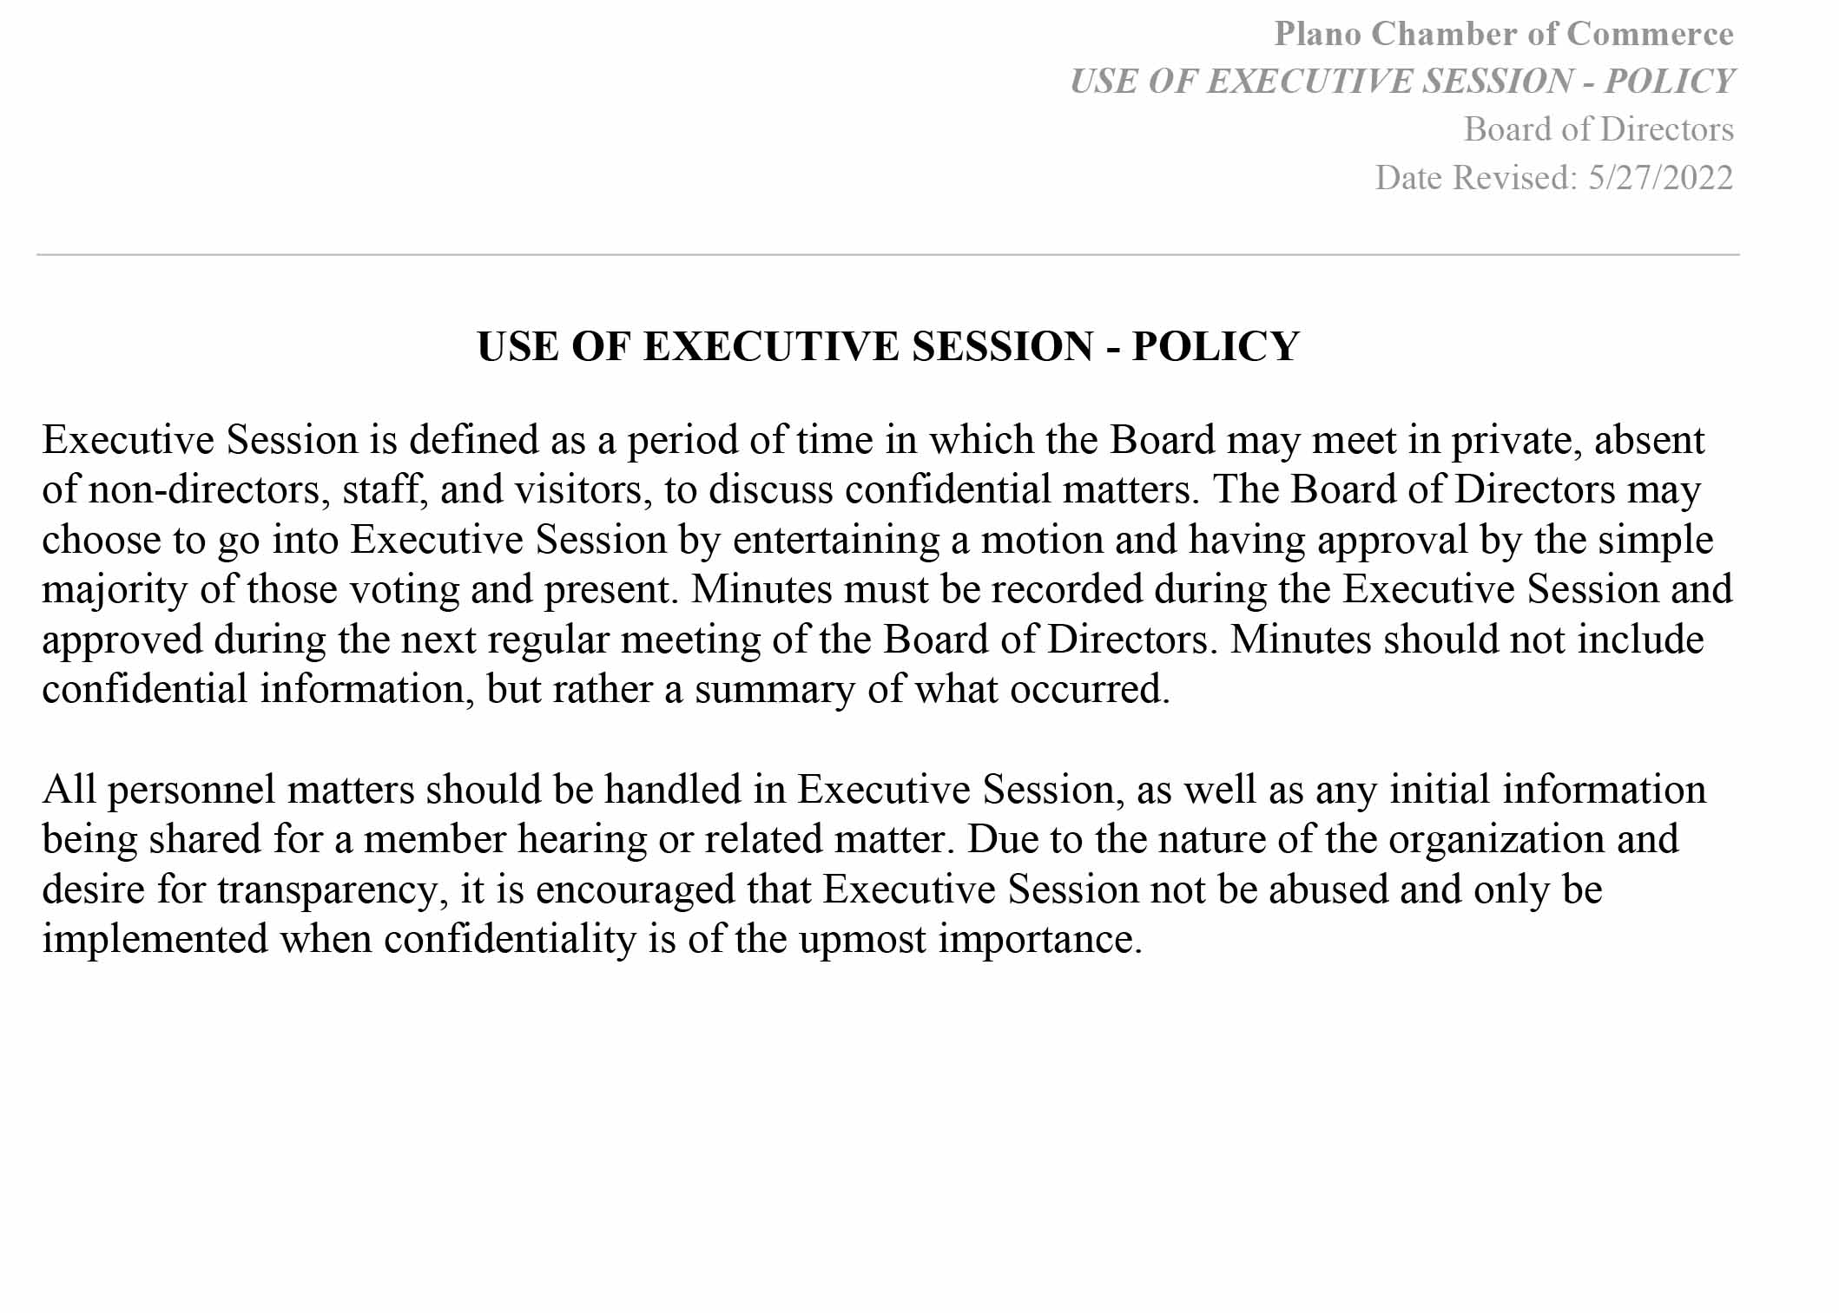
Policies
Written Policies Should Include…
WHO, WHAT, WHEN, WHY, HOW, in a standardized language/format
Types of Policies
Governing
Operating
Personnel
Social Media

Slide 53
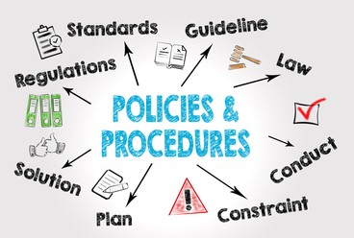
Policies
Good Policies…
Are written in clear, concise, simple language
Address WHAT the rule is, rather than how to implement
Are readily available
Designate policy “experts” who are readily available
Represent a consistent and logical framework for action
Allow you to accomplish things, but also save you from trouble

Slide 54
Governing Policies
Roberts Rules of Order
Code of Conduct
Board/Volunteer Expectations
Financial Policies
Investment Policies

Slide 55
Operational Policies
Event refund policy
Photo policy
Membership policies for various types
Anti-harassment policy

Slide 56
Personnel Policies
Employee Handbook
Nondiscrimination policy
Gift policy
Dress code
Paid time off
Pay policies
Attendance policies
Management structure

Slide 57
IRS Form 990

Slide 58
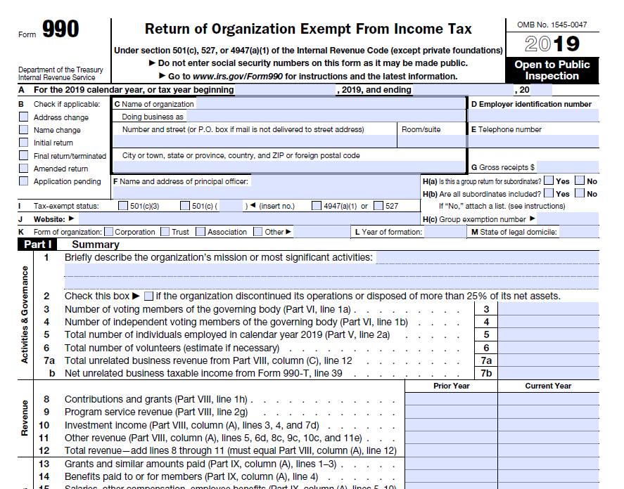

Slide 59
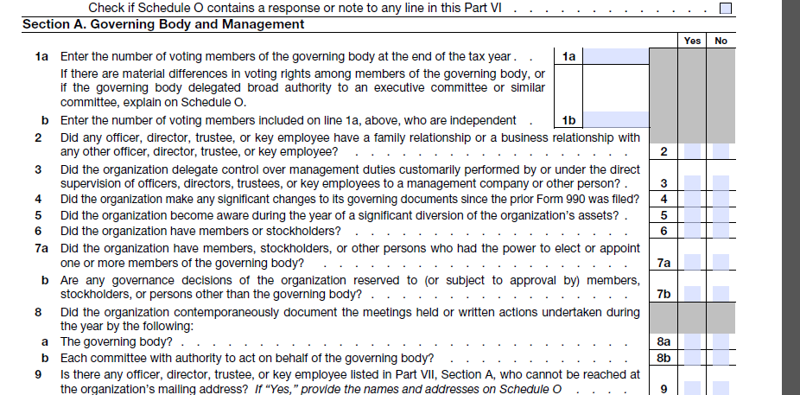

Slide 60
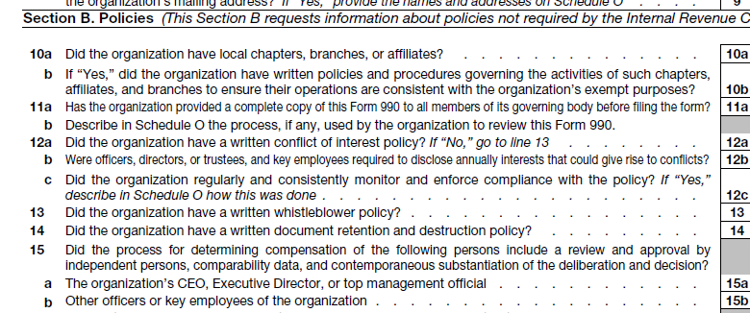

Slide 61
Conflict of Interest
Code of Conduct
Commitment Form

Slide 62
Resources
www.nonprofitcenter.com
www.boardsource.com
www.councilofnonprofits.com

Slide 63
Discussion
When asked for the 1 thing you’d change, is it still what you’d change?
How do you work toward diversity of thought on your board?

Slide 64
Thank you.
Kelle Marsalis, IOM, CCE
kellem@planochamber.org

