Slide 1
Developing a Competitive Workforce

Slide 2
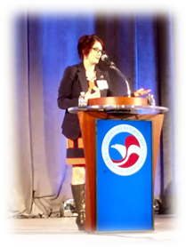
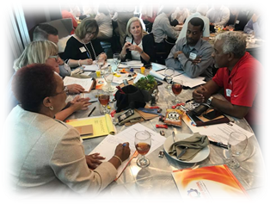
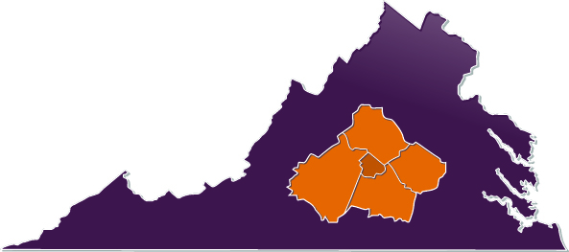
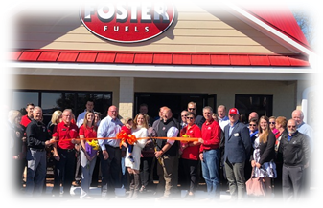
My organization: Lynchburg Regional Business Alliance
We represent the Lynchburg Virginia MSA: Amherst, Appomattox, Bedford and Campbell Counties; Towns of Altavista, Amherst, Appomattox, Bedford and Brookneal; and the City of Lynchburg.
750+ members - large and small businesses, entrepreneurs, education institutions, localities, workforce providers, etc.
Our Vision: Creating a region where businesses and individuals thrive.
Our Mission: To lead regional economic development through:
Enhancing the Business Climate
Cultivating Talent
Generating Jobs & Investment
Promoting our Brand & Image Globally
We administer numerous learning & training opportunities through our nationally award- winning Leadership Lynchburg program.
Consecutive 5 Star Accreditation for 20 years

Slide 3
Course Objectives…..
Understanding workforce development activities and terminology.
Identifying common initiatives and roles of chambers in workforce development.
Exploring resources to assist you in your workforce development program.
What education/workforce questions do you want to make sure we cover today? Any pressing issues?

Slide 4
Just last quarter…..
“Perhaps what’s most notable about the name the Great Resignation is that its main substance—resignations—may be the least consequential thing about the moment that it’s come to represent. The real takeaway is why people are leaving their jobs in the first place—rampant stress, the shift to remote work, a forced reckoning with what matters in light of the pandemic—and what resigning is leading them to do next.
Taken on its surface, the Great Resignation foregrounds the language of job status, but misses a parallel, arguably bigger story: the radical realignment of values that is fueling people to confront and remake their relationship to life at home, with their families, with their friends, and in their lives outside of labor.”
https://www.wired.com/story/great-resignation-misses-the-point/?mc_cid=235246c825&mc_eid=f766c9553e&utm_source=Area+Development+Site+%26+Facility+Planning+Newsletters&utm_campaign=8b6368e4e1-SFP_this_week_544&utm_medium=email&utm_term=0_94850a8d43-8b6368e4e1-302908633&goal=0_94850a8d43-8b6368e4e1-302908633

Slide 5
Three Pillars of the Talent Pipeline
Early Childhood Education & Care
Connecting K-12 to Careers
Postsecondary & Workforce Development

Slide 6
Relevant Legislation
Elementary and Secondary Education Act (Every Student Succeeds Act)
Higher Education Reauthorization Act (HEA)
Workforce Innovation and Opportunity Act (WIOA)
Career and Technical Education (Carl D. Perkins)

Slide 7
Questions your organization can explore:
How are you relevant and a “must” for your members in this arena?
What’s your lane? What workforce & education challenges is your Chamber/Association BEST suited to impact?
How can you BEST impact these?
You can’t just present data and discuss. You must do something.
Do your events & activities lead to outcomes?
What best practices exist for the challenges you’re wanting to tackle?
Who needs to be “in the room” and engaged in solutions?
How is collective impact being discussed and utilized locally to address complex national challenges like these?

Slide 8
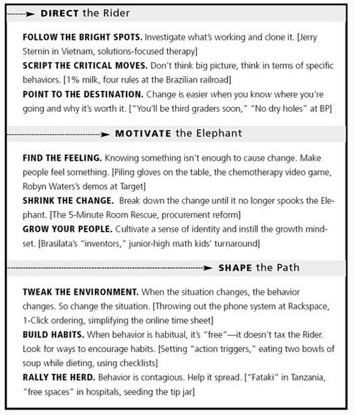

Slide 9
EARLY CHILDHOOD EDUCATION & CARE
Notes:
The Chamber Foundation sees ECE as a two generation workforce issue. This issue impacts our workforce today because stable childcare is often a barrier to enter, re-enter, or stay in the workforce for many people. It’s also a crucial piece to the puzzle of retaining and recruiting skilled talent. This issue also impacts our workforce of tomorrow because we need to prepare children for a labor market that we can’t even imagine. Therefore, we need to lay a strong foundation for these children during the earliest years to ensure they have the skills they need to be successful in school and life. A world-class workforce begins with a world-class education system.

Slide 10
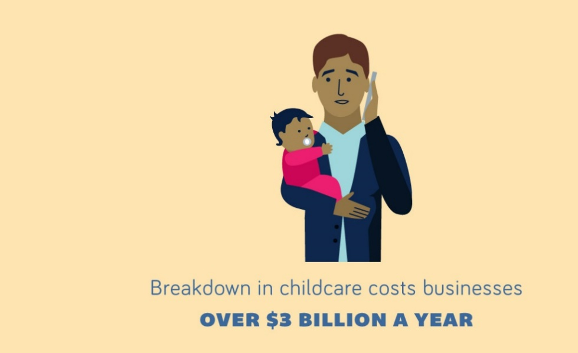
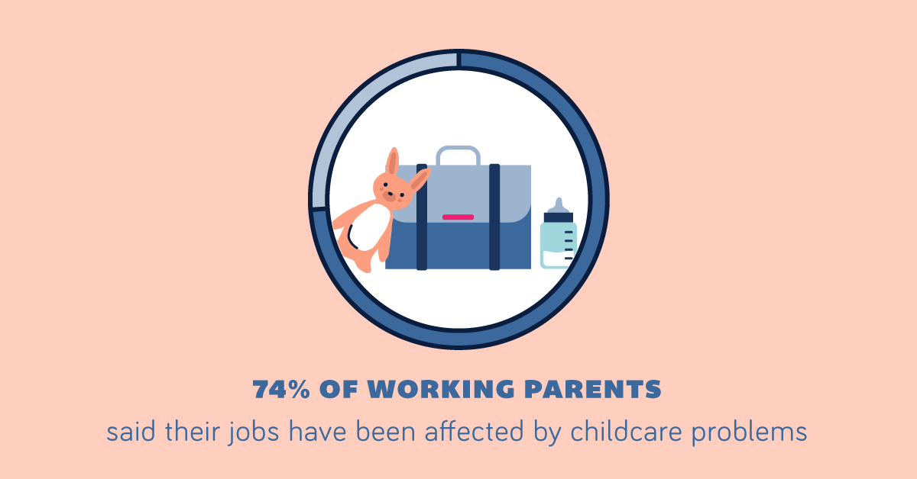
The Challenge
8 of every 10 births today are to millennials, who make up 1/3 of today’s workforce.
Almost 13 million Americans in their prime working years have children under age 6.

Slide 11
The Workforce of Tomorrow
Early experiences matter
Gaps emerge early
Adversity has a big impact
Future economic mobility is affected
80% of a child’s brain development occurs before age 3.
Notes:
If access to quality, affordable care were improved, data shows a positive impact on:
Increased tax revenue
More skilled workers
More effective schools
Improved personal and public health
Less crime and incarceration
Less dependence on social programs

Slide 12
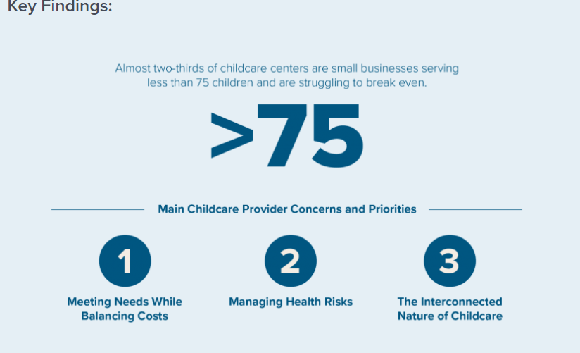
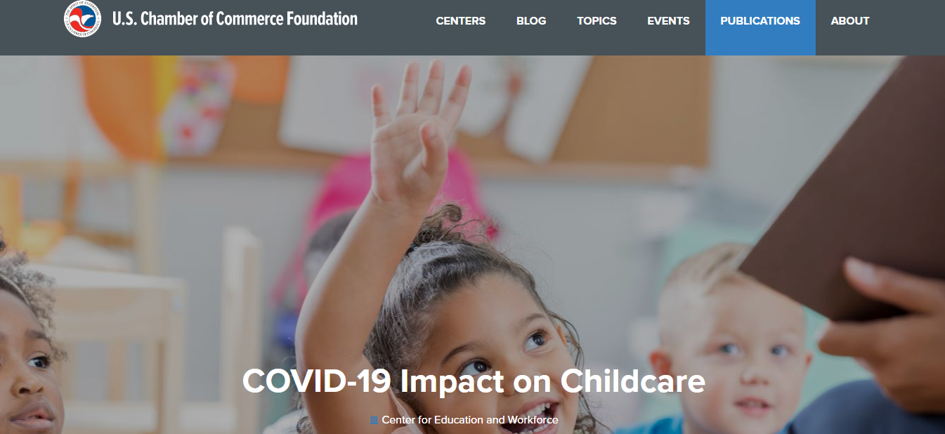
Resources
Leverage US Chamber data, talking points, and checklists!
Utilize your local and state data to inform action.

Slide 13
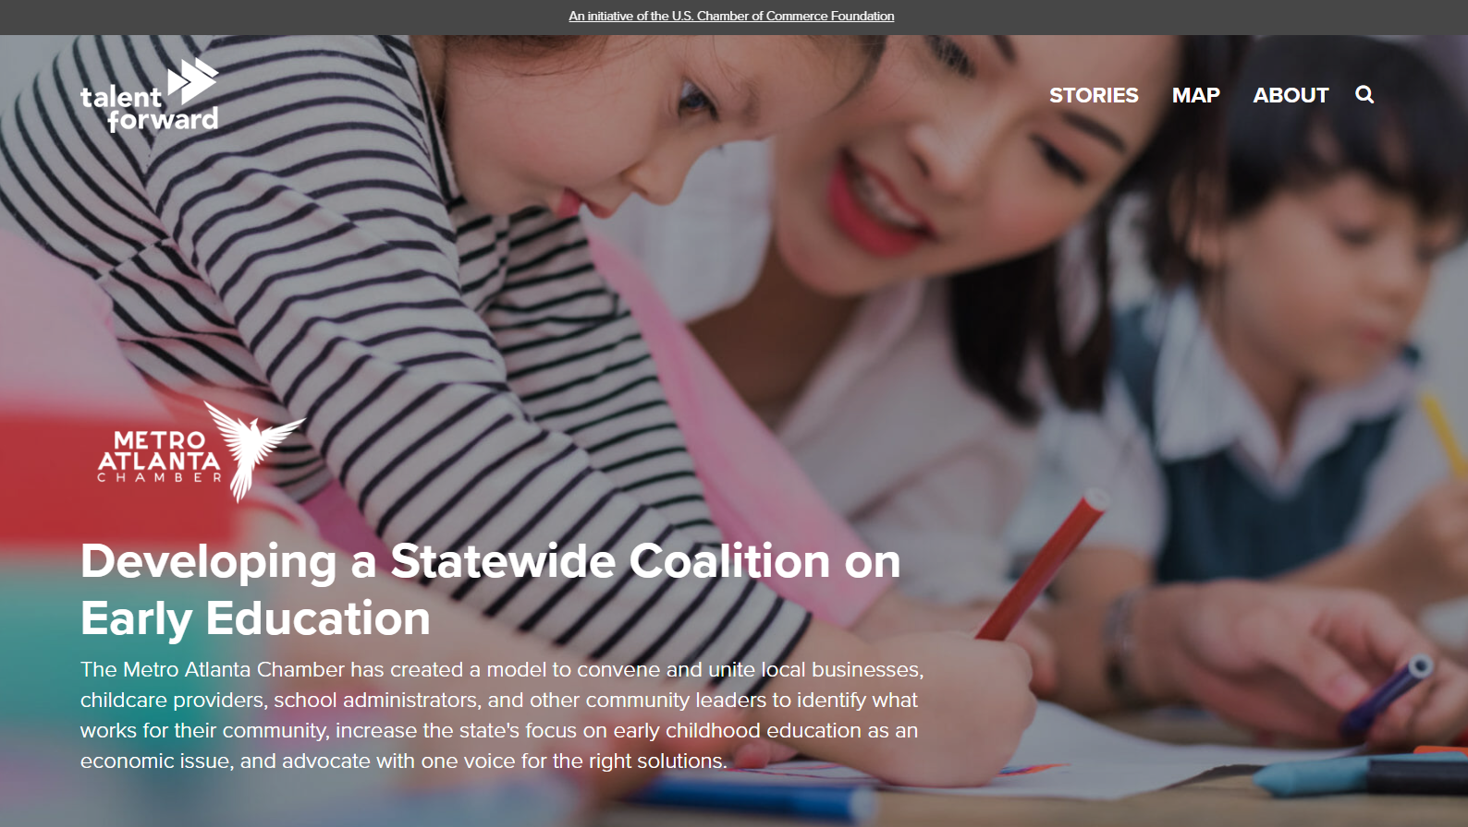
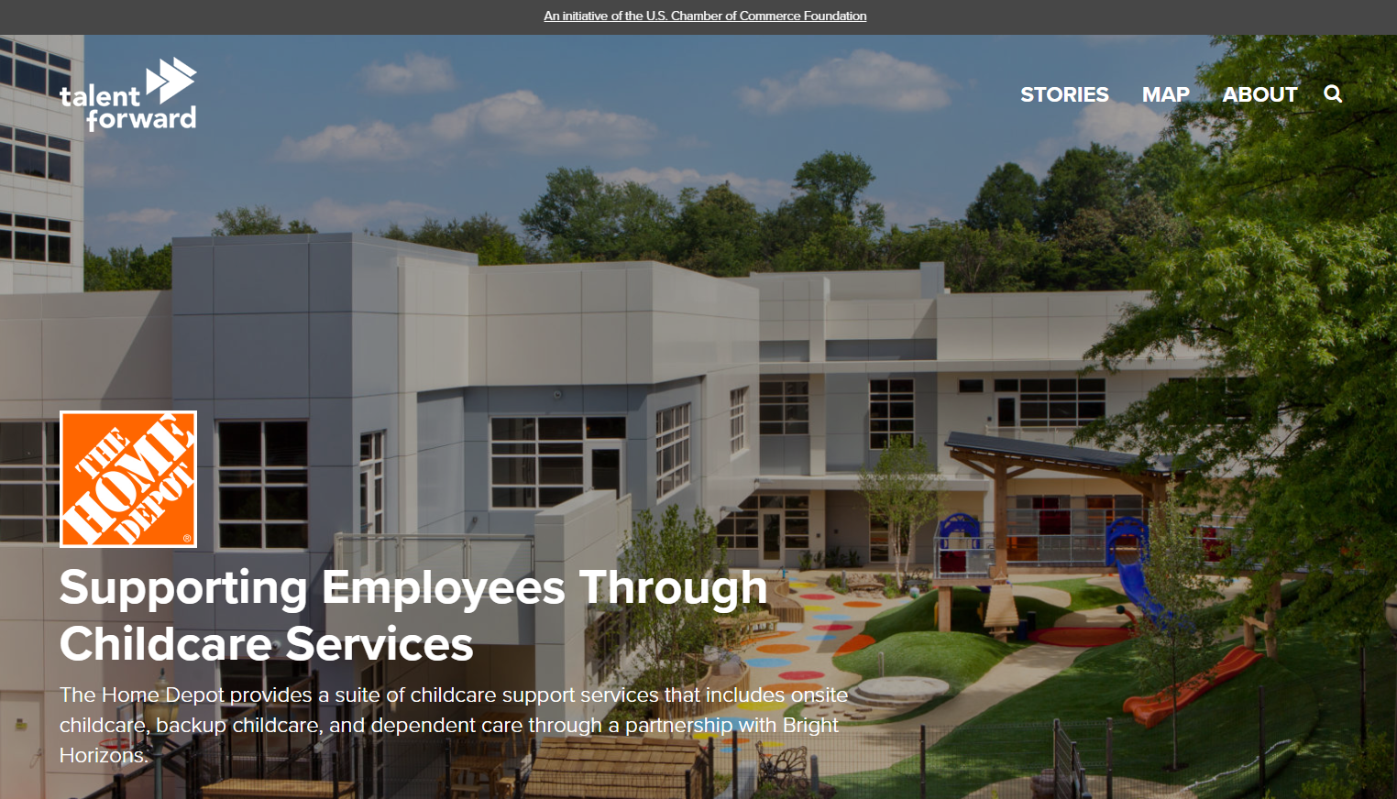
Case Studies
When employers provide childcare supports, employee absences decrease by 30% and job turnover can decline by as much as 60%.

Slide 14
CONNECTING K-12 TO CAREERS

Slide 15
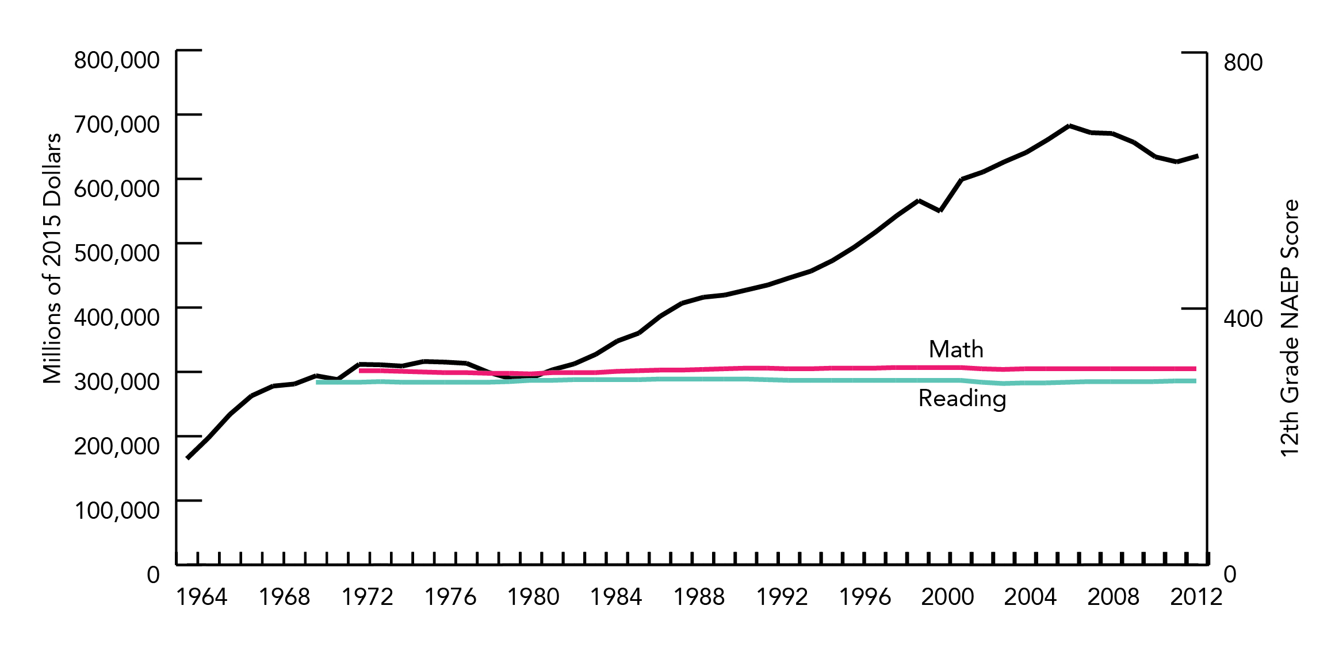
The Challenge
Despite significant investment, our K-12 system is currently failing to close gaps in student achievement.
Notes:
Only 37% of 4th graders and 36% of 8th graders are at or above proficient in reading (2017)

Slide 16
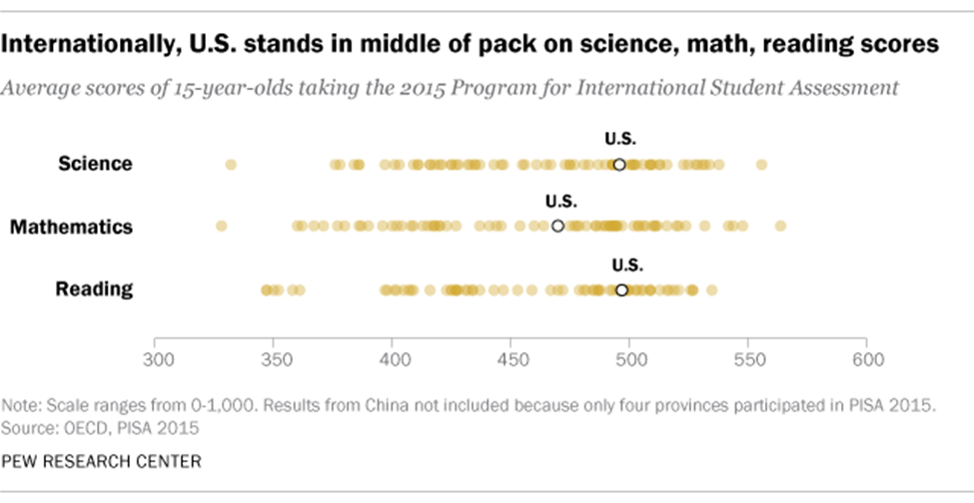
The Challenge
The U.S. ranks 38th in math and 24th in reading and science out of 71 countries.
Notes:
Only 37% of 4th graders and 36% of 8th graders are at or above proficient in reading (2017)
Program for International Student Assessment (PISA)—OECD study, every three years, test 15 year olds in science, math and reading (2015, 2012, 2009 starting 2000)
National Assessment of Educational Progress (NAEP)—since 1969, national report card for grades 4,8,12. test on what students know and can do across many subjects (reading, math, science, civics, writing, arts –10 total).

Slide 17
The Pace of Change
The fourth industrial revolution has led to the fastest pace of change for in-demand skills in generations.
47%
of all U.S. jobs are at risk of elimination in the next 10-20 years
65%
of children entering primary school today will end up working in new job types that don’t exist today
Notes:
We are in an era where the jobs that we are educating our students for today, won’t exist by the time they get to the workforce. But this isn’t the first time we’ve experienced this as a country. We are entering the fourth industrial revolution.
This 4th industrial revolution has brought us exponential expansion that our generation can’t remember the likes of. Technologies are merging and blurring the lines between the physical, digital, and biological spaces, uprooting industries all over the world.
SOURCE: https://www.sentryo.net/the-4-industrial-revolutions/

Slide 18
Resources
Leverage our reports and case studies on the website
Leverage the knowledge of local industry and education partners
More case studies at ForwardonTalent.org

Slide 19
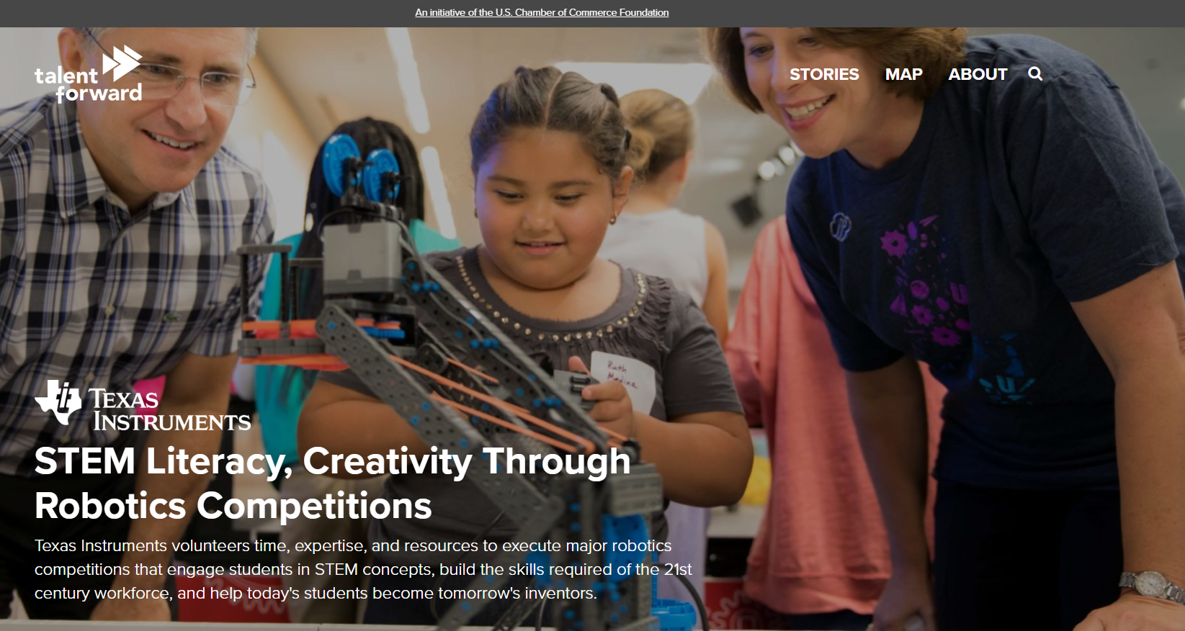
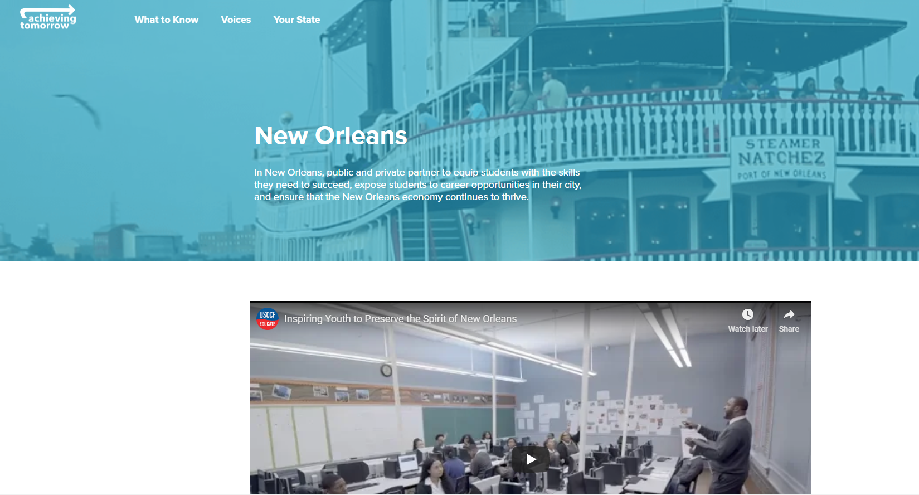
Case Studies
Educators, administrators, community leaders, parents, and businesses can have an incredible impact when they join forces to help students succeed.

Slide 20
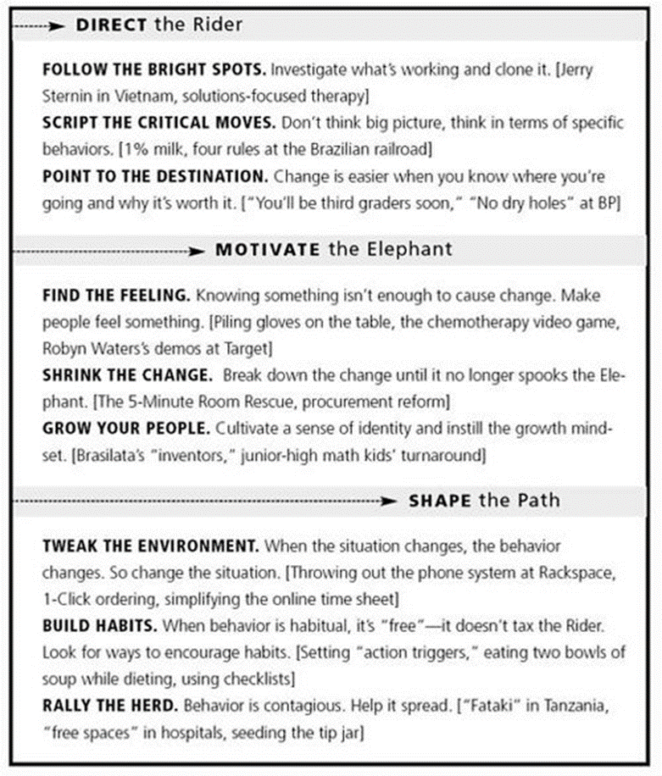
Let’s chat!
Identify one education challenge in your community
Identify one program or activity your chamber or association has been involved in or could be involved in that can help overcome that challenge
What might be the first step to moving the needle?

Slide 21
POSTSECONDARY & WORKFORCE DEVELOPMENT

Slide 22
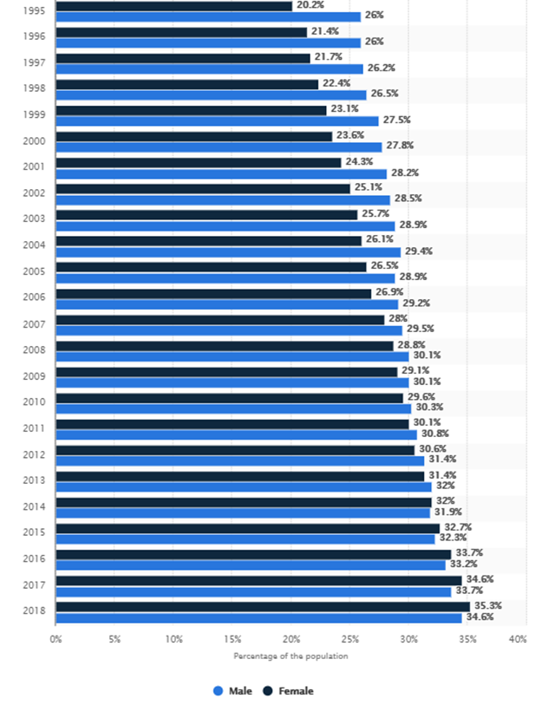
The Challenge
Students are not coming out of the education system career ready.
Record number of graduates are getting degrees and credentials…
…and yet, 89% of employers can’t find the qualified candidates they need for open positions.
Notes:
60% of students entering four-year colleges and 60% of students entering two-year colleges are placed in remedial classes.
There is an obvious issue with our definition of “career readiness.”
98% of colleges are confident they are preparing students for the workforce. Only 11% of business leaders agree.
2/3 of graduates struggle to launch their careers.
Companies spend $600 billion annually on staff training or re-training.
Guess who those folks are…your future workforce.

Slide 23
The Challenge
Employers aren’t getting the skills they need.
40%
of businesses can’t take on more work because they can’t fill open jobs.
50%
of open, available jobs go unfilled
of hiring managers report difficulty finding and hiring the right tech talent.
83% said the shortage of skilled talent was slowing company revenue growth.
90%
Notes:
Lost revenue, lost wages, lost opportunities

Slide 24
Increased Competition For Labor
July
2021
February
10.9 Million Job Openings in the United States
2020
6.9 Million Job Openings in the United States
Source: U.S. Bureau of Labor Statistics – Job Openings and Labor Turnover Survey (JOLTS)

Slide 25
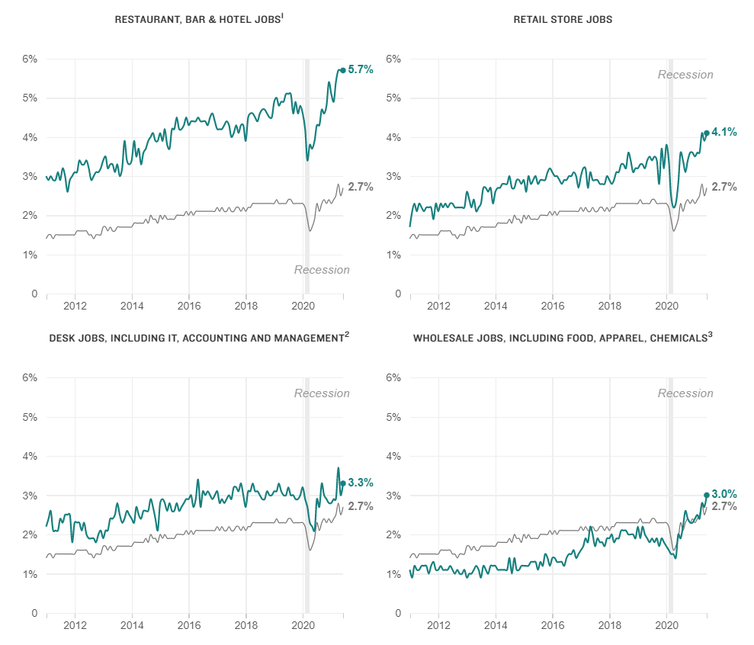
Labor Market Disruption
Quit rate (% of workers who quit their job that month) broken down by industry from January 2011 to June 2021
Source: U.S. Bureau of Labor Statistics – Job Openings and Labor Turnover Survey (JOLTS)

Slide 26
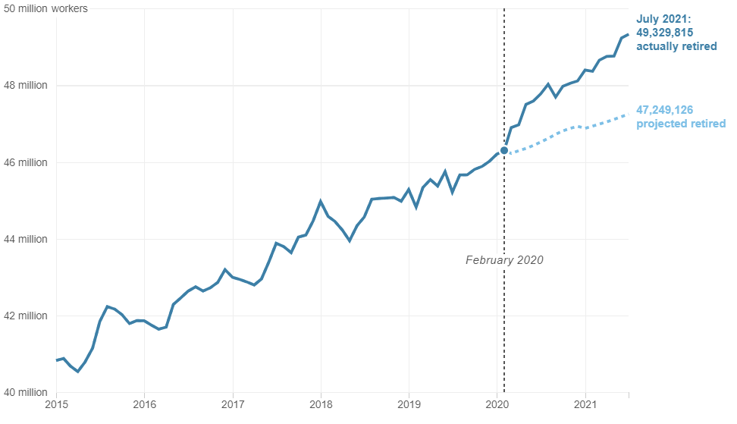
The Pandemic Has Accelerated Retirements
Based on pre-pandemic trends, more than 47 million workers age 55 or older were projected to retire as of July 2021. 2 million more workers than expected, approximately 49.3 Million, have actually retired.

Slide 27
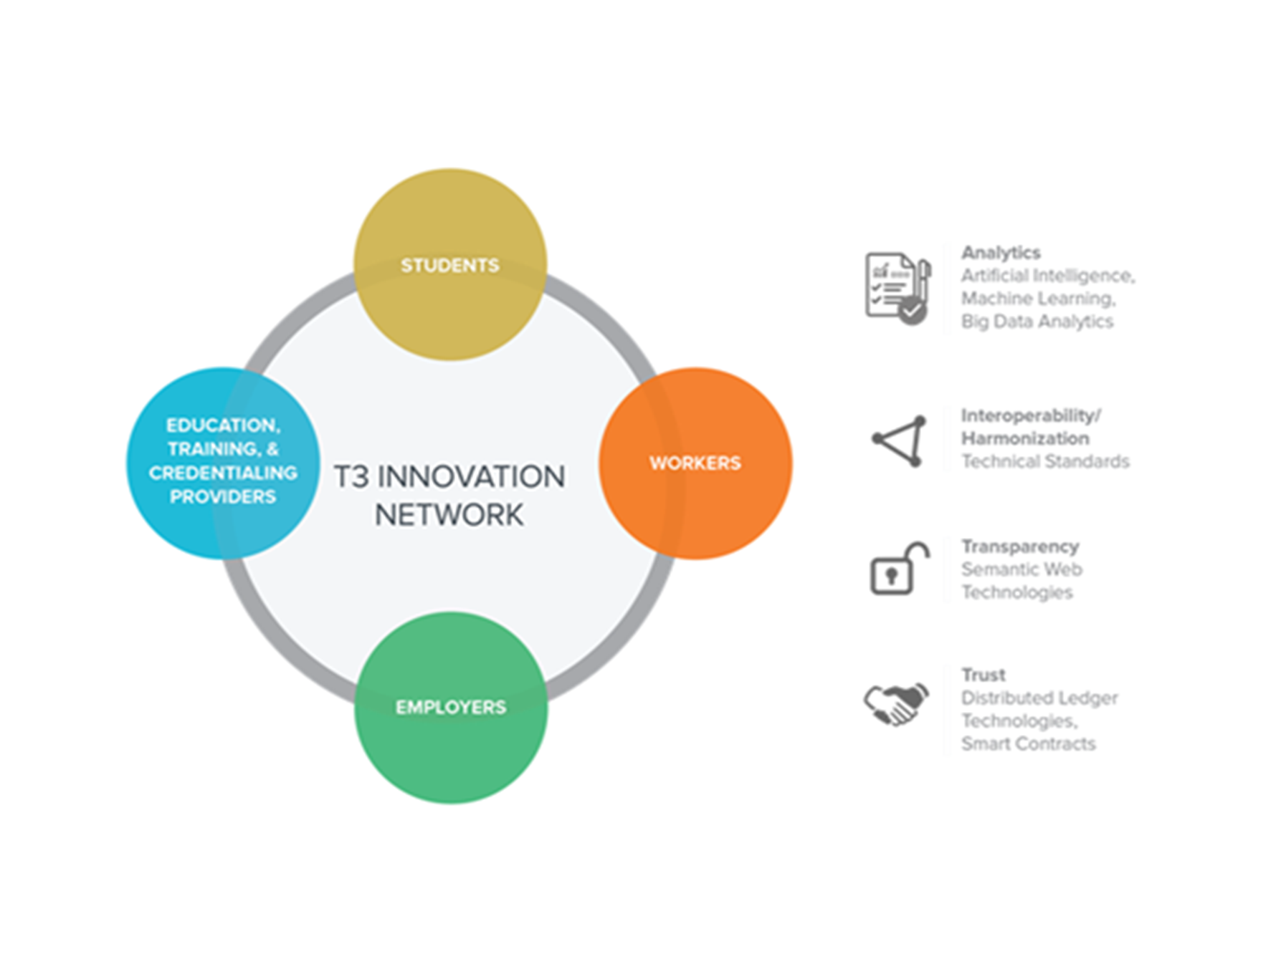
US CHAMBER APPROACH
Launched in 2018
Over 500 public and private organizations
An open innovation network focused on building the data and technology infrastructure of the future for a more equitable talent marketplace.
Notes:
T3 Innovation Network
400+ organizations working together to build an open, public-private data and technology infrastructure
3 Underlying Issues With Our Talent Marketplace Today:
Fragmented data silos within and across employers, credential providers, and individual-level records that inhibit the transfer of information and the ability to digest data into multiple systems (e.g. SIS systems vs. HRIS systems)
Inability to communicate and translate competencies and skills effectively across all major stakeholders in the talent marketplace (learners, workers, military, etc.)
The individual has the least amount of access or agency when it comes to data about them

Slide 28
US CHAMBER Approach
Developing new ways for employers and the financial services community to:
Collaborate and identify new private sector tools for financing talent
Develop new strategies for managing risk in the labor market
Manage how to pay for workers to get and constantly refine the skills they need.
Notes:
T3 Innovation Network
400+ organizations working together to build an open, public-private data and technology infrastructure
3 Underlying Issues With Our Talent Marketplace Today:
Fragmented data silos within and across employers, credential providers, and individual-level records that inhibit the transfer of information and the ability to digest data into multiple systems (e.g. SIS systems vs. HRIS systems)
Inability to communicate and translate competencies and skills effectively across all major stakeholders in the talent marketplace (learners, workers, military, etc.)
The individual has the least amount of access or agency when it comes to data about them

Slide 29
Lynchburg Regional Business Alliance Approach
DIRECT THE RIDER:
2017 Workforce Summit - highlighting the Bright Spots and Pointing to the Destination
MOTIVATING THE ELEPHANT:
2018- Intercity visit to Alabama - (Find the feeling, Shrink the change)
SHAPE THE PATH
2019- Region wide career exploration event for middle and high schoolers
2020- Grants, regional conversations, preparing for the future, Virtual Workforce Summit
2021- Workforce Summit
2022 and beyond -RINSE AND REPEAT!
Execute talent coalition actions, execute virtual career exploration using gamification and incentives for students, launch educator academy for regional K-12 leaders

Slide 30
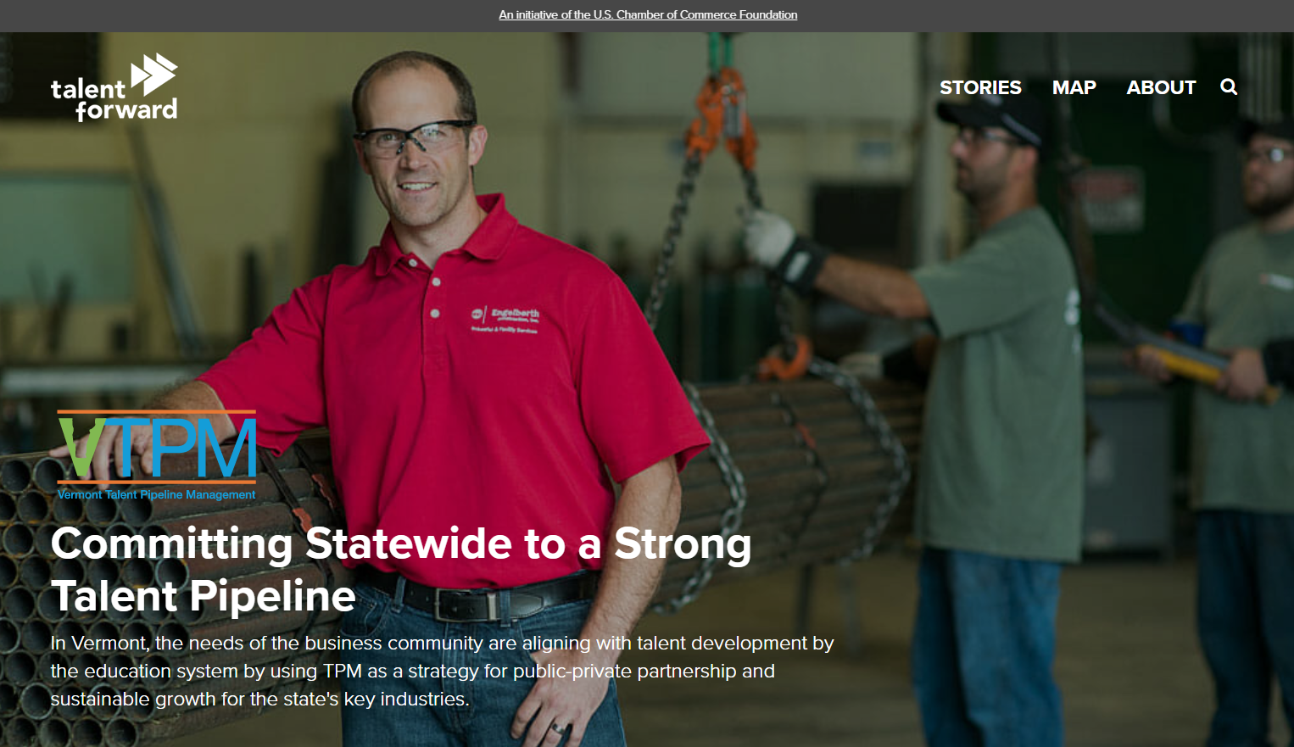
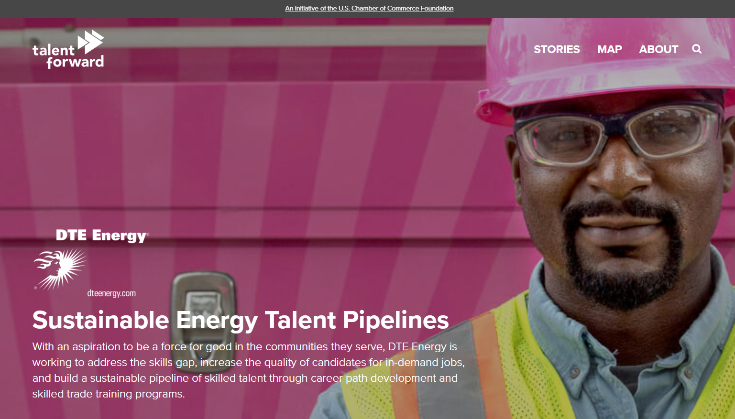
Case Studies
98% retention rate for Michigan jobs
5.5K new jobs projected across 11 critical areas of need for Vermont’s economy
48% increase in Houston’s higher education enrollment for majors aligned to critical industry sectors

Slide 31
Resources
Leverage reports and data on our website
More about TPM at TheTalentSupplyChain.org
More case studies at ForwardonTalent.org

Slide 32
Reminder: Question’s your organization can explore:
How are you relevant and a “must” for your members in this arena?
What’s your lane? What workforce & education challenges is your Chamber/Association BEST suited to impact?
How can you BEST impact these?
What best practices exist for the challenges you’re wanting to tackle?
Who needs to be “in the room” and engaged in solutions?
How is collective impact being discussed and utilized locally to address complex national challenges like these?

Slide 33
GROUP ACTIVITY
Identify one workforce development issue in your community or in your industry
Identify one possible solution and the steps you would take to get there
Identify three partner organizations you could work with

Slide 34
US Chamber Resources
uschamberfoundation.org/cew
/early-ed
/early-ed/the-business-case (talking points, action steps)
/k-12-education
/workforce-development (TPM, JDX, T3)
TheTalentSupplyChain.org (TPM)
ForwardonTalent.org (case studies)

Slide 35
EXTERNAL RESOURCES
Harvard Center for the Developing Child (https://developingchild.harvard.edu)
Department of Education (www.ed.gov)
Education Trust (www.edtrust.org)
Honesty gap (www.honestygap.org)
Department of Labor Employment & Training Administration (www.doleta.gov)
Georgetown Center for Education and the Workforce (www.cew.georgetown.edu)
W.K. Kellogg Foundation (WKKF)) (https://www.wkkf.org/)

Slide 36
Wrapping it up…..
What are some a-ha’s from this session?
What is your first step regarding education and workforce when you get home?
What didn’t you get that you need?

Slide 37
GET CONNECTED
Subscribe to US Chamber mailing lists and monthly newsletter
Apply for the Business Leads Fellowship Program
Get connected with Talent Pipeline Management (TPM) in your state
ACCE Education & Talent Division
Schedule a call/zoom with a Bright Spot Community.
Share a story of success from your community

Slide 38
Contact: US Chamber contact:
Jaimie M. Francis
Executive Director Policy and Programs JFrancis@uschamber.com
@JaimieMFrancis
GENERAL INFORMATION
USChamberFoundation.org
EMAIL US ANYTIME
workforce@uschamber.com education@uschamber.com
SOCIAL
@usccfeducation
This Photo by Unknown Author is licensed under CC BY-SA

