Slide 2
E360
Strategic Communications

Slide 3
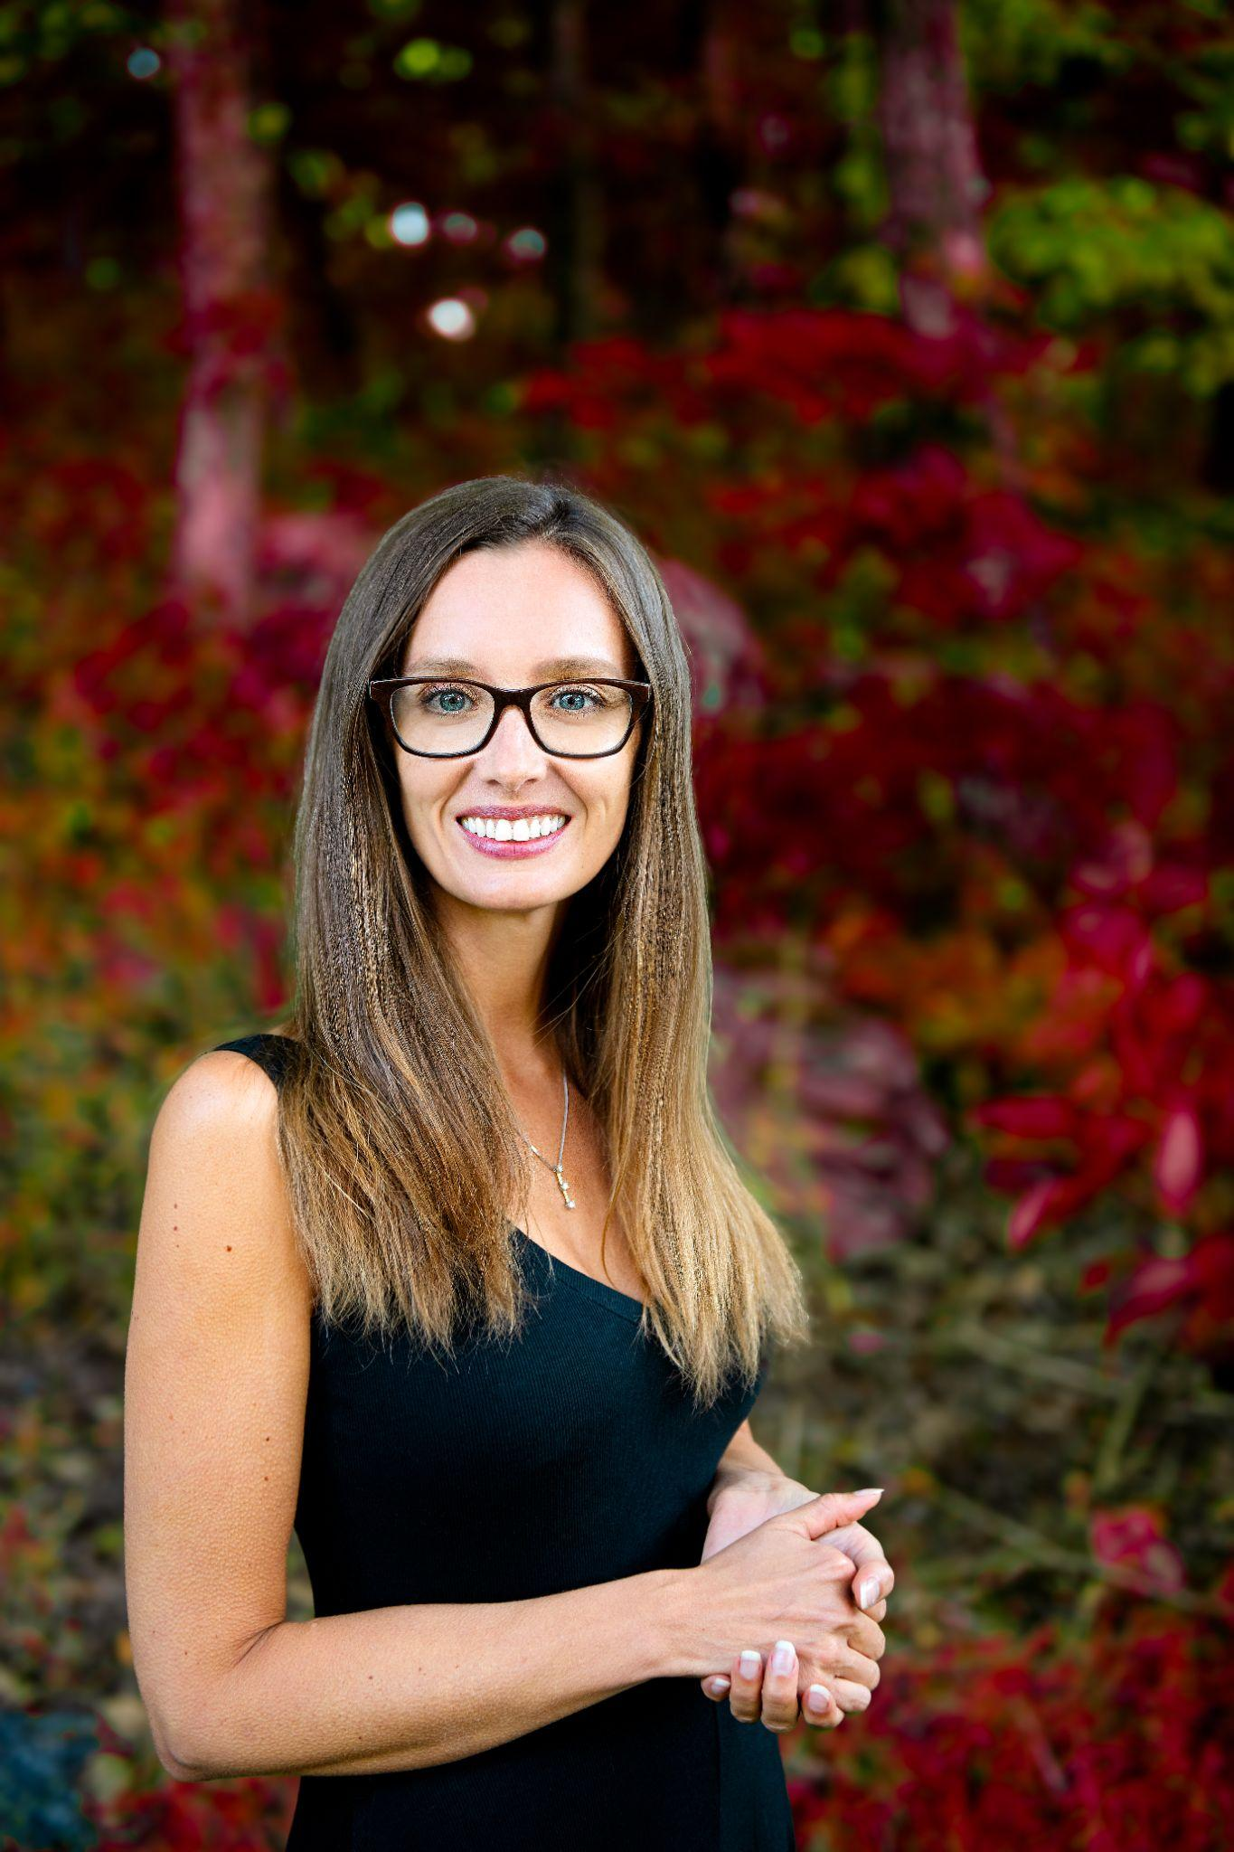
Meet Amy
Why listen to me?
Lived 12 lives but have always been building a community of followers
Worked at and with Chambers & Associations
Communications, Marketing, Executive Director, Event Planning, Membership, Strategic Planning, Budgeting, Technology, Board and Volunteer Management.
I don’t do accounting
My Superpowers: Building Community and Asking Questions
Traveling, pontoon captain, wife, cat mom who loves to cook.
Sometimes I am funny 😉

Slide 4
Hello? Anyone Out There?

Slide 5
What are some of the best communications campaigns you have ever seen?

Slide 6
Examples
ASAE’s 2020 Gold Circle Award Recipients
Overall Excellence Award Winner:
Infectious Diseases Society of America https://www.idsociety.org/
Convention/Meetings Marketing Winner:
Insured Retirement Institute https://www.irionline.org/
Media/Public Relations Winner:
Institute of Management Accountants https://www.imanet.org
Video Winner:
National Hospice and Palliative Care Organization https://www.nhpco.org/
E-Newsletter Winner:
Association of Equipment Manufacturers https://www.aem.org/

Slide 7
Examples
The Association of Chamber of Commerce Executives Communications Excellence Awards
Campaigns Winner:
Joplin Area Chamber of Commerce https://www.choosejoplin.com/
Digital Media Winner:
The Chamber of Catawba County https://youtu.be/FAIjyv_MqKY
Event Marketing Winner:
Frederick County Chamber of Commerce https://www.frederickchamber.org/she-week.html
Print & Electronic Publications Winner:
Greater Binghamton Chamber of Commerce https://greaterbinghamtonchamber.com/wp-content/uploads/2020/01/Economic-Forecast-2020-PRD-Dig.pdf

Slide 8
What is a Communications Strategy?
A communications strategy is a plan for communicating with your target audience. It includes who you are talking to, why you are talking to them, how and when you will talk to them, what form of communication the content should take and what channels you should use to share it.
Forbes: https://www.forbes.com/sites/forbescommunicationscouncil/2021/06/22/five-components-of-a-successful-strategic-communications-plan/?sh=1793684c5813

Slide 9
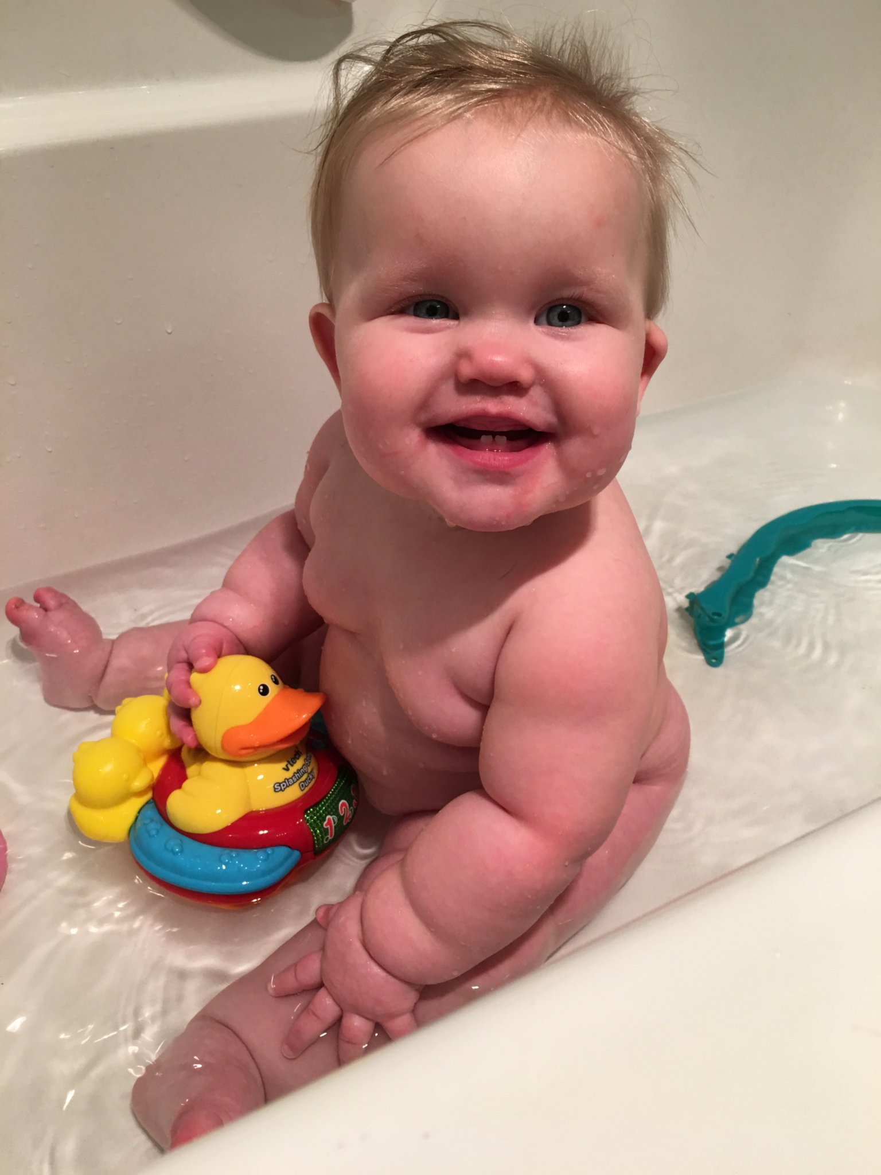
What do we CURRENTLY do?
Don’t throw the baby out with the bathwater

Slide 10
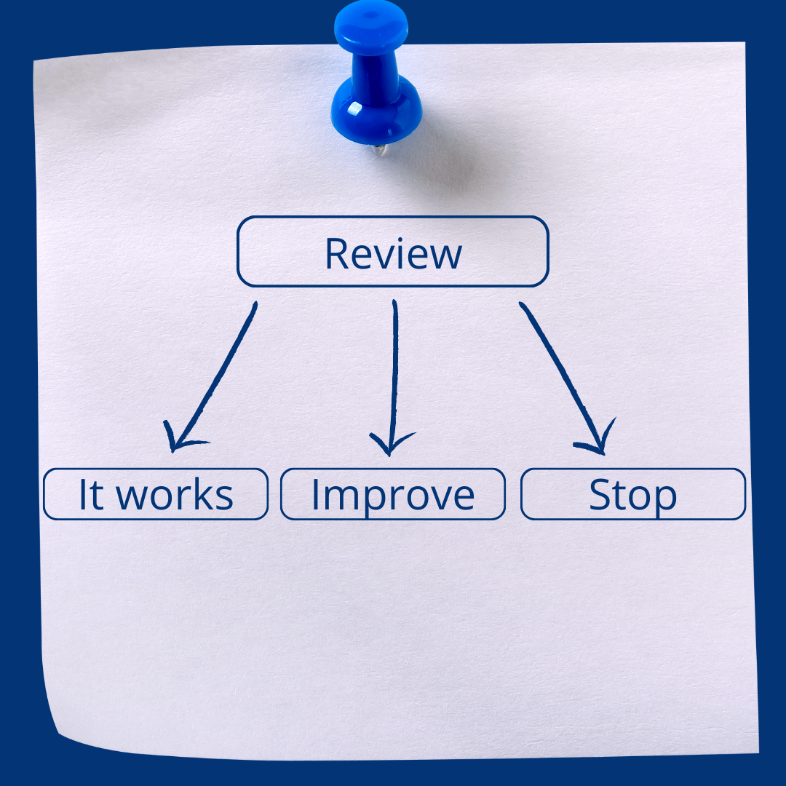
Audit or Take Stock
Source: You can use these 5 questions as a guide: https://blog.vingapp.com/5-ways-to-measure-if-your-communications-plan-is-effective/

Slide 11
Developing the Plan: Four Focuses
Goal: What are you trying to achieve? What is the goal?
Who: Who is the target audience(s)?
Members? Legislators? Many audiences?
How: What resources, tools, and vehicles do you have available to execute?
Who: Who will be the key staff members doing the communicating?
https://mshannonhernandez.com/quiz/

Slide 12
Dive Deeper with These Questions
Who will be the key staff members doing the communicating?
What are the communications goals and objectives?
Who is the target audience(s)?
When and how frequently do you plan to communicate?
How will you communicate the results to your staff?
What resources are available for communicating internally and externally?
Source: https://blog.vingapp.com/5-ways-to-measure-if-your-communications-plan-is-effective/

Slide 13
What is the main focus of your plan?
Target Audience
Members
Sponsors
Government/Legislators
Personally: I like a plan that is organized by the target audience.

Slide 14
How Does This Plan Tie Into Our Brand and Support Our Mission?

Slide 15
How Far Do You Plan Ahead?
12 Months with a 90 day focus

Slide 16
Q&A + Sharing = #Werisetogether

Slide 17
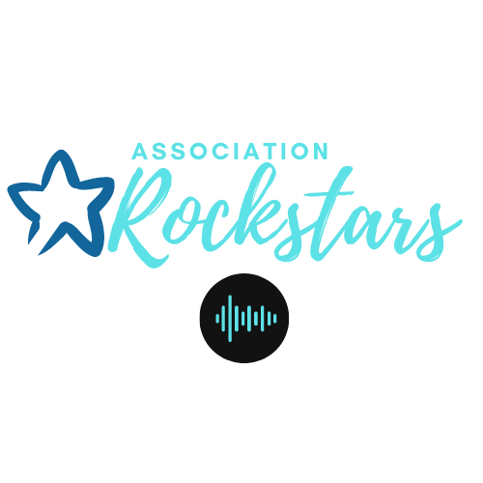
How do you subscribe to more Amy?
Association Rockstars
https://www.facebook.com/groups/AssociationRockstars
https://associationrockstars.com/
Facebook
https://www.facebook.com/amy.hager.58
LinkedIn
https://www.linkedin.com/in/amy-hager-cae-iom-393493a/
RISE Traveller Interview Series on Youtube https://www.youtube.com/channel/UCmAVL3SepcsGOkXMWLt0jKg
Coming Soon: Creating a Value Proposition for Your Association to Attract Members E-book

