Slide 1
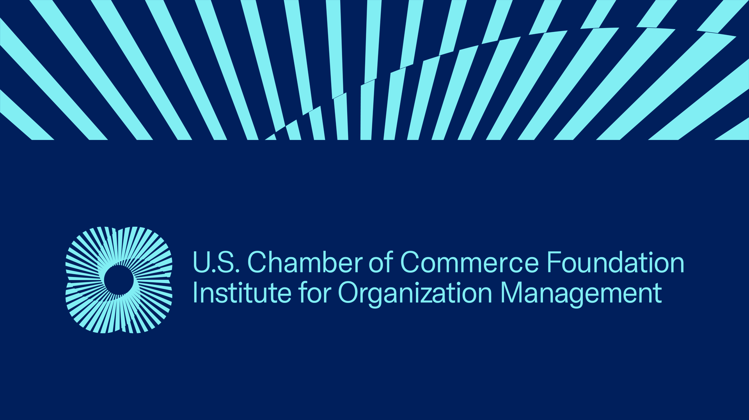
Winter Institute 2022
Friday, Jan 7
10:30am to 12:30pm
Deigned & Facilitated by:
Dr. Steven Swafford, IOM
Washington, DC/Los Angeles/Hartford/Florida www.leadershipoutfitters.com
E350
Art of Persuasion and Negotiation

Slide 2

E350
The Art of Persuasion and Negotiation
Course Description
Persuasion and negotiation require patience and determination. Learn to shift opinions through key people, cases studies, power words, and presentation techniques. Convince others to step up and take on new initiatives. Learn how to obtain the results you want through negotiation.
Course topics include:
Understanding types of decision makers and how they can be most effectively persuaded.
Identifying words and techniques to convince others to take action.
Implementing a plan of action for negotiations.

Slide 3

Definitions & Considerations
Persuasion
Process of changing or reinforcing attitudes, beliefs, or behaviors.
A form of social influence. It is the process of guiding people toward the adoption of an idea, attitude, or action by rational and symbolic (though not always logical) means. It is strategy of problem-solving relying on "appeals" rather than strength.
Influence
The act or power of producing an effect without apparent exertion of force or direct exercise of command. (Webster)
Negotiation
Discussion aimed at reaching agreement. (Webster)
Effective persuasion becomes a negotiating and learning process through which a persuader leads colleagues to a problem’s shared solution. Jay Conger

Slide 4
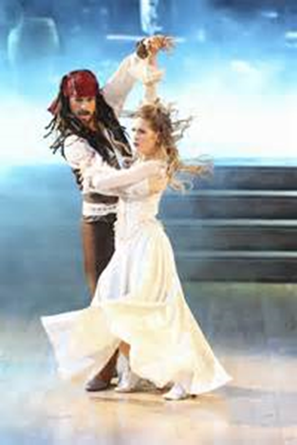
Capt. Jack Sparrow’s
Negotiation & Persuasion
Tips
Jack Sparrow’s Seven Lessons from the Seven Seas
Lesson #1 – Enter a negotiation confident even if you are not in a position of power or authority.
Lesson #2 – Create a culture of respect and they are more willing to listen to your proposal or idea.
Lesson #3 – It is not important to “win” every battle as long as you “win” the war.
Lesson #4 – Negotiate in the “pirate” culture and remember pirates are only concerned with personal gain. Understand what “is” or “isn’t” acceptable in each negotiation culture.
Lesson #5 – Define your goal in advance and have a plan to achieve it.
Lesson #6 – Use a contract or some type of mutually agreeable documentation to record the final terms.
Lesson #7 – Don’t linger (or gloat) after the deal is closed or you may risk undoing all the hard work.
Which one do you do well? Which one needs improvement?

Slide 5
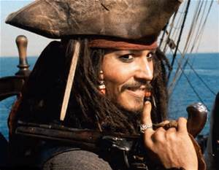
Conventional & Unconventional Tips from Capt. Sparrow
Begin positively and light heartedly; establish a friendly and willing atmosphere.
Consider command and emotive approach which asserts authority and places your opposition off balance.
Use reverse psychology to gain position of power through knowledge and surprise.
Scare tactics place pressure to reduce or strip perceived power.
Appeal to reason and flattery which might make a suggestion sound appealing and more logical.
Make concessions and appeal so the other party thinks they are more important and getting the better deal.
Initial “bluff” comment and appeal to logic so you can maintain a feeling of control while attempting to follow your advice.
Use trust to gain leverage establishing common ground for a level playing field.
Appeal to authority & flattery in an attempt to gain a better outcome (In this video clip, a new hat as a gift).
https://www.youtube.com/watch?v=xjQ5OomkVpg

Slide 6

Main Persuasion Moves
Changing & Adapting
Interest-Based Persuasion
Pitching your idea as addressing the other party’s underlying needs.
Authority
When you appeal to your formal position or authoritative rules or
policies as a means to get others to agree with your proposal.
Politics
Working through coalitions and alliances to achieve change.
Rationality
Influencing someone’s attitudes, beliefs, or actions by offering reasons
and/or evidence to justify a proposal on its merits.
Inspiration and Motivation
An appeal to an audience’s overriding sense of purpose, values, or
beliefs.
Relationships
Using similarity, rapport, and reciprocity, or rely on your networks to
open doors as part of selling your idea. We tend to say yes to those we
know, like, or respect.
Shell, G. Richard & Moussa, Mario. “The Art of Woo: Using Strategic Persuasion to Sell Your Ideas.” (NY:Penquin, 2007)

Slide 7

Persuasion
Styles
Situational and Contextual
Driver (Higher volume and self-oriented perspective) Approach: Authority
Commander (Low volume and self-oriented) Approach: Rationality, Authority
Chess Player (Lower volume and other-oriented) Approach: Politics, Interest-based, Relationship, Inspiration, Emotion
Promoter (Higher volume and other-oriented) Approach: Interest-based, Relationship, Inspiration, Emotion
Advocate (Moderate volume, balance between self and other-oriented) Approach: Rationality, Inspiration, Emotion, Relationship, Politics
Shell, G. Richard & Moussa, Mario. “The Art of Woo: Using Strategic Persuasion to Sell Your Ideas.” (NY:Penquin, 2007)

Slide 8

Getting to “Yes”
Six integrative negotiation skills
1. Separate the people from the problem -- In negotiation, it’s easy to forget that our counterparts have feelings, opinions, values, and unique backgrounds that contribute to what they do and say during talks.
2. Focus on interests, not positions -- We tend to begin our negotiation by stating our positions. When we stake out firm positions, we set ourselves up for impasse.
3. Learn to manage emotions -- Be sure that you and your counterpart have ample opportunities to express and discuss any strong emotions related to your negotiation. Allowing one another to speak your mind will benefit both sides.
4. Express appreciation -- Express appreciation by working to understand the other’s perspective, seeking merit in that perspective, and communicating understanding through words and actions—all critical negotiation skills.
5. Put a positive spin on your message -- Communicating in a positive way is a much more effective means of getting to yes than blaming and criticizing. Instead of speaking on behalf of your group, speak only for yourself.
6. Escape the cycle of action and reaction -- Avoiding escalation by refusing to react. Instead, us to channel our resistance into more productive negotiation strategies, such as exploring interests and inventing options for mutual gain.
What methods have helped in you getting to yes?
Adapted from Harvard Law Journal, October 15, 2020, Six Guidelines for “Getting to Yes”
Which one do you do well? Which one needs improvement?

Slide 9

Mental Models
Affect Negotiation
Mental Models are “deeply ingrained assumptions, generalizations, or even pictures or images that influence how we understand the world and how we take action.” (Senge, Peter. Fifth Discipline Fieldbook)
Our brains make models automatically. Like a river, our patterns flow continually over the same path, leaving a deeper and deeper mark each time. The deeper the path, the harder it is to change the pattern. (McGehee, Tom. Whoosh. Business In The Fast Lane. Unleashing the Power Of A Creation Company)
Mental Models
Represent our “perception” not what is necessarily real or true;
Are powerful in their influence over our actions and our responses;
Prevent us to being open to new ideas, options, or learning.
Bias or Stereotype
A bias -- or what is sometimes called a “stereotype” -- is an inflexible positive or negative prejudgment about the nature, character, and abilities of an individual and is based on a generalized idea about the group to which the person belongs. (Theidermann, Sondra. Making Diversity Work)
What are our mental models or bias around:
Gender Profession/Occupation
Generations Education
Cultures /Ethnicity Sexuality
Race Ink/Tatoos
Piercings/Spacers Military Service
Health/Ability Geographic
Economic Faith

Slide 10
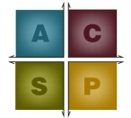
Controller
(Tasks/Results)
Understanding
How Behavior Styles Impact Persuasion & Negotiation
Analyzer
(Process/Tasks)
Accuracy orientated; needs to be correct; supports standards/guidelines; likes perfection; provide facts/data; settling on a position; enjoys logic.
Results oriented; needs control; supports objectives; likes efficiency; likes
immediate results; lower active listening skills; enjoys options.
Stabilizer
(Process/Relationships)
Persuader
(Results/Relationships)
Relationship oriented; needs security; supports personal goals; likes to be heard; needs to be appreciated; slower decision-making process; enjoys teams.
People oriented; needs to be liked; supports risk taking; likes praise; follows ‘gut feeling’ over facts; dislikes structure/ guidelines; enjoys social interaction.
Adapted from The Effectiveness Institute, Inc.

Slide 11

What About Body Language?
Attentive Audience
Nodding head yes…agree/understand
Sustained eye-contact… following you
Sitting up/leaning forward…interested
Smiling…engaged
Laughing at humor…tuned in
Comments/questions…want to be involved
Taking notes…eager to learn, remember
Relaxed…comfortable, open
What else?
What Might These Mean?
Clenched jaw
Raised eyebrows
Fidgety movements
Clenched fists
Crossed arms
Furrowed brow
Hands open, palms out
Head tilted
Narrowed eyes
Pursed lips
Slumping posture
Wringing hands
Inattentive Audience
Head in hands…bored, tired
Sparse eye contact…interest waning
Rubbing eyes…ready to move on
Shifting in seat…antsy, moving on
Yawns…tired, bored, nervous
Arms, legs crossed…closed off
Head and eyes down…somewhere else
Picking at clothes…getting tedious
Eyes wandering…bored, what else?
Blank stare…mind wandering
What else?
From Timothy J. Koegel, The Exceptional Presenter, Greenleaf Book Group Press, 2007

Slide 12

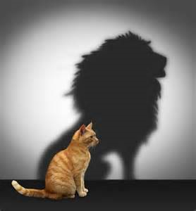


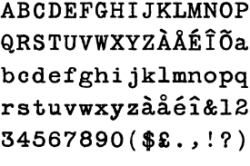
In a negotiation, what are you communicating (intentionally or unintentionally) to others through:
Body Language
Voice Inflection
Physical Actions
Verbal Reactions/Responses
How do these affect the meaning of what you say?
Intonation, Inflection, Volume, Speed
Which percentage goes with the three on the left?
38%
55%
7%
Appearance, Posture, Gestures, Clothing, Surroundings
Verbal – the Text

Slide 13
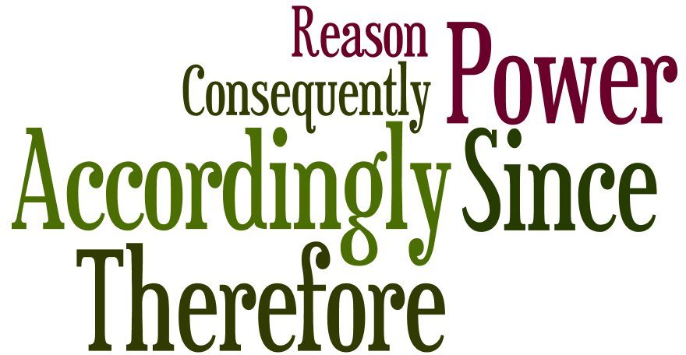
Power Words & Action Phrases
“Because” – Social psychologist at Harvard University Ellen Langer tested the power of a single word in an experiment where she asked to cut in line at a copy machine. She tried three different ways of asking:
“Excuse me, I have five pages. May I use the Xerox machine?” – 60% said OK
“Excuse me, I have five pages. May I use the Xerox machine because I’m in a rush?” – 94% said OK
“Excuse me, I have five pages. May I use the Xerox machine because I have to make some copies?” – 93% said OK
Did you think Langer’s third request was rather elementary. Yet it didn’t matter. The trigger word “because” was all she needed. The takeaway: When you want people to take action, always give a reason. The three other persuasive words in the English language are: “You” – “Free” – “Instantly”
10 Cause-and-Effect Power Words & Phrases
“Accordingly” – “As a result” – “Because” – “Caused by” – “Due to” “Consequently” – “For this reason” – “Since” – “Therefore” – “Thus”
Author & Executive Speech Coach, Darlene Price, the originator of this cause-and-effect list, has great insight into what makes these cause-and-effect phrases so useful: “Cause-and-effect words make your claims sound objective and rational rather than biased and subjective.” Where to try these? Closing paragraphs, transitions

Slide 14

Popular Power Words
• Hot
• First
• Big
• Anniversary
• Premiere
• Basic
• Complete
• Save
• Plus!
• Create
• Health
• Guarantee
• New
• Proven
• Safety
• Money
• Now
• Today
• Results
• Protect
• Help
• Easy
• Amazing
• Latest
• Extraordinary
• How to
• Worst
• Ultimate
• Improve
• Trust
• Immediately
• Discover
• Profit
• Learn
• Know
• Understand
• Powerful
• Best
• Win
• Hot Special
• More
• Bonus
• Exclusive
• Extra
• You
• Free
Each employee on the circulation and email marketing teams at Interweave Press has these words printed and posted on their wall. The list, which was originally compiled by Linda Ruth and Curtis Circulation Company, came from studying best-selling magazine covers. Interweave’s Bob Kaslik found that the words work equally well on magazines, promo copy, and in email subject lines. Where to try these power words? Email subject lines, headlines, calls-to-action.
Others?

Slide 15

Pre-Negotiation
Strategy
Check List
Has the Situation Been Assessed? – Each negotiation is going to be different, no matter how often we’ve addressed similar situations.
What Kind of Negotiation? – There are three (3) general negotiation circumstances which are:
  a) One time negotiation? b)Repeated negotiation again? c) Negotiation to form some kind of long term relationship?
What Type of Conflict Will We Face? There are basically two (2) types of conflict situations in a negotiation as well as a blend of the two. They are:
  a) agreement conflict – views, opinions, beliefs, values, or ideolology; and b) resource conflict – tangible, measurable, or quantifiable.
What is the Purpose? There are two (2) basic situations that trigger a negotiation. These are:
  a) Urgency; Emergency; or Survival; or b) Opportunity or Exploratory
Is There a “Ripple Effect” to Consider? Based on the outcome of this negotiation are there other impacts or readjustments to be considered?
Do We Need to make or sign a formal agreement? In the event of the negotiation collapsing at a later date this will impact this consideration. Do other parties need to approve this agreement?
Is There a Time Element? There two general considerations regarding the time element which are filing or decision deadlines as well as ongoing negotiations take up time – time is money.
www.negotiations.com/training; Harvard Business Essentials ‘Negotiation’ Harvard Business School Press; Leigh Thompson, ‘The Heart and Mind of the Negotiator’
What one do you always practice? Which one(s) do you usually not consider?

Slide 16

Negotiation Strategy:
Seven Common Pitfalls
Poor Planning – Successful negotiators make detailed plans.
Thinking the Pie is Fixed– Usually it’s not especially on congruent issues.
Failing to Pay Attention to Your Opponent – Negotiators need to analyze the biases their opponents bring to the table. How will the offers be evaluated?
Assuming That Cross-Cultural Negotiations are Just Like “Local” Negotiations – Differences do exist and this is not necessarily negative and can produce huge potential benefits or big problems, if ignored.
Paying too Much Attention to Anchors – Anchors are part of a bargaining dynamic known as “anchoring and adjustment.” This involves clearly setting the parameters for negotiation.
Caving in Too Quickly – Accepting a well-priced deal too quickly can cause anger on the other side, too.
Don’t Gloat – Finally, when you’ve cut a sweet deal, never do the dance of joy in public by turning to your opponents and telling them you have done it for less.
www.gsb.Stanford.edu/insights/negotiation

Slide 17
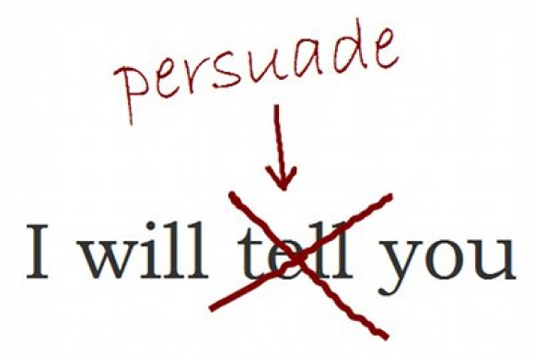
Case Study
What is the idea, concept or position being negotiated?
(e.g. New approach on an established way of doing something, moving to action on a position, negotiating a raise, extending a work deadline, ,vacation request, co-worker issues, ____________).
Persuasion/Negotiation Situation:
Who does this idea affect directly or primarily? Stakeholders?
Who can these people influence?
How will you approach them? What persuasion and/or negotiation strategies will you use?
What is compelling or valuable about the idea? Concept?
Go back into the curriculum -- What would Jack Sparrow do?

Slide 18

Making it Personal
Negotiation Strategies
Establish Your Credibility + Credibility of the Source
  Trust + Expertise = Credibility
  Three-fold credibility – you, your idea, your organization
  Listen to what resonates with your receiver
  Track Record
  Questions: How can I build credibility with my listener? How can I build trust?
2. Find Common Ground
  Is this something that will benefit my listener or benefit an organization? What are the advantages?
  Understand others’ views
  Question: What is in it for them?
3. Provide Vivid Evidence
  Examples as evidence
  Share facts, data, stories, further information
  Question: What can I provide them to support this idea?
4. Make Emotional Connections
  Is the idea linked to organizational mission or goals?
  Can people get passionate about this idea?
  Demonstrate commitment
  Question: How can I demonstrate my passion and commitment to this idea?
From Jay A. Conger “The Necessary Art of Persuasion” Harvard Business Review, May-June, 1998.
http://www.kpcolorado.net/sites/default/files/2011_01_06_art_of_persuasion.pdf

Slide 19

Putting
Strategies
To Work
Instructions:
Consider an idea or organizational change you want to negotiate.
Choose a stakeholder with whom you want to build/improve relations and develop strategies for persuading him/her/them toward a particular perspective.
Make notes in the boxes on your page then discuss your approach to your stakeholder with the rest of your team.
Establish Credibility
Expertise and knowledge
Listen to others
Track record
Find Common Ground
Clarify the benefits
Illuminate the advantages
Understand others’ views
Provide Vivid Evidence
Logic and facts
Imagery and metaphors
Stories and examples
Spreadsheets and statistics
Connect Emotionally
Show empathy
Demonstrate commitment
Stakeholder: _________________________________________________
Stakeholder Behavior Style and/or Perspective | Establish Credibility How can I build/reinforce my credibility? How can I build trust? (If I don’t have credibility and trust, who can I ask to communicate with this stakeholder?) | Find Common Ground Do I understand their views related to this issue? What is in it for them? | Provide Vivid Evidence Does this person prefer hard data, empirical information, examples, or stories? | Connect Emotionally Do I understand the sensitivities involved? How will I show my passion while acknowledging their passion?

Slide 20


Our Core Strengths
Strategic Thinking/Planning
Leadership Development
Staff Retreats
Communication Skills
Facilitation Training
Convention Breakouts
Conference Keynotes
Dr. Steve Swafford, IOM, Balance Warrior + CEO, has worked more than 30 years for and with non-profits, trade associations, and professional societies in areas of strategy, leadership development, communication, membership and executive management. He brings a practical knowledge of strategy and executive leadership with past organizations such as the National Association of Home Builders (NAHB), Club Managers Association of America (CMAA), and American Subcontractors Association (ASA) where he most recently served as the executive director. He is active in California Society of Association Executives (CalSAE) and American Society of Association Executives (ASAE) leadership serving on the Board of Directors; Membership Committee Chair; Professional Development Committee Chair (aka Purple Cow Posse); Southern California Regional Council; Nominating Committee; University leadership advisor; and volunteer staff pastor. Steve is also a 15-year faculty member for the U.S. Chamber of Commerce’s Institute of Management and serves on the Curriculum Committee for the U.S. Chamber of Commerce. A native of Kansas, Steve has a B.S. in journalism from Kansas State University; a M.Div. from Wesley Theological Seminary in Washington, DC; and an Ed.D. from Pepperdine University's School of Education & Psychology focusing on Strategic Organizational Change. Steve is a Full-Time Practitioner Faculty for Pepperdine University’s Graziadio Business School creating courses on organization design, organization behavior, change, strategy, and leadership. He is also co-founder of Leadership Outfitters, LLC.
Washington, DC Office Los Angeles Office
Voice/Text: (301) 404-5323 Voice/Text: (310) 428-6795
Email: jill@leadershipoutfitters.com Email: steve@leadershipoutfitters.com
Notes:
20

