Slide 1
WELCOME 2022 Winter Institute Building Organizational Excellence
Excellent organizations begin with a determination to be the best. When your board asks, “Are we the best?” know how to answer their question.

Slide 2
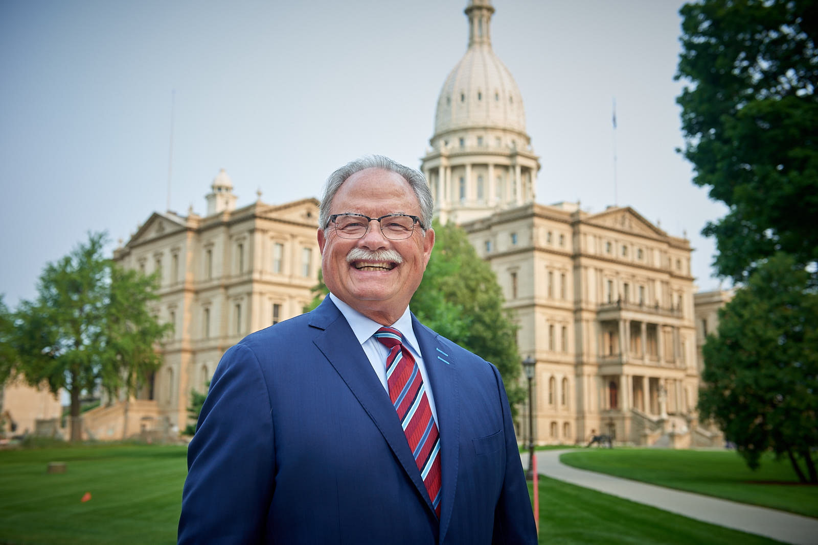
Rich Studley rstudleymi@gmail.com (517)927-5138 CELL
Organizational Management
Michigan Chamber accredited with distinction by the U.S. Chamber June, 2012
Michigan Chamber accredited with distinction by the U.S. Chamber, March, 2019
MIRS News Lansing Insider Survey Voted, Most Effective Membership Lobbying Organization for the eight time, June 2021
Employment
City Manager, Clare Michigan
Policy Director, Michigan Senate Republican Caucus
Retired December 31, 2021 from the Michigan Chamber, after 4 decades in various positions & last 13 years as President and CEO

Slide 3
Rich Studley
Education
Bachelor of Arts, Political Science, Alma College, 1974
Completed U.S. Chamber Institute for Organizational Management, University of Notre Dame, 1987
Masters of Science in Administration, Central Michigan University, 1993
Professional Development
U.S. Chamber Bord of Directors, 2013-2019
Chair, US. Chamber Committee of 100, 2013-2019
Chair, U.S. Chamber Accreditation Committee, 2013 – 2019
Member Council of State Chambers Board of Directors, 2013 - 2019
Personal
Michigander
Husband, Father, Grandfather
CMU Board of Trustees
Motorcycle Rider

Slide 4
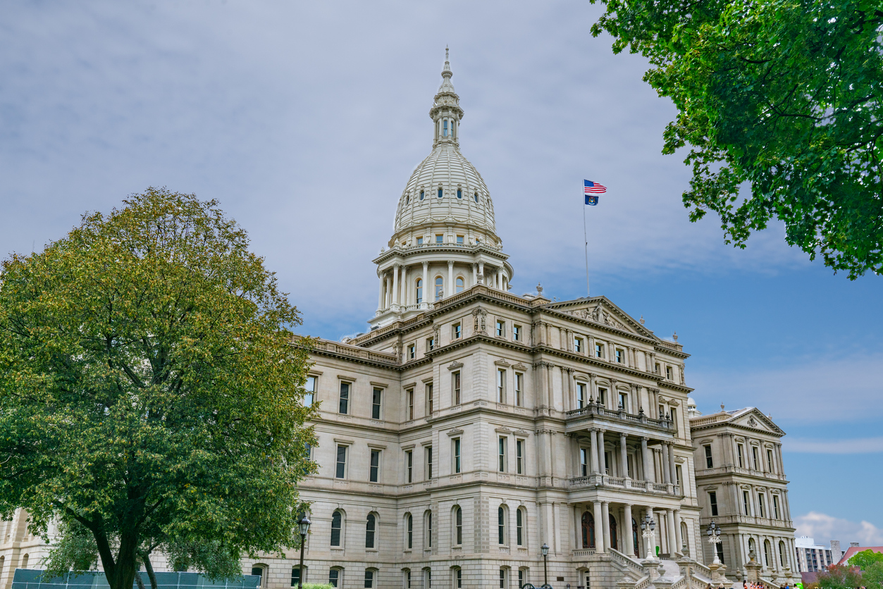
Course Objectives –
Identifying the principles and best practices of successful organizations.
Characteristics of successful organizations
How are best practices determined? How do they evolve? Why are they important?
Benchmarking your organization’s performance against the standards of other top organizations.
Suggested Metrics
Conducting an organizational assessment
What is an assessment?
Why perform an assessment?
Internal Involvement: staff, board, volunteers
External involvement: members, community, prospects
Outlining desired results
Performing a SWOT analysis
Organizational climate assessments/evaluations/measurements
Surveys, questionnaires, open forums, focus groups

Slide 5
Course Objectives –
Implementing best practices.
Provide examples or case studies
Prioritize and focus
Communicate practices to internal and external stakeholders
Celebrate and acknowledge milestones and accomplishments achieved
Highlight accreditation, certifications, recognitions, and/or awards opportunities
Class Exercise:
Please bring a copy of your organization’s Bylaws; Organizational Chart, Strategic Plan, and your employment agreement..
Benchmarking activity
Recommended reading – “Good to Great” By Jim Collins, 2001
Recommended reading – “What the Heck is EOS” By Gino Wickman & Tom Bouwer, 2017

Slide 6
Quotes on Organizational Excellence
“Perfection is not attainable, but if we chase perfection we can catch excellence.”
Vince Lombardi, American Football Coach and NFL Executive
“Success is to be measured not so much by the position that one has reached in life as by the obstacles which he has overcome while truing to succeed.”
Booker T. Washington, American Educator
“Excellence is not a destination; it’s a continuous journey that never ends.”
- anonymous

Slide 7
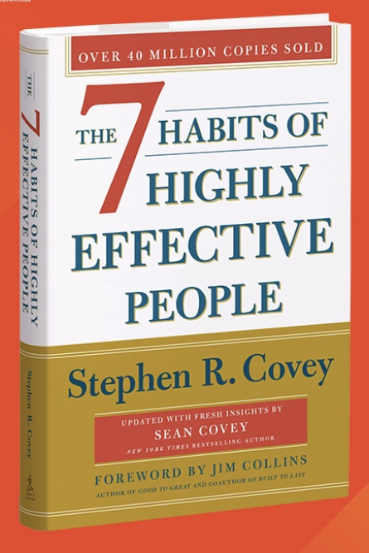
7 Habits Of Highly Effective People
Be Proactive
Begin with the End in Mind
Put First Things First
Think Win-Win
Seek First to Understand, then to Be Understood
Synergize
Sharpen the Saw

Slide 10
MI Chamber All Staff Meeting

Slide 13
Accreditation Self-Analysis Survey
Please use the following checklist to determine if you're ready to apply for accreditation.
Governance
Does the chamber have an article of incorporation or a charter?
Is the chamber's mission statement clear and feasible?
Bylaws: Do they regulate the main areas of chamber management; Are they considered to be adequate for the laws of the state to the protection of both the chamber and its members; and have they been shared with the board?
Organizational Structure: Is it clear and appropriate to the chamber's size and goals? Has the chamber developed an organization chart depicting flow of information and hierarchy?
Are there appropriate term limits and job descriptions in place for the board of directors?
Are board meetings held on a regular basis and are minutes kept on file?
Does a review process exist to evaluate the performance of officers and directors?
Are the proper committees in place for the chamber to meet goals?

Slide 14
Accreditation Self-Analysis Survey
Finance
Does the chamber meet generally accepted accounting practices? (GAAP)
Are the chamber's financial policies and procedures documented in a manual?
Is an annual operational budget in place (including costs for all programs, management and fundraising) and is it approved by the board?
Does the board of directors review and approve all financial statements?
Does the chamber maintain current financial statements?
Does the chamber maintain liability insurance or director and officer insurance?
Does the chamber meet the Accreditation standards for conducting an audit? (Chambers with revenue below $500,000 must conduct an annual review by a certified financial firm and conduct an audit every three years. Chambers with revenue of more than $500,000 must conduct an annual review by a certified financial firm and conduct an audit every other year.)
Does the chamber meet IRS and state filing requirements?
Does the chamber withhold and report taxes from employee paychecks to the IRS and state and local government?

Slide 15
Accreditation Self-Analysis Survey
Human Resources and Staff
Are there distinct roles and job descriptions set up for staff?
Does staff understand the chamber's mission and program of action?
Are personnel policies in place and current?
Does the chamber meet federal and state regulations regarding employees?
Government Affairs
Does the chamber have a systematic procedure in place to identify government affairs issues critical to the business community?
Does the chamber create a legislative agenda and share it with the membership?
Does the chamber communicate its positions on priority issues with elected officials?
Does the chamber actively share state/U.S. Chamber information with its members?
Has the chamber established a grassroots network?

Slide 16
Accreditation Self-Analysis Survey
Program Development
Does the chamber understand issues and needs important to all segments of the membership?
Does the chamber collect member feedback at least annually?
Does the chamber provide an annual report to its members?
Has the chamber developed a strategic plan or business plan for the current year?
Does the chamber understand the impending factors that will affect the chamber?
Technology
Does the chamber have functioning telephone, computer, and mailing systems?
Does the chamber keep its computer systems current and secure?
Does the chamber use anti-virus software?
Does the chamber have a membership database that can track membership information, dues, participation?
Does the chamber back up data regularly?
Has the chamber developed a data protection and privacy policy?
Does the chamber have a Web site that is updated regularly?
Is the chamber's Web site registered on Web site search engines?

Slide 17
Accreditation Self-Analysis Survey
Communications
Has the chamber developed a written communications and marketing plan with clear annual goals?
Does the chamber use diverse forms of media to promote the chamber?
Does the chamber contact members at least monthly?
Does the chamber's Web site communicate general information about the chamber?
Can the chamber communicate with members using mass-distribution e-mails?
Does the chamber comply with federal CAN-SPAM requirements?
Does the chamber issue press releases to local and regional media outlets?
Facilities
Does the chamber's facility project an appropriate business image, and is the facility accessible by the public?
Does the chambers facility support the chamber’s communications and technology capabilities?
Is the workplace kept neat, clean and free of potential safety hazards
Is the workplace inspected annually by a safety professional?
Does the chamber facility meet accepted OSHA regulations?
Is a crisis plan in place?
Are employees trained or educated about the crisis plan?

Slide 18
Do You Have a CEO Employment Agreement?
If yes, why?
If no, why not?!
Key provisions of a good Employment Agreement –
Recitals
Employment
Term, Automatic Extension
Termination, Own Dismissal
Compensation
Additional Benefits
Automobile, Dues and Other
Expense Reimbursement
Vacation
Working Facilities
Restrictive Covenant
Confidentiality
Arbitration
Successors
Entire agreement
Notices
Governing Law

Slide 19
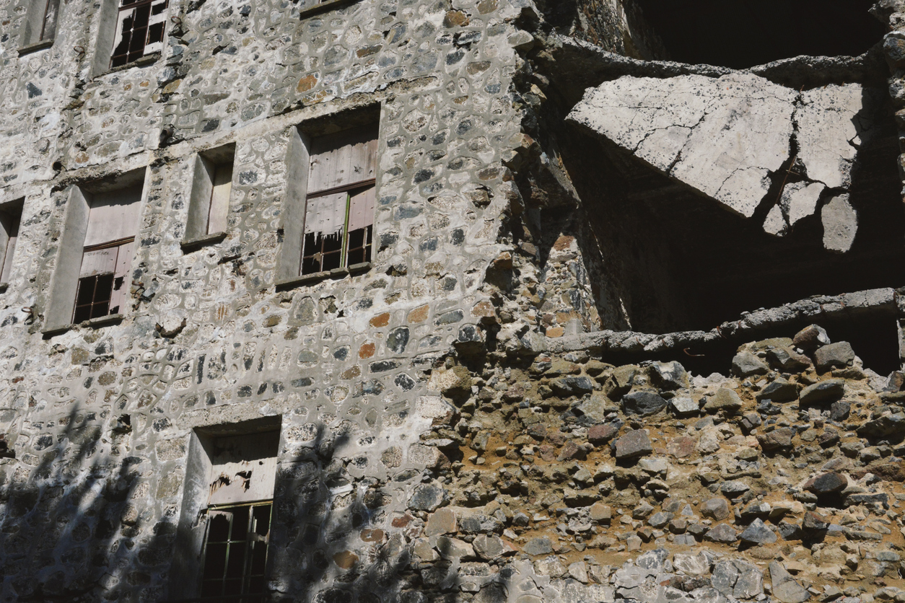
The Builder
I saw them tearing a building down
A team of men in my hometown.
With a heave and a ho and a yes yes yell,
They swung a beam and a sidewall fell.
And I said to the foreman, “Are these men skilled?”
”Like the ones you’d use if you had to build?”
And he laughed and said, “Oh no, indeed…
the most common labor is all I need…
for I can destroy in a day or two
what takes a builder ten years to do.”
So I thought to myself as I went on my way…
Which one of these roles am I willing to play?
Am I one who is tearing down as I carelessly make my way around?
Or am I one who builds with care, in order to make the world a litter better…because I was there?

