Slide 2
Volunteer Development
Lowell Aplebaum, FASAE, CAE, CPF

Slide 3
Volunteer Development
cc: Tim Marshall - https://unsplash.com/@timmarshall?utm_source=haikudeck&utm_medium=referral&utm_campaign=api-credit

Slide 4
Volunteer Narratives
cc: Robyn Budlender - https://unsplash.com/@robzy_m?utm_source=haikudeck&utm_medium=referral&utm_campaign=api-credit

Slide 5
Professional Volunteer Narratives
CAE Commission
ASAE Research Cmte
IOM Curriculum Cmte
DELP mentor
Charrette creator
cc: Robyn Budlender - https://unsplash.com/@robzy_m?utm_source=haikudeck&utm_medium=referral&utm_campaign=api-credit

Slide 6
Volunteer Ideas?
Where would you volunteer?
cc: Diz Play - https://unsplash.com/@dizplay?utm_source=haikudeck&utm_medium=referral&utm_campaign=api-credit

Slide 7
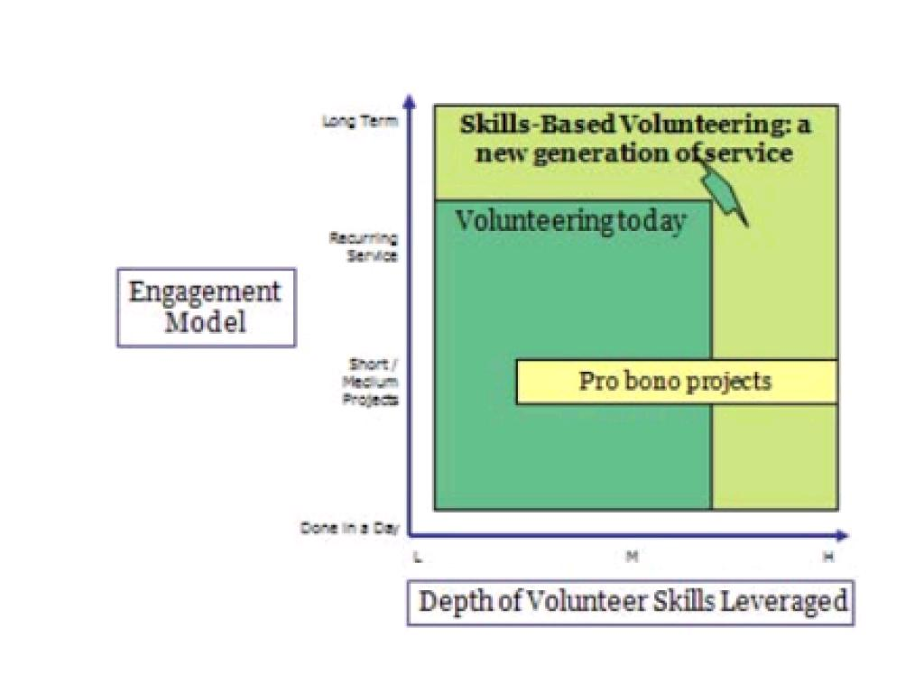

Slide 8
Skills Based Volunteering
What are core areas of expertise that will make a volunteer better suited for a position?
What are core skill sets that a volunteer will gain in fulfilling a position?
What is the balance of experts/learners for each group?
cc: Michał Parzuchowski - https://unsplash.com/@mparzuchowski?utm_source=haikudeck&utm_medium=referral&utm_campaign=api-credit

Slide 9
Skills Based Interviews
cc: Christina @ wocintechchat.com - https://unsplash.com/@wocintechchat?utm_source=haikudeck&utm_medium=referral&utm_campaign=api-credit

Slide 10
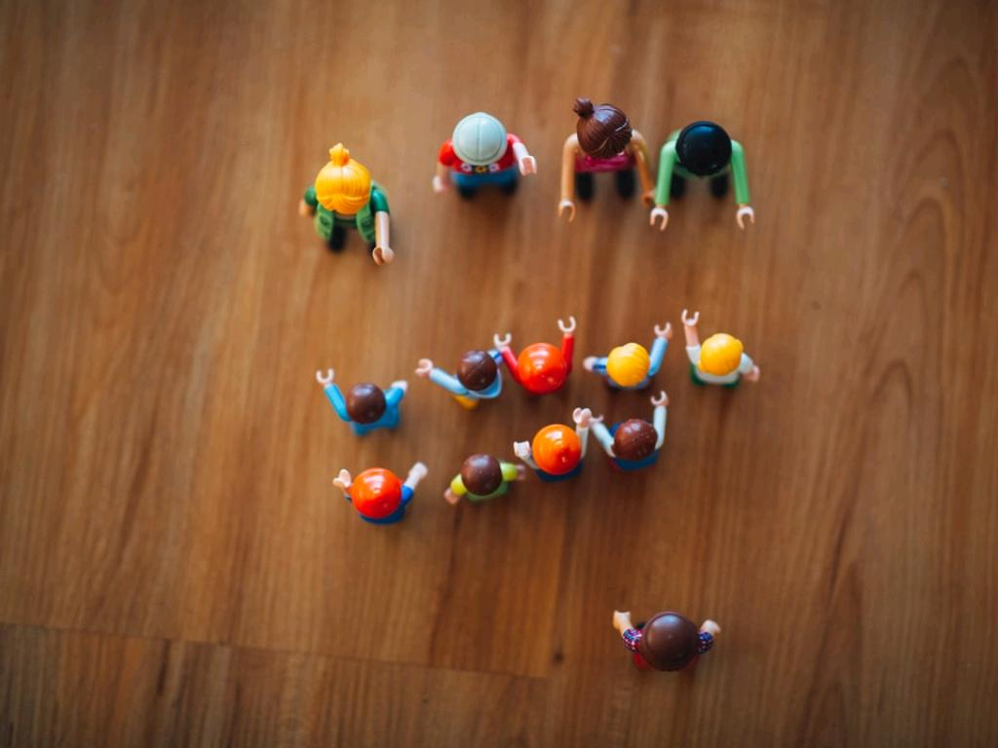
Generations: Retirees
What is walking out the door?
cc: Markus Spiske - https://unsplash.com/@markusspiske?utm_source=haikudeck&utm_medium=referral&utm_campaign=api-credit

Slide 11
Generations: Retirees
Time
Treasure
Talent
Thoughtful Narratives
cc: Markus Spiske - https://unsplash.com/@markusspiske?utm_source=haikudeck&utm_medium=referral&utm_campaign=api-credit

Slide 12
The Reality of $$
cc: Fabian Blank - https://unsplash.com/@blankerwahnsinn?utm_source=haikudeck&utm_medium=referral&utm_campaign=api-credit

Slide 13
Generations: Retirees
What are ways to keep them involved in your community that is additive and fun?
cc: Markus Spiske - https://unsplash.com/@markusspiske?utm_source=haikudeck&utm_medium=referral&utm_campaign=api-credit

Slide 14
ISACA
cc: Ross Findon - https://unsplash.com/@rossf?utm_source=haikudeck&utm_medium=referral&utm_campaign=api-credit
Notes:
https://engage.isaca.org/volunteeropportunities

Slide 15
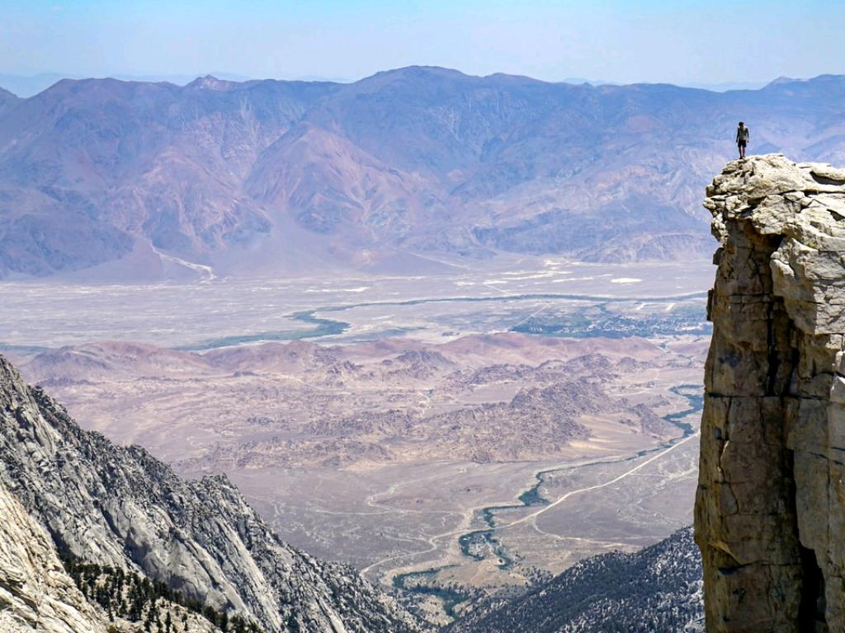
The Volunteer Precipice
End of the Volunteer Path
cc: EJ Strat - https://unsplash.com/@xoforoct?utm_source=haikudeck&utm_medium=referral&utm_campaign=api-credit

Slide 16
What We Lose
Organizational history
Strategic fluency
Key VIP Connections
Models of passion and loyalty
Organizational operational mastery
cc: EJ Strat - https://unsplash.com/@xoforoct?utm_source=haikudeck&utm_medium=referral&utm_campaign=api-credit

Slide 17
Risks
Strategic overstep
Burnout
Ego
Growth
Creating space for models of respect
cc: EJ Strat - https://unsplash.com/@xoforoct?utm_source=haikudeck&utm_medium=referral&utm_campaign=api-credit

Slide 18
The Volunteer Precipice
What models can we build to keep our most dedicated volunteers, who have already given so much, involved?
cc: EJ Strat - https://unsplash.com/@xoforoct?utm_source=haikudeck&utm_medium=referral&utm_campaign=api-credit

Slide 19
The Volunteer Precipice
Presidents Advisory Council
Foundation Service
Volunteer First Responders
Diamond in the Rough Mentors
New Member Orientation
Story Tellers/Evangelists
Thought Leaders
cc: EJ Strat - https://unsplash.com/@xoforoct?utm_source=haikudeck&utm_medium=referral&utm_campaign=api-credit

Slide 20
Volunteer Challenges Today
cc: roberthuffstutter - https://www.flickr.com/photos/29528454@N04

Slide 21
Volunteer Challenges Today
Time
Exhaustion
Need for volunteers
Feelings of meaning
Shift vs. commitment
cc: roberthuffstutter - https://www.flickr.com/photos/29528454@N04

Slide 22
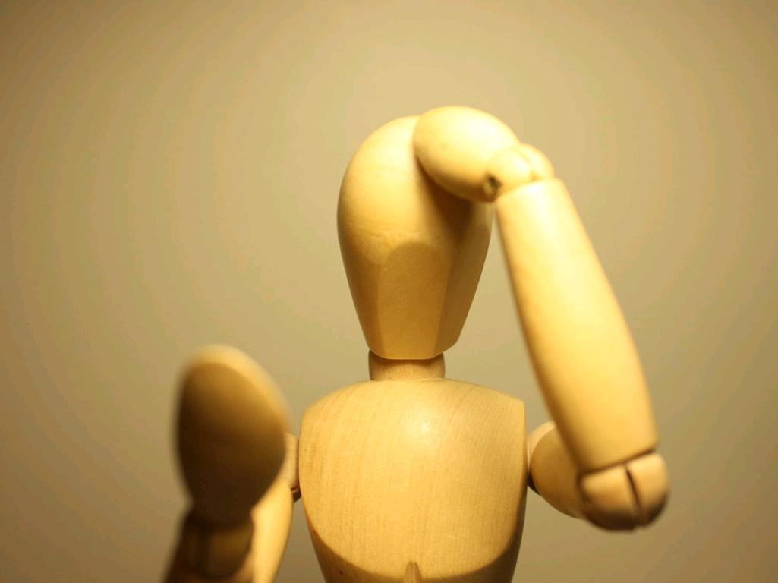
Why Volunteer?
cc: 13desetembro - https://www.flickr.com/photos/32615337@N07

Slide 23
Why Volunteer?
Values
Understanding
Enhancement
Career
Social
Protective
cc: 13desetembro - https://www.flickr.com/photos/32615337@N07

Slide 24
Volunteer Lifecycle
cc: JordanEightySeven - https://www.flickr.com/photos/137512247@N04

Slide 25
Volunteer Lifecycle
Planning
Recruiting
Training
Managing
Evaluating
cc: JordanEightySeven - https://www.flickr.com/photos/137512247@N04

Slide 26
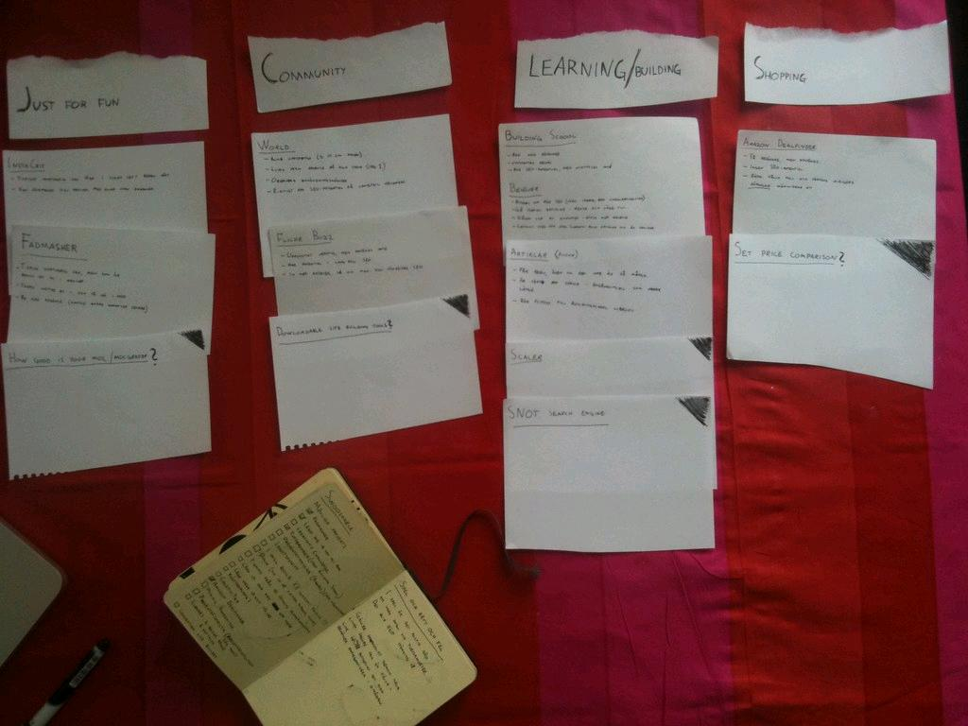
Planning
Mapping your system
Clarity of roles
Agreements of service
cc: Bohman - https://www.flickr.com/photos/79729522@N00

Slide 27
Volunteer Map Examples
cc: Aron Visuals - https://unsplash.com/@aronvisuals?utm_source=haikudeck&utm_medium=referral&utm_campaign=api-credit

Slide 28
Volunteer Map Examples
Map your structure
cc: Aron Visuals - https://unsplash.com/@aronvisuals?utm_source=haikudeck&utm_medium=referral&utm_campaign=api-credit

Slide 29
Volunteer Map Examples
Do you have the breadth & depth of engagement opportunities to involve your members?
cc: Aron Visuals - https://unsplash.com/@aronvisuals?utm_source=haikudeck&utm_medium=referral&utm_campaign=api-credit

Slide 30
Volunteer Map Examples
What would your system look like if you designed it today?
**Governance reviews
cc: Aron Visuals - https://unsplash.com/@aronvisuals?utm_source=haikudeck&utm_medium=referral&utm_campaign=api-credit

Slide 31
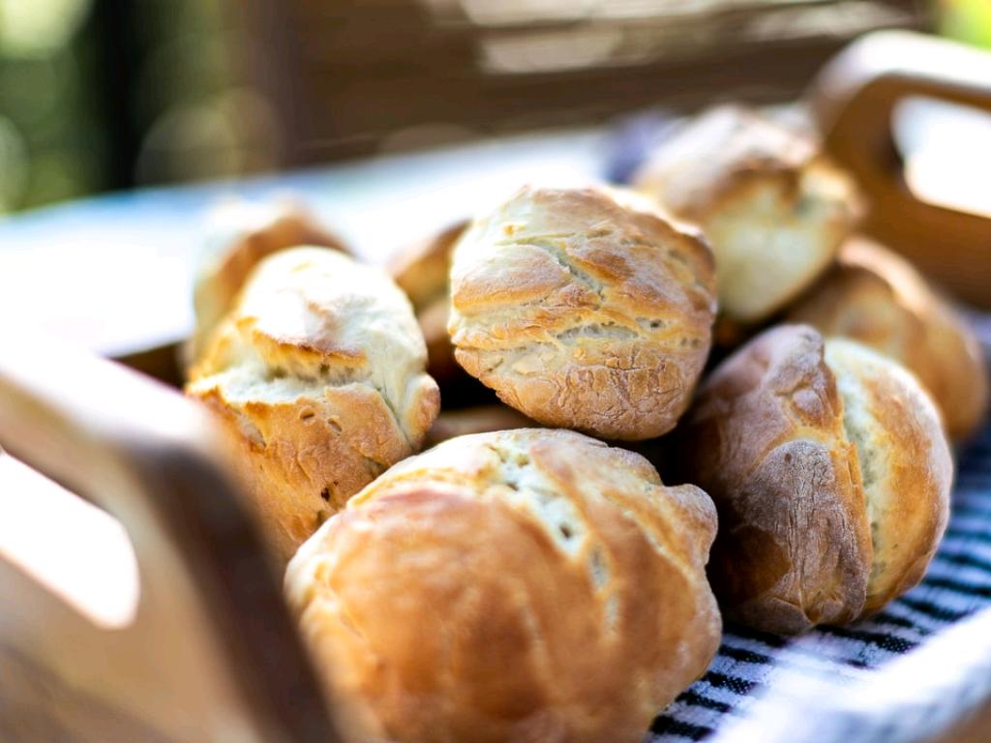
Volunteer Job Descriptions
Clarity of Roles
cc: James Coleman - https://unsplash.com/@jhc?utm_source=haikudeck&utm_medium=referral&utm_campaign=api-credit

Slide 32
Volunteer Job Descriptions
Position title
Purpose of position
Volunteer’s responsibilities/tasks
Outcomes/goals (success measures)
Training and support plan
Reporting
Time commitment
Qualifications needed
Benefit
cc: James Coleman - https://unsplash.com/@jhc?utm_source=haikudeck&utm_medium=referral&utm_campaign=api-credit

Slide 33
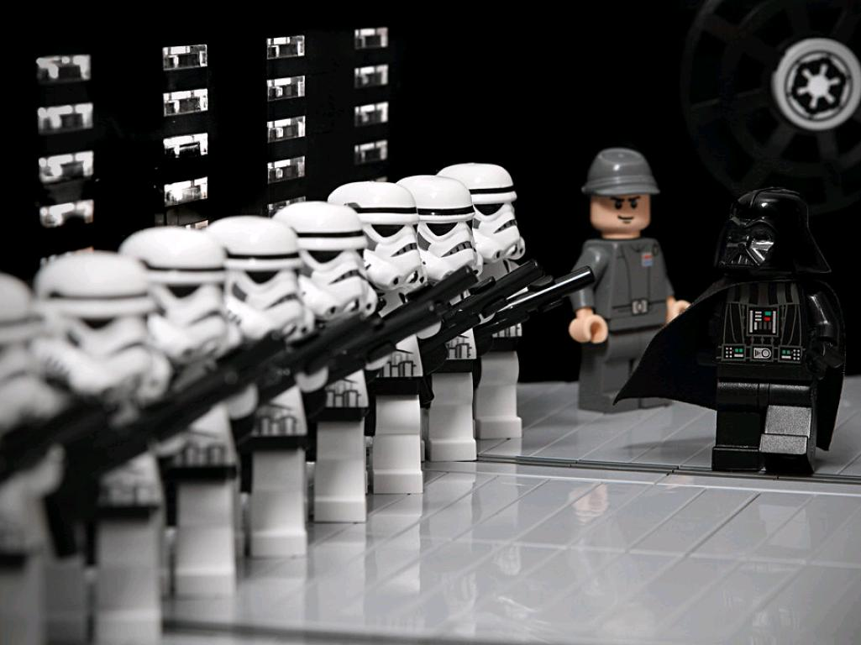
Recruiting
Who asks
How do you ask?
Alignment of placement
cc: W_Minshull - https://www.flickr.com/photos/23950335@N07

Slide 34
Who asks?
cc: Karmishth Tandel - https://unsplash.com/@karmishth?utm_source=haikudeck&utm_medium=referral&utm_campaign=api-credit

Slide 35
How do you ask?
cc: Jon Tyson - https://unsplash.com/@jontyson?utm_source=haikudeck&utm_medium=referral&utm_campaign=api-credit

Slide 36
How do you ask?
Proactive vs Reactive
Seizing the moment
cc: Jon Tyson - https://unsplash.com/@jontyson?utm_source=haikudeck&utm_medium=referral&utm_campaign=api-credit

Slide 37
Where are you looking?
Current volunteer network
Events/programs
Ease of sign up
Social media opportunities
Referrals
Cross volunteer partnerships
cc: Daniel Lerman - https://unsplash.com/@dlerman6?utm_source=haikudeck&utm_medium=referral&utm_campaign=api-credit

Slide 38
Inclusive, Strategic Leadership
cc: Viviana Couto Sayalero - https://unsplash.com/@vii_doom?utm_source=haikudeck&utm_medium=referral&utm_campaign=api-credit

Slide 39
Inclusive, Strategic Leadership
Transparency in leadership selection
Strategic competency & diverse representation
Nepotism is not invisible
cc: Viviana Couto Sayalero - https://unsplash.com/@vii_doom?utm_source=haikudeck&utm_medium=referral&utm_campaign=api-credit

Slide 40
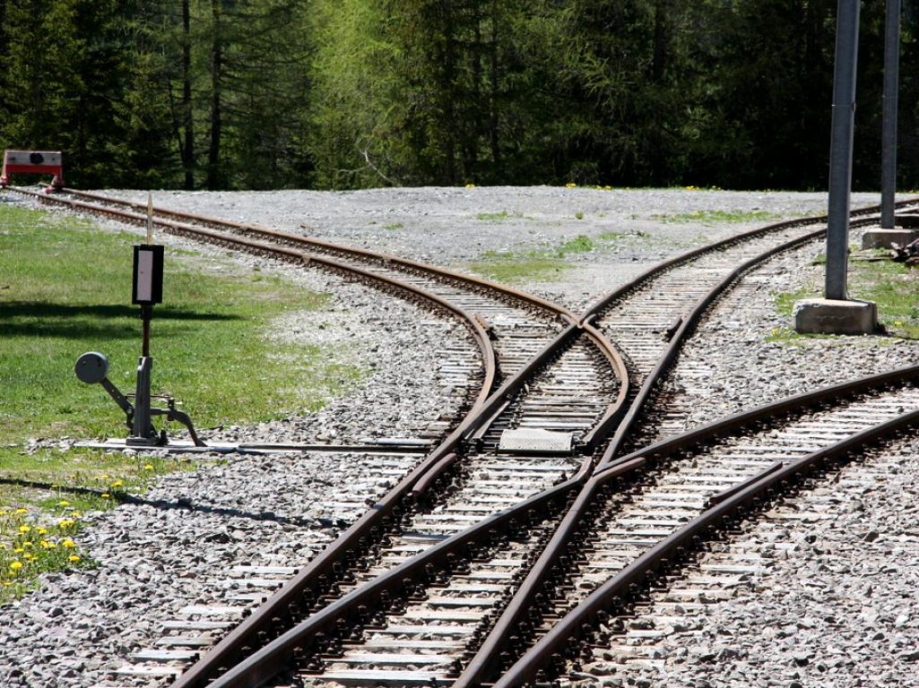
Selecting Volunteers
More important that getting a volunteer for a position is getting the right volunteer for a position
cc: marfis75 - https://www.flickr.com/photos/45409431@N00

Slide 41
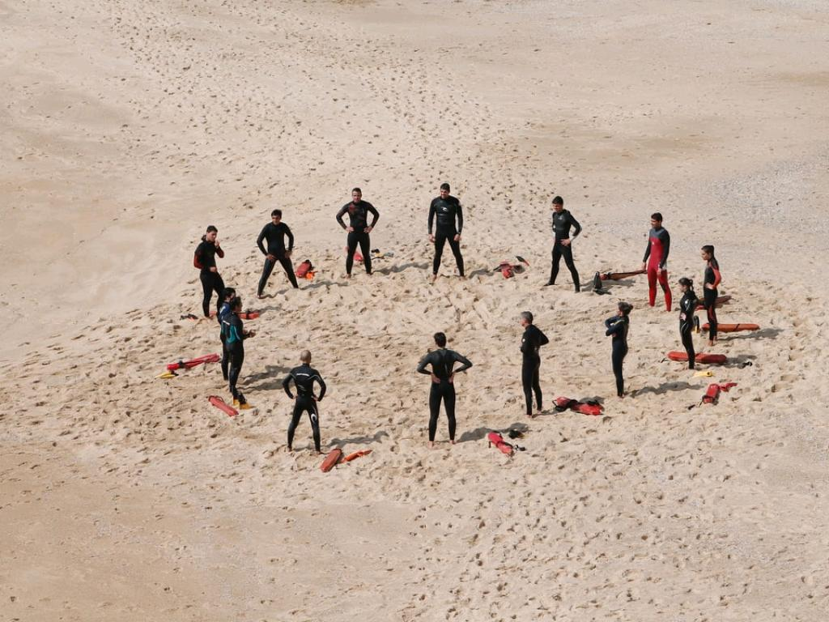
Training
Orientation
Refresh
Onboarding
cc: Margarida CSilva - https://unsplash.com/@marg_cs?utm_source=haikudeck&utm_medium=referral&utm_campaign=api-credit

Slide 42
Orientation
New volunteer knowledge, skill, culture, and responsibility transfer and fluency
cc: Margarida CSilva - https://unsplash.com/@marg_cs?utm_source=haikudeck&utm_medium=referral&utm_campaign=api-credit

Slide 43
Refresh
Returning volunteers opportunity for enhancement & reflection
Mentors?
cc: Margarida CSilva - https://unsplash.com/@marg_cs?utm_source=haikudeck&utm_medium=referral&utm_campaign=api-credit

Slide 44
Onboarding
The experience of the whole group in learning how to lead and give together
cc: Margarida CSilva - https://unsplash.com/@marg_cs?utm_source=haikudeck&utm_medium=referral&utm_campaign=api-credit

Slide 45
Managing
Ongoing balance of support given, continuing growth opportunities, and responsibility fulfillment
cc: afzalimram - https://www.flickr.com/photos/90586264@N00

Slide 46
Crafting the Volunteer Story
cc: Road Trip with Raj - https://unsplash.com/@roadtripwithraj?utm_source=haikudeck&utm_medium=referral&utm_campaign=api-credit

Slide 47
Crafting the Volunteer Story
What are the volunteer journey components?
Who are you looking to serve?
Whose reflections would make impact?
cc: Road Trip with Raj - https://unsplash.com/@roadtripwithraj?utm_source=haikudeck&utm_medium=referral&utm_campaign=api-credit

Slide 48
Crafting the Volunteer Story
Copy
Image
Video
Conversation
Where do you want the story told?
cc: Road Trip with Raj - https://unsplash.com/@roadtripwithraj?utm_source=haikudeck&utm_medium=referral&utm_campaign=api-credit

Slide 49
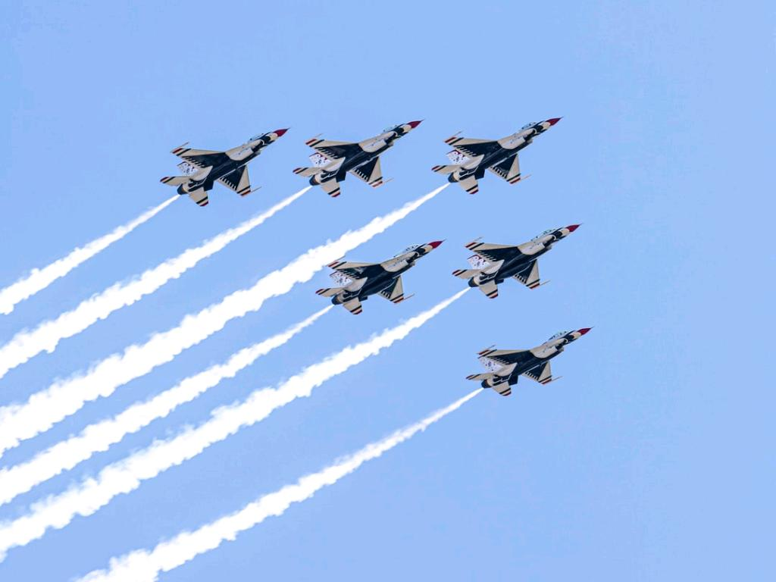
Volunteer Recognition
cc: James Lewis - https://unsplash.com/@jamesplewis?utm_source=haikudeck&utm_medium=referral&utm_campaign=api-credit

Slide 50
Volunteer Recognition
Personal
Public
Group
Leadership
Above and Beyond
Broad Definitions of Volunteer
cc: James Lewis - https://unsplash.com/@jamesplewis?utm_source=haikudeck&utm_medium=referral&utm_campaign=api-credit

Slide 51
Evaluation
cc: patrick.verstappen - https://www.flickr.com/photos/56393389@N05

Slide 52
Evaluation
Program
Position
Person
cc: patrick.verstappen - https://www.flickr.com/photos/56393389@N05

Slide 53
Volunteer Lifecycle
Planning
Recruiting
Training
Managing
Evaluating
cc: JordanEightySeven - https://www.flickr.com/photos/137512247@N04

Slide 54
Volunteering as a Journey
Not a Position
cc: Jaromír Kavan - https://unsplash.com/@jerrykavan?utm_source=haikudeck&utm_medium=referral&utm_campaign=api-credit

Slide 55
Volunteer Formula
cc: ThisisEngineering RAEng - https://unsplash.com/@thisisengineering?utm_source=haikudeck&utm_medium=referral&utm_campaign=api-credit

Slide 56
Volunteer Formula
Right positions
Right asks
Right matches
Stronger volunteer base
cc: ThisisEngineering RAEng - https://unsplash.com/@thisisengineering?utm_source=haikudeck&utm_medium=referral&utm_campaign=api-credit

Slide 57
Diamonds in the Rough
cc: Tahlia Doyle - https://unsplash.com/@tahliaclaire?utm_source=haikudeck&utm_medium=referral&utm_campaign=api-credit

Slide 58
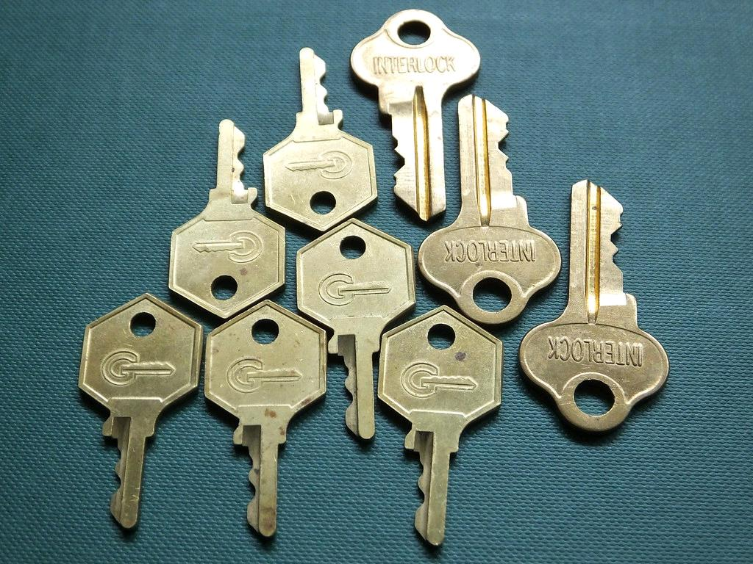
Keys to Success
Why do you rock?
Why is it fun to serve?
Is there tangible impact?
Recognition, recognition, recognition
Honor new voices alongside elevating those of experience
cc: jacqui.brown33 - https://www.flickr.com/photos/120600995@N07

Slide 59
Space and Grace
cc: Jeremy Thomas - https://unsplash.com/@jeremythomasphoto?utm_source=haikudeck&utm_medium=referral&utm_campaign=api-credit

Slide 60
Questions?
cc: Veronique Debord - https://www.flickr.com/photos/41497284@N00

