Slide 1
C490 Organization Leadership for the Future
presented by Bill Graham

Slide 2
Course Objectives
Utilizing situational awareness
Implement techniques to lead change
Develop a culture of leadership

Slide 3
Followers Want from Leaders “4 basic needs”
Compassion
Trust
Stability
Hope
Gallup research

Slide 4
Leaders → Employee Engagement
Past → ……..……..…..... → Future
My Paycheck
My Satisfaction
My Boss
My Annual Review
My Weaknesses
My Job
Gallup
My Purpose
My Development
My Coach
My Ongoing Conversations
My Strengths
My Life

Slide 5
ORGANIZATIONS → Member Engagement
Past → …………...... → Future
Our DUES
Our Satisfaction
Our CONTACTS
Our Annual CALL
Our ISSUES
Our PRESENT
.
Our Investments
Our Growth
Our Catalysts
Our Ongoing Collaborations
Our Opportunities
Our Future

Slide 6
2. Implement techniques to lead change

Slide 7
Why Should They? Are you really worth their time?
The disengagement revelation:
Time is currency.
People selectively spend time.
Engagement is about your value to them.

Slide 8
To get them to listen … Listen

Slide 9
Before You Speak … WAIT!
Ask yourself:
Why
Am
I
Talking?

Slide 10
They are talking … what are you hearing?

Slide 11
Before You Speak … Listen!
They want to be heard:
Listen
Respond
Ask
Repeat

Slide 12
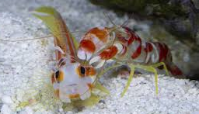
Recognizing Strengths: Tiger Pistol Shrimp
A tiger of a shrimp:
Their power claw is half the size of its entire body.
It precisely shoots bubbles from that gun-like claw
momentarily as hot as the sun’s surface.
at 200dB, it’s about as loud, as a blue whale
They have weaknesses
A big pistol shrimp = 1¼ inches
They are almost all blind.

Slide 13
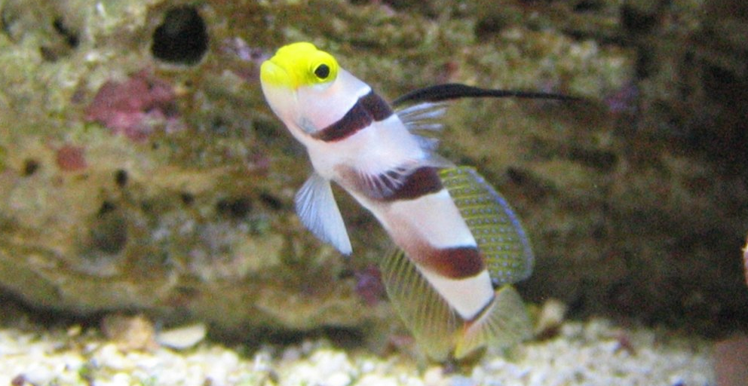
Recognizing Strengths: Goby Fish
Some might say a Goby has no strengths, no defenses
Goby fish work as the Pistol Shrimp’s eyes: feeding, guiding, protecting, and sleeping with the pistol shrimp.
Goby fish sleep in burrows in the sediment,
Pistol shrimp dig better burrows.
So the shrimp digs and shares its burrow with the goby

Slide 14
Pistol Shrimp & Goby Fish
When a predator nears, the goby leads the shrimp back to the sediment
If they can’t make it back, the goby positions the pistol shrimp to shoot a bubble at the predator.
The bubble air can be 14,000 F.
The sound is as loud as the blue whale.
This is not a marriage. It’s a partnership. An alliance.
Different, collaborative, and engaged

Slide 15
It’s harder to listen → If you need to be right

Slide 16
Recognize Your Confirmation Bias
“A tendency to interpret or favor information in a way that affirms one’s prior beliefs.”
Everybody functions with Confirmation Bias
“If you go looking for something, you will find it.”
Listen without Confirmation Bias … it’s easier to hear.

Slide 17
When it’s time to speak …
Presume the best:
What would you like to hear?
What would they like to hear?
How would they like to hear the difference?
Praise loud … fix soft

Slide 18
The Sincere Compliment … a culture changing tool
You will influence your listener
when your listener knows
you are listening

Slide 19
What is a Compliment?
A relationship/culture building tool that is:
Simple
Sincere
Specific
Helpful

Slide 20
Why Compliment?
Inspires and motivates
Builds trust
Models & encourages humanity
“Everybody likes a compliment.”
Abraham Lincoln

Slide 21
How to Compliment
Notice a specific strength
Why do you like working with him/her?
Use “Precise Praise”

Slide 22
Accept a Compliment … use genuine gratitude
“Wow, you just made my day!"
"Thank you. I really appreciate that!”

Slide 23
Your Turn
Person A: Share one thing that you are proud of. (professional or personal)
Person B: Give Person A a compliment based on the new information
Person A say: Thank you!
Person B say: You are welcome!
Switch Roles

Slide 24
3. Develop a Leadership Culture

Slide 25
Employee Engagement
“An engaged employee works with passion and feels a profound connection
to his/her organization.”
Gallup employee engagement research

Slide 26
People join their company, and …
they quit their immediate supervisor.

Slide 27
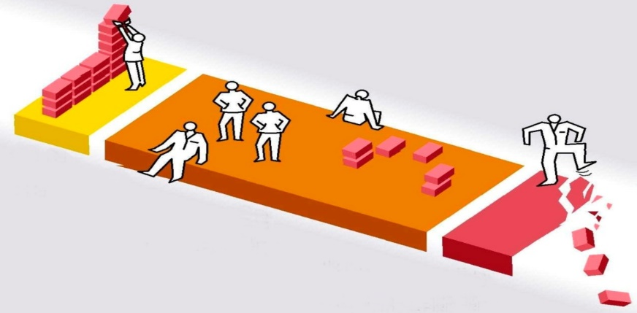
Engagement in the USA
Engaged
33%
Actively
Disengaged
16%
Not
Engaged
51%

Slide 28
Actively Disengaged Team Members
"Consistently Against Virtually Everything”
CAVE dwellers:
Not just unhappy;
Tear down what engaged coworkers build.

Slide 29
Top 25% Engaged Organizations
When a team is engaged:
37% Lower Absenteeism*
25% Lower Turnover in High-turnover Orgs.*
65% Lower Turnover in Low-turnover Orgs.*
21% Higher Productivity*
22% Higher Profitability*
*When compared with bottom 25%

Slide 30
The 12 Questions for Engagement
I know what is expected of me at work.
I have the materials and equipment I need to do my work right.
At work, I have the opportunity to do what I do best every day.
In the last 7 days, I have received recognition or praise for doing good work.
My supervisor, or someone at work, seems to care about me as a person.
There is someone at work who encourages my development.
At work my opinions seem to count.
The mission or purpose of my company makes me feel my job is important.
My associates or fellow employees are committed to doing quality work.
I have a best friend at work.
In the last six months, someone at work has talked to me about my progress.
This last year, I have had opportunities to learn and grow at work.

Slide 31
Engagement Hierarchy
12. Gets to learn and grow
11. Progress in last 6 months
Growth
10.Best friend
9. Others committed to quality
8. Purpose of company
7. My opinions count
Teamwork
6. Encourages development
5. Supervisor cares
4. Recognized this week
3. Do my best every day
Management Support
2. Materials/equipment
1. What is expected
Basic Needs

Slide 32
Basic Needs 1. I know what is expected of me at work.
Personalize – Learn about the person, then frame expectations.
Communicate – don’t make them guess … or ask
Quantify – Expectations must be known to be met: What’s the game? The rules? How do we win?

Slide 33
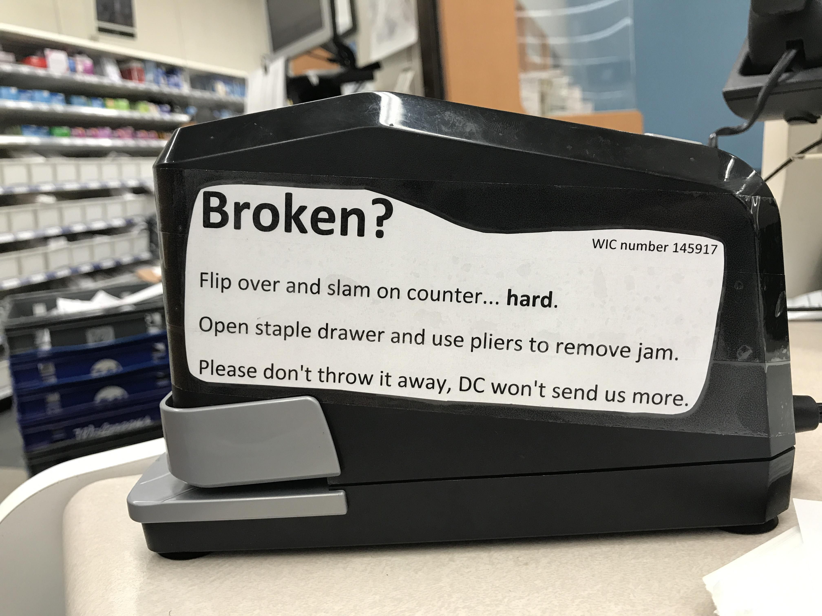
Basic Needs 2. I have the materials and equipment I need to do my work right.
An engagement killer … get Q2 right:
Supplies,
Tools
Software and
People

Slide 34
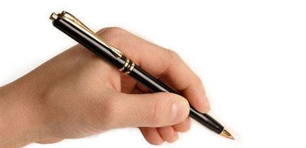
Management 3. At work, I have the opportunity to do Support what I do best every day.
Pistol Shrimp or a Goby Fish?
Appreciate each person’s unique talents
Fit talents and responsibilities to tasks
Don’t ask them to write lefthanded all day. Unless they are lefthanded!
Wow! Are you right-handed?
Said no
left-hander.
EVER!

Slide 35
Management 4. In the last 7 days, I have received Support recognition or praise for doing good work.
Genuine precise praise engages
To motivate make the worker feel specifically valued …
If you don't hear anything … you're doing a good job.
The opposite of any recognition is being ignored.
Q4 consistently receives the lowest ratings

Slide 36
Ignore Focus on Focus on Them Weakness Strengths
Engaged
Not
Engaged
Actively
Disengaged

Slide 37
Management 5. My supervisor, or someone at work, Support seems to care about me as a person
You want employees to say:
My manager genuinely cares.
I am valued for my effort, talent, & humanity
I am respected, not just worker.
People join their companies.
They quit their managers.

Slide 38
Management 6. There is someone at work who Support encourages my development.
If you focus on their weaknesses … Then they think they do everything wrong.
Collaborate on a focused plan
Ongoing – move their goalposts forward It shows you believe in them.

Slide 39
Teamwork 7. At work, my opinions seem to count.
Be Open – listen, respond, ask, repeat
Proactive – solicit thoughts, concerns, & ideas
Responsive – respond, implement or celebrate
Listen.

Slide 40
Teamwork 8. The mission or purpose of my company makes me feel my job is important.
Know: what you do, why you do it & how you do it!
Leadership needs to model the mission … recognize it discuss it, practice it
83% say it’s “very important” to believe their life is meaningful or has purpose.

Slide 41
Teamwork 9. My colleagues or fellow employees are committed to doing quality work.
Culture: quality is a priority
If I trust my team, I’m probably engaged.
All say, “Yes,” to: “Are you committed to quality?”
Only Engaged Employees say, “Yes,” to Q9.
Notes:
The best managers and teams see quality issues as challenges to improve their product or service and, increase positive customer outcomes.

Slide 42
Teamwork 10. I have a best friend at work.
These friendships are critical to loyalty & retention
“Best” friends often deliver on other 12 questions.
Highest Q10 scores = Most productive teams

Slide 43
Growth 11. In the last six months, someone at work has talked to me about my progress.
Make reviews positive
Name their strengths
Be performance-based, discuss:
goals, plans, & tracking

Slide 44
Growth 12. This last year, I have had opportunities to learn and grow at work.
Invite them to work smarter
If they learn & grow, so does the org.
Create a culture, open to new ideas
Let them explore possibilities without fear of rejection or retribution.

Slide 45
Questions?

Slide 46
Followers Want from Leaders “4 basic needs”
Compassion
Trust
Stability
Hope
Gallup research

Slide 47
Followers Want from Leaders “4 basic needs”
Love
Trust
Stability
Hope
Gallup research

Slide 48
Graham Corporate Communications
making the complicated simple
and the simple powerful®
Bill@GrahamCC.com
Bill Graham
917-705-0663
www.GrahamCC.com
Copyright© 2021

